Slide 1








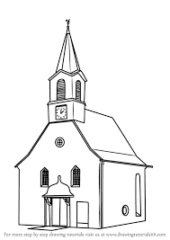



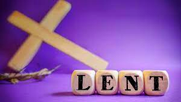
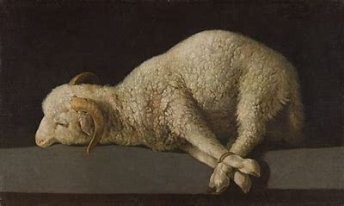

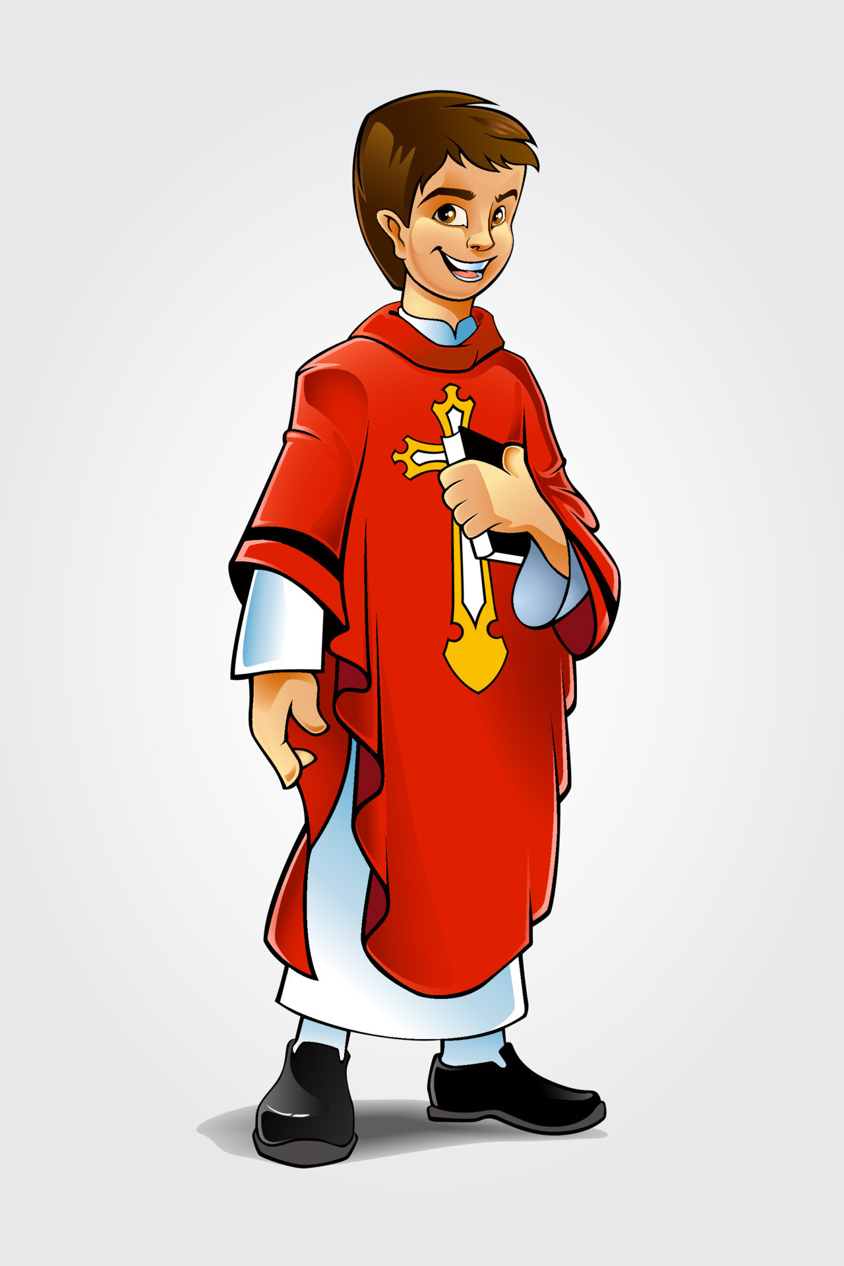



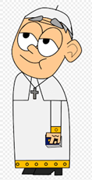



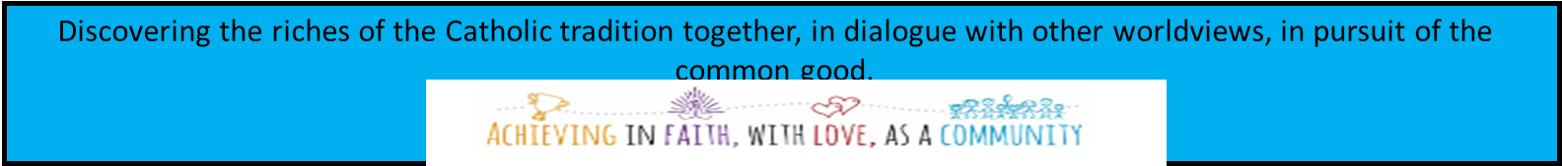
Year 9 LEARNING JOURNEY
St Michael’s Catholic School
Year 10
End of year assessment
To the Ends of the Earth
Dialogue and Encounter
What am I learning: Unit 5: To the Ends of the Earth(Pentecost 1)
1 Cor 12:27-31 – characteristics of the early church: foundations, congregation, disputes, gifts, Paul’s complaints and exhortations
Church as Communion od Saints
Structure of the Church on earth: Universal sacrament of salvation
Church in heaven – intercession of the saints
Church being purified – purgatory and prayers for the dead
Angels and saints in the liturgy and other devotions
Church is an invisible bond between Christians
Iconography of angels
What am I learning: Unit 6: Dialogue and Encounter(Pentecost 2)
Meeting God in Friend and Stranger
Common Good
Dialogue in action
Abrahamic Faiths, dialogue, Ecclesiam Suam, rights and traditions
Qur’an
Differences in belief
5 Pillars
Mosque
Ramadan
Halal and Harem
Desert to Garden
What am I learning: Unit 4: Desert to Garden(Lent 2)
Key features of Herod’s temple – sacrifice, covenants sealed with blood
Role of the high Priest
Day of Atonement (Christ’s sacrifice superseding Atonement rite in the temple
Old Covenant superseded by New Covenant – Agnes Dei and Ecce Agnus prayers during Mass
New Covenant = New priest (Jesus): Christ’s body is the new temple
Believers are all one in Christ: Overcoming divisions of sin
Mystery of redemption
Justice and peace (Gaudium et Spes)
Prophesy and Promise
Galilee to Jerusalem
What am I learning:
Unit 2: Prophesy and Promise(Advent 2)
Typology (allegorical sense of scripture): Adam and Eve
Blessed Virgin Mary, four Marian dogmas
Story of one holy woman of OT with themes of humility, exaltation of God, faith, gratitude, salvation
Link OT women kept Israel’s hope of salvation alive, BVM role in Salvation
Marian devotions around the world, art
What am I learning: Unit 3: Galilee to Jerusalem(Lent 1)
Historical context of Mark’s Gospel, including audience.
Vocations (Henry Newman), discipleship, evangelical counsels
Sacrament of Holy Orders (3 parts of ordination, Sacrament at the service of Communion
Consider women and the priesthood, religious orders
Christ’s call to poverty and the wealth f the church
artwork
Creation and Covenant
What am I learning: Unit 1. Creation and Covenant(Advent 1)
Introduction to RE and our community.
Two Creation accounts in Genesis, authorial voices
Imago Dei and inalienable dignity, St. Paul’s teaching on dignity of the human body
Equal dignity
Nature and purpose of marriage, Sacrament of marriage
Sanctity of life at conception, prolife organisations
Ancient human art displaying human dignity
START
Year 9

