Slide 1
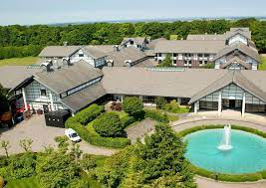
PGL Residential 2022
23.05.22-27.05.22

Slide 2
Important Timings
Pupils are expected to be in school on Monday 23rd May by 8.45am, as usual. We leave school at about 12.30pm, arriving at PGL, Liddington in time to check in, make beds, have evening meal and then start an evening of activities.
During the morning at school, we will be outdoors, starting some team activities to get us ready for our residential. Children will not be expected to come to school in uniform that day and it is advised that they wear comfortable shoes and clothing.
On Friday 27th May, we are hoping to arrive back at school between 3pm and 4pm, traffic depending. We will likely have a twitter account which you may follow which is updated daily and will be updated about expected time home on Friday. The twitter account will also be accessible through the school website.

Slide 3
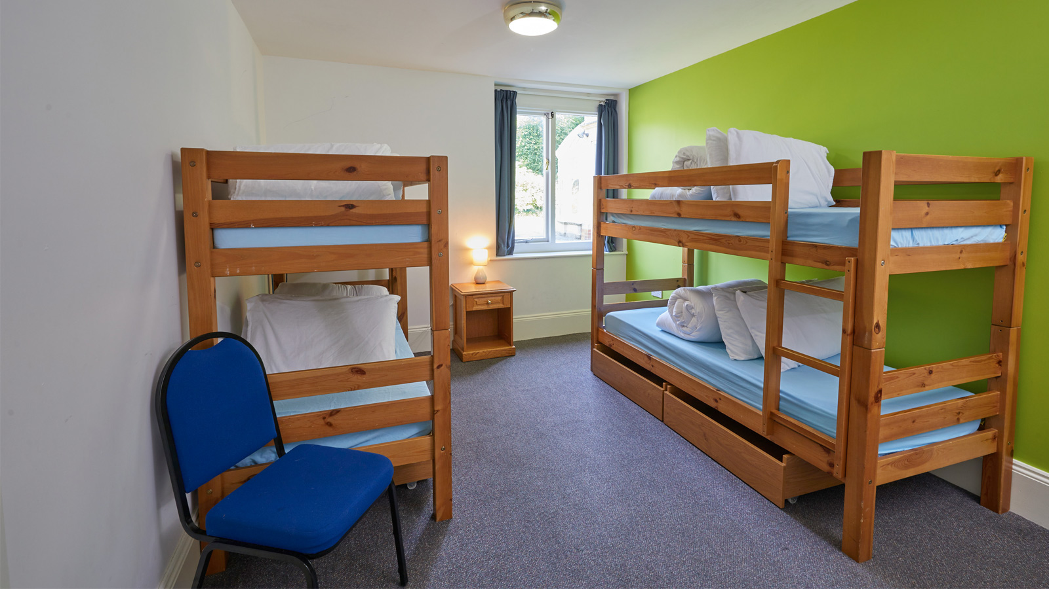
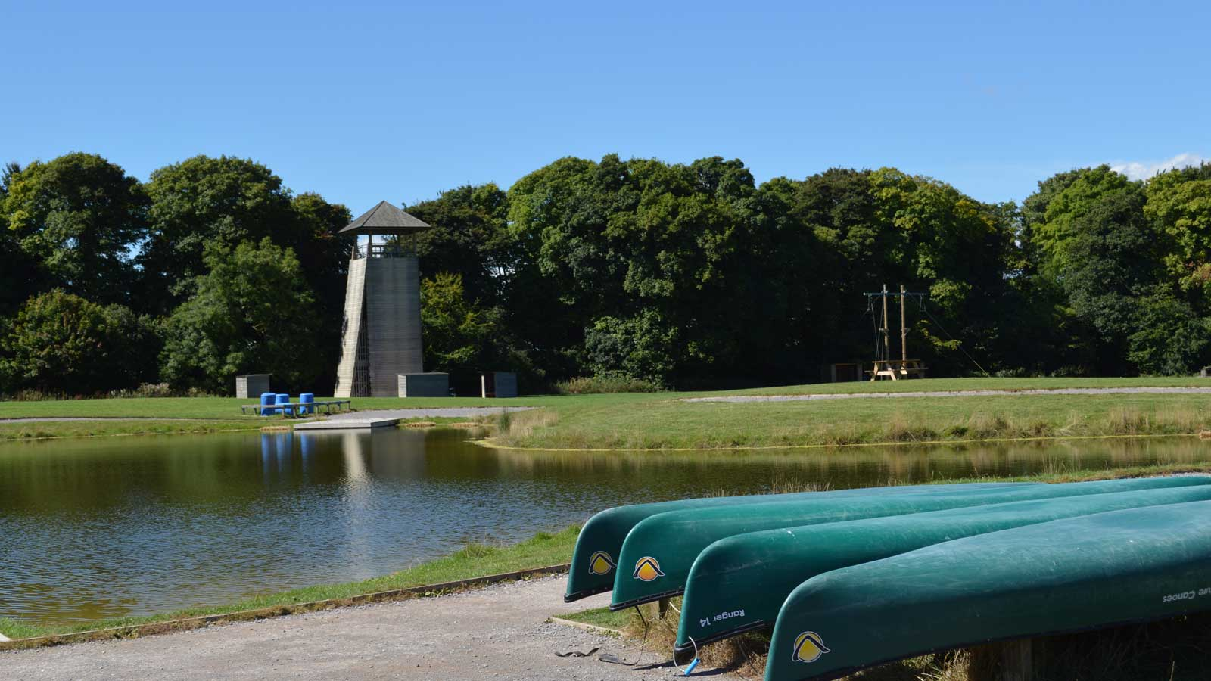
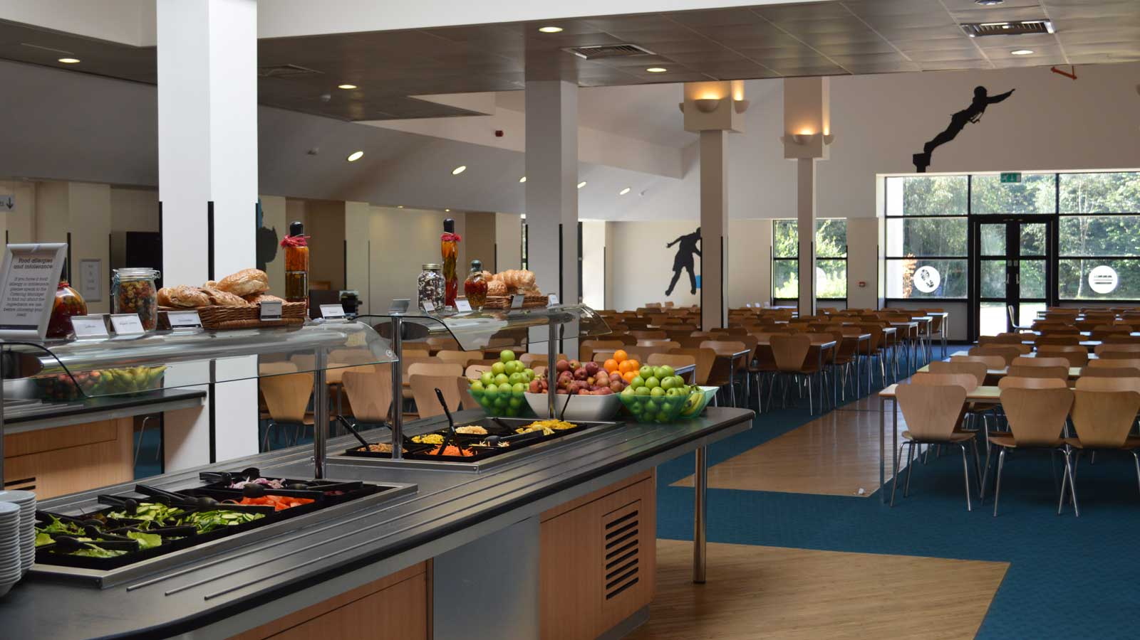
Facilities
http://www.pgl.co.uk/en-gb/school-trips/primary-schools/centres/liddington
Over 40 exciting adventure activities, including zip wires, giant swing, high ropes and a lake for canoeing or raft building.
Evening entertainment which could include quiz night, disco and campfire.
All children room sleep between 3-6 children and are ensuite.

Slide 4
What does a day look like?
Sample day for Primary Schools at Liddington
Schedule | Activities
07.00 - 09.00 | Get up, get ready and fuel up for the day ahead
09.15 - 12.30 | Morning activities - usually 2 sessions with a 15 minute break in-between
12.30 - 14.00 | Dry off & clean up. Time for a fresh & tasty two-course hot lunch
14.15 - 17.30 | Afternoon activities - 2 exciting sessions with a 15 minute break in-between
18.00 - 19.00 | Time to eat again - a different menu each day
19.00 - 21.00 | Talent shows, campfires, quizzes and more. The evening entertainment programme keeps you laughing until bedtime.
21.00 / 21.30 | Bedtime. Catch up on some zzz's and prepare to do it all over again tomorrow!

Slide 5
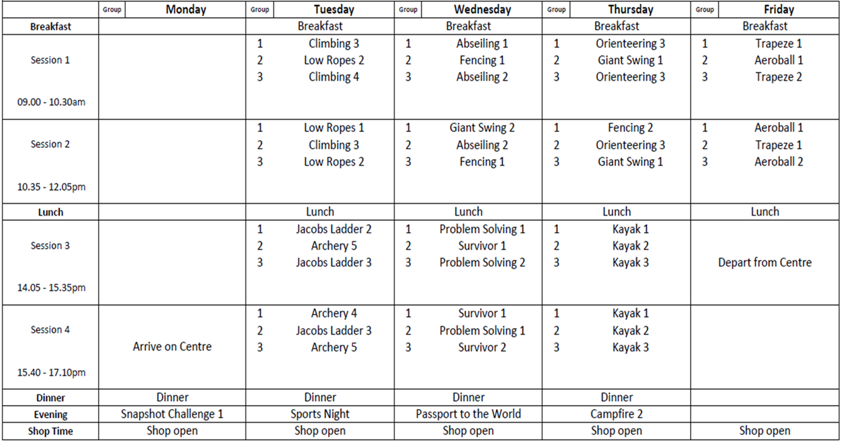
Sample Programme

Slide 6
Home away from Home
All residential dormitories are warm, comfortable and 100% secure.
Girls and boys sleep in separate areas and teachers' rooms are located close by to allow for plenty of close supervision.
Children will need to provide their own bedding; a sleeping bag is highly recommended (and pillow).
Closer to the residential, the children will write names of children they would like to share a room with (and group during the day) and we will organise the children based on their choices.

Slide 7
Mealtimes and Food
Three hot meals are provided each day, with at least three options. Vegetarian or other dietary requirements are catered for. The salad bar is always available and there are plenty of seconds.
Juice and water are always available.

Slide 8
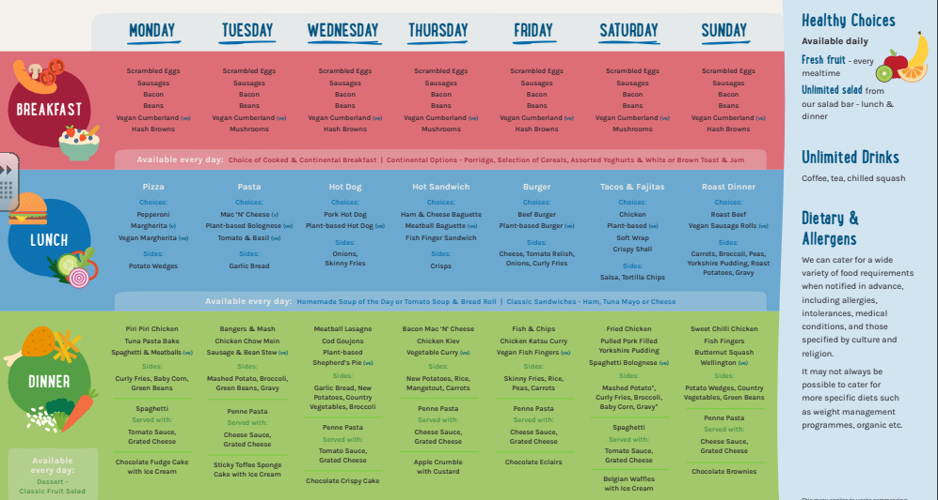
Sample Menu

Slide 9
Kit List
1 bath towel
Night clothes
Toiletries bag including toothbrush, toothpaste, roll-on deodorant soap, shampoo, hairbrush etc.
Socks (plenty) and underwear
At least 4 long sleeve tops (think layers).
Sweatshirts / thick sweaters / jumpers for layering
3 pairs of trousers – preferably tracksuit bottoms
1 disco outfit (tbc nearer to the time)
Outdoor jacket / coat
2 pairs of trainers – one pair which can get muddy and will be used outside and one pair for inside
Sun hat
Water bottle
Bedding (sleeping bag and pillow).
A disposable/old camera.
Please also pack a large black bin bag for all laundry.

Slide 10
What not to pack!
Lots of brand new clothes!
Sweets, crisps, biscuits – there is plenty of food available and any additional items will be confiscated.
Any technological games or gadgets – the children are too busy to use it and it’s not sensible to have valuable items in cases where they are at risk of being damaged or lost. Any cameras brought should be disposable.
Mobile phones: children will not be using mobile phones during the residential.

Slide 11
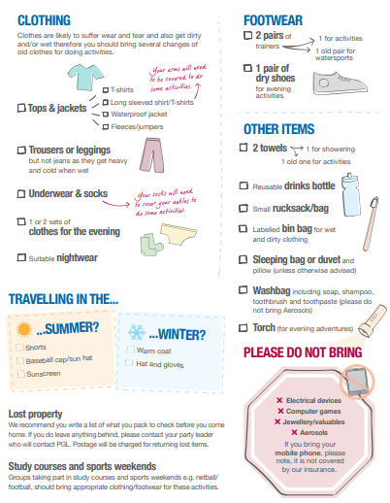
PGL Kit List

Slide 12
Medication
An annual medical consent form has already been sent home to you. Please make sure you have completed this with your most up-to-date information, including listing any allergies or medical needs.
Any medication that needs to be taken (including travel sickness tablets) should be sent in a labelled bag or container with clear instructions for administration.
Teachers will have Calpol available if required. Parents to consent in advance.

Slide 13
Important Information
During the trip, in case of emergencies please contact the school office and they will contact us. We will contact you if there are any issues that arise during the trip that you as parents need to know about (such as your child falling ill).
Behaviour – PGL will not allow children to remain at the centre if their behaviour does not fulfil the expectations which are outlined to all visitors at the beginning of the visit and are recapped daily. You will be telephoned and expected to collect your child if they fail to behave in a safe or responsible manner, if they damage PGL property or injure or put at risk the safety of other visitors.

Slide 14
Thank you!
We are very much looking forward to taking the children on their adventure, it is always a fantastic week in which the children have an amazing time!
Any questions?

