Slide 1

St Michael’s Catholic School Meet The Tutor Evening

Slide 2


The St Michael’s Prayer
Dear God
We thank you for creating this beautiful world and for
St Michaels Catholic School within it.
We are so diverse, yet each one of us is precious
in your eyes and you have faith in us.
All our gifts and talents and all that we achieve in life,
Comes from you.
May we always use what you have given us wisely and
fairly so that we can really shine both at school and in the wider world.
We may face issue and problems in life,
but we are never alone when we invite you in.
We humbly ask you to help grow our spirits,
plant the seeds of faith in our hearts and water them with traits of love, so that our St Michael’s Community will bloom, achieving in your glory.
AMEN

Slide 3
Year 7 pastoral team - What are we here for?
Support- with academic, social and emotional growth.
Setting the expectations for the day
Communicating with class teachers, parents and pupils
Our expectations are that:
Pupils will be on time for registration at 8.50, having already been to their lockers and the toilet.
Pupils will have all of their equipment with them at all times (list is available on the school website and in planners) Whiteboards and pens a new addition this year.
Pupils will be dressed correctly
Pupils will always have a reading book with them
Planners will be signed each weekend ready for us to sign on a Tuesday- you can write us notes in planners
Pupils will follow the school rules (PROUD) and our own class rules that we came up with between us.

Slide 4



What does the reading programme look like?
Each form group will be reading a book together during form time, each person has their own copy of the text, with a bookmark
The class read the book together, taking turns to read aloud
The form tutor/teacher will begin reading and pass on to a student at random a bit like popcorn reading
Students will read aloud sections of the text, as the teacher selects the next student to take over
All students will need to be following along, and focusing on the text
Each morning the teacher will pick up where they left off the previous day and begin the process again

Slide 5

Books Year Seven to Year Thirteen
This program will allow a student who joins us in year seven and leaves at the end of GCSE to read an additional 30 books and a student who stays for their A-Level to read an additional 42 books.
Each half term students will read a book, there is a variety of books that have been chosen that provide students with a diverse range meeting cultural capital needs.

Slide 6
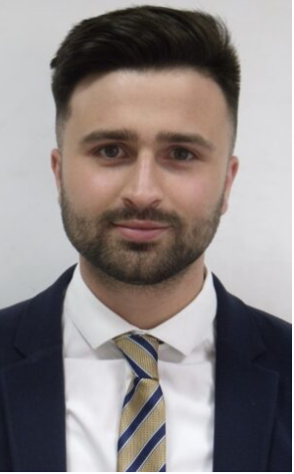
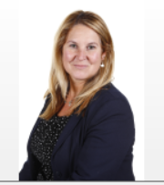
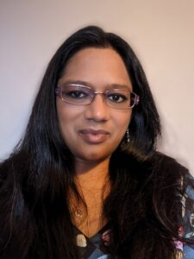
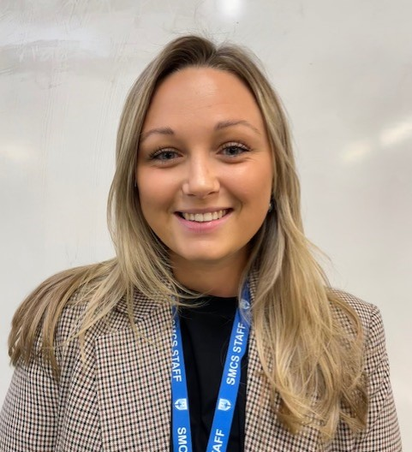
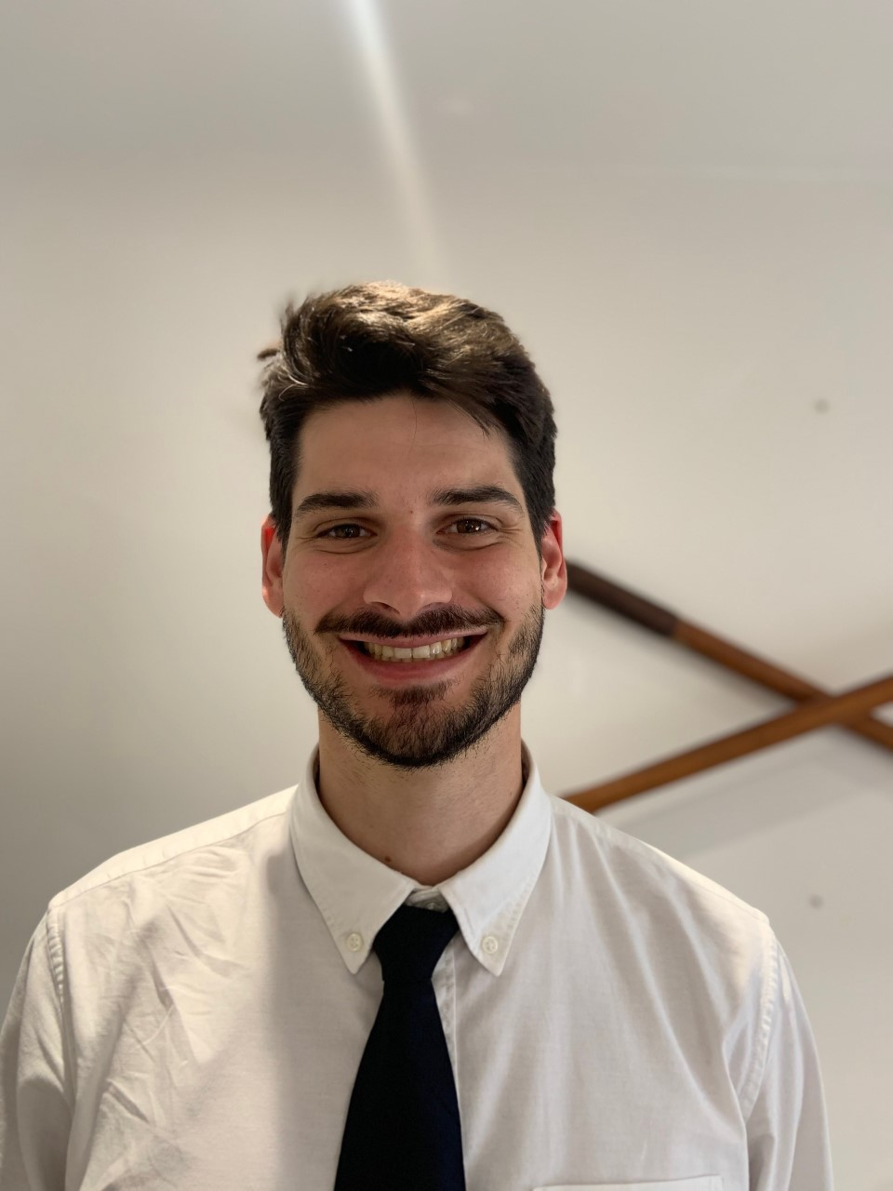
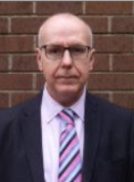
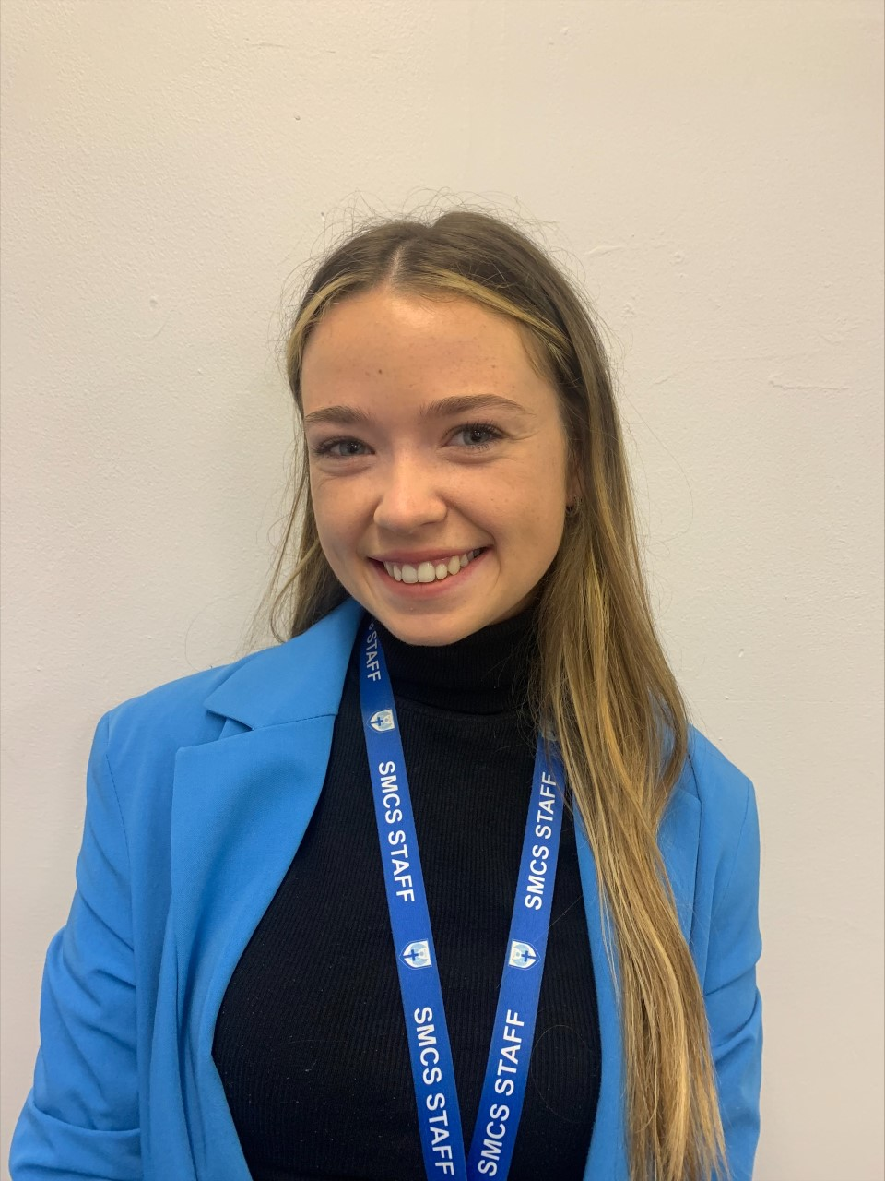
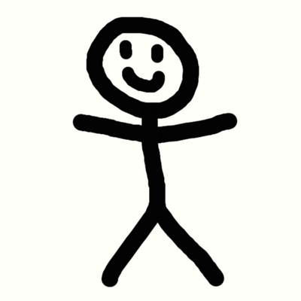
Putting a face to a name…
Mr Doris – Head of Year 7
Ms Urbani – Assistant Headteacher & SENDCO
Ms King – Year 7 Pastoral Support & DDSL
Ms Connolly – 7MW
Ms Cooper – 7JN
Mr Touchette – 7PL
Mr Johns – 7LE
Mr Higgs – 7MK

Slide 7
Role of a Form tutor
Essential for safeguarding
They are the only people who see our students every single day.
Essential for work ethic
Poor attendance? Always late? Unfocused? Uniform incorrect? Intervene - speak to the students, contact parents if necessary
Essential for wellbeing
Aim to make tutor time each morning, well structured, with all students in Year 7 doing the same thing during tutor time.
Essential for successful education
We ensure that when students leave for lesson time, they are calm, relaxed and ready to learn

Slide 8
MISS connolly – 7 Matthew
English and History Teacher
3rd year at St. Michael's.
Degree in Arts majoring in English
Some of my hobbies/ interests:
Listening to music
Reading, watching films
Travelling.

Slide 9
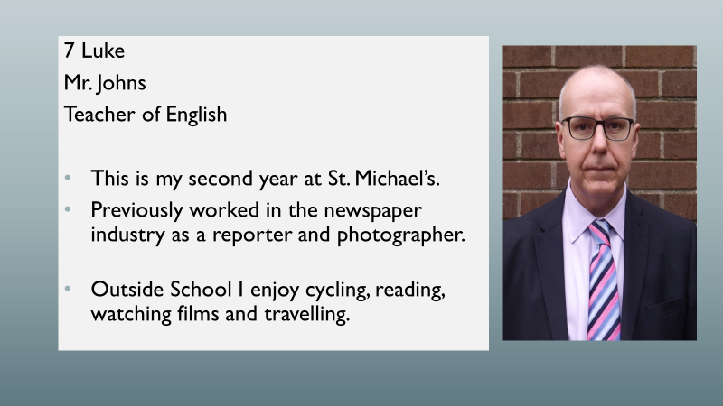

Slide 10
7 PAUL
A little bit about me:
My name is M. Touchette.
This is my first year working at St. Michael’s Catholic school.
I am the form tutor for 7 Paul.
I’m also a teacher of French.
Some of my interests are:
In my free time, I like to practice guitar and to read.
I also love to practice several sports.
I look forward to getting to know all of 7 Paul as the year continues. If you have any further questions/concerns, feel free to send me an email via the form tutor address which will be shown at the end.

Slide 11
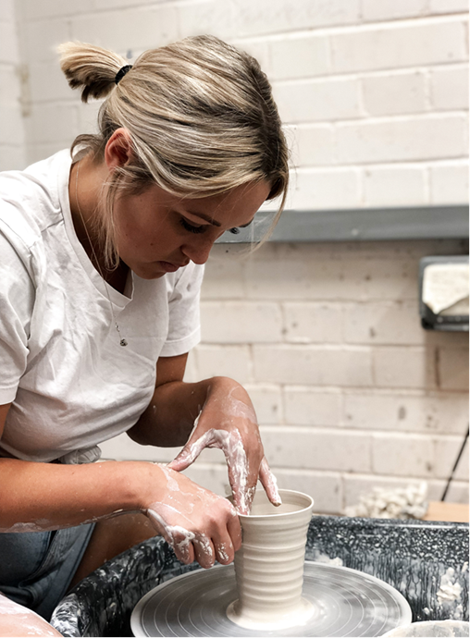
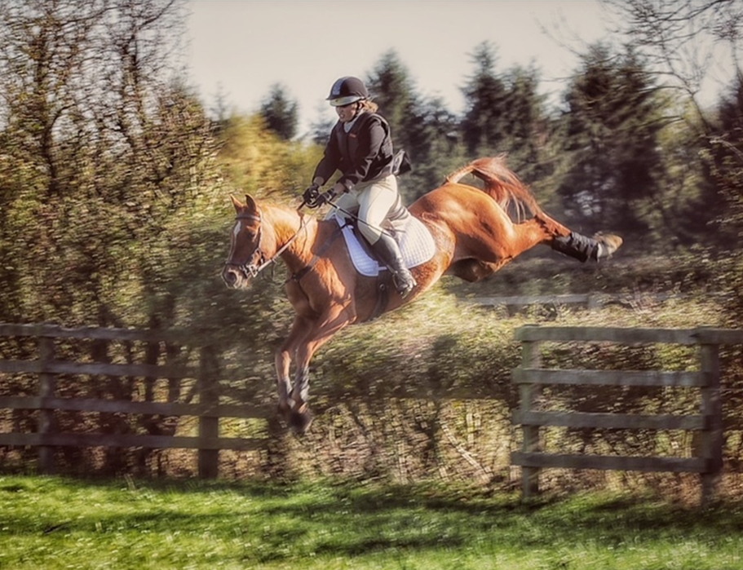
MISS cooper – 7 john
Art Teacher
1st year at St. Michael's
Grew up in Germany with the British Army
Degree specialising in Ceramics
Hobbies:
Horse riding/paying vets bills
Skiing
painting

Slide 12
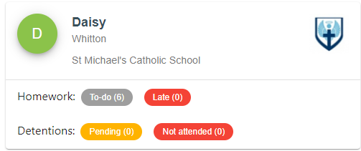
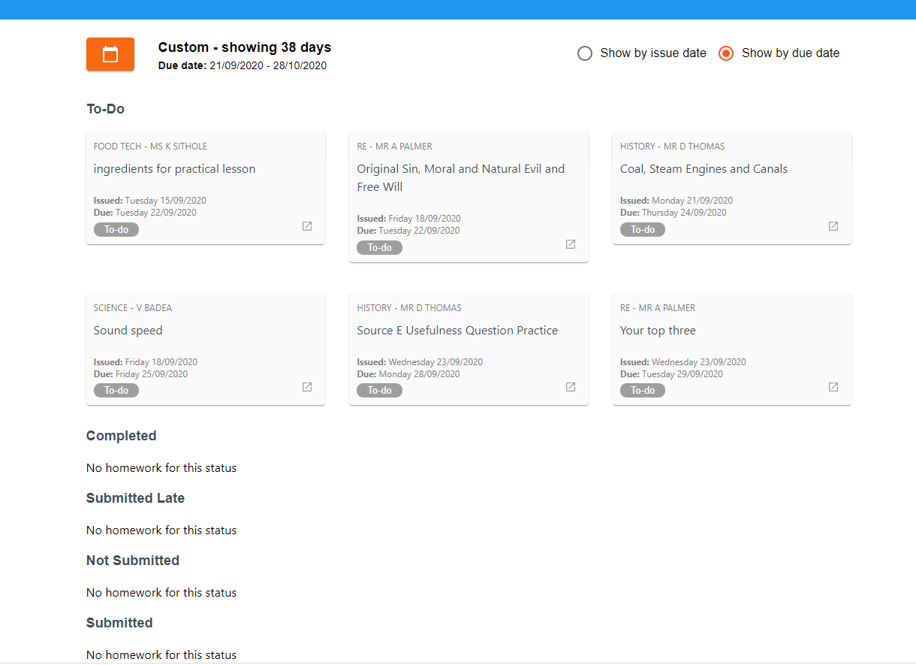
Class charts
Students Name
From using your parents log in, you
can see the students overview page.
You can then enter into the homework and detentions/behaviour to see the individual items.

Slide 13
Microsoft TEAMS
This platform is used for online learning. Students may interact with their peers and teachers in a safe way which is monitored by the school.
This allows students to access schoolwork and resources online from home.
Students have been given their login details in order to access their account and this is the same as their email login details

Slide 14
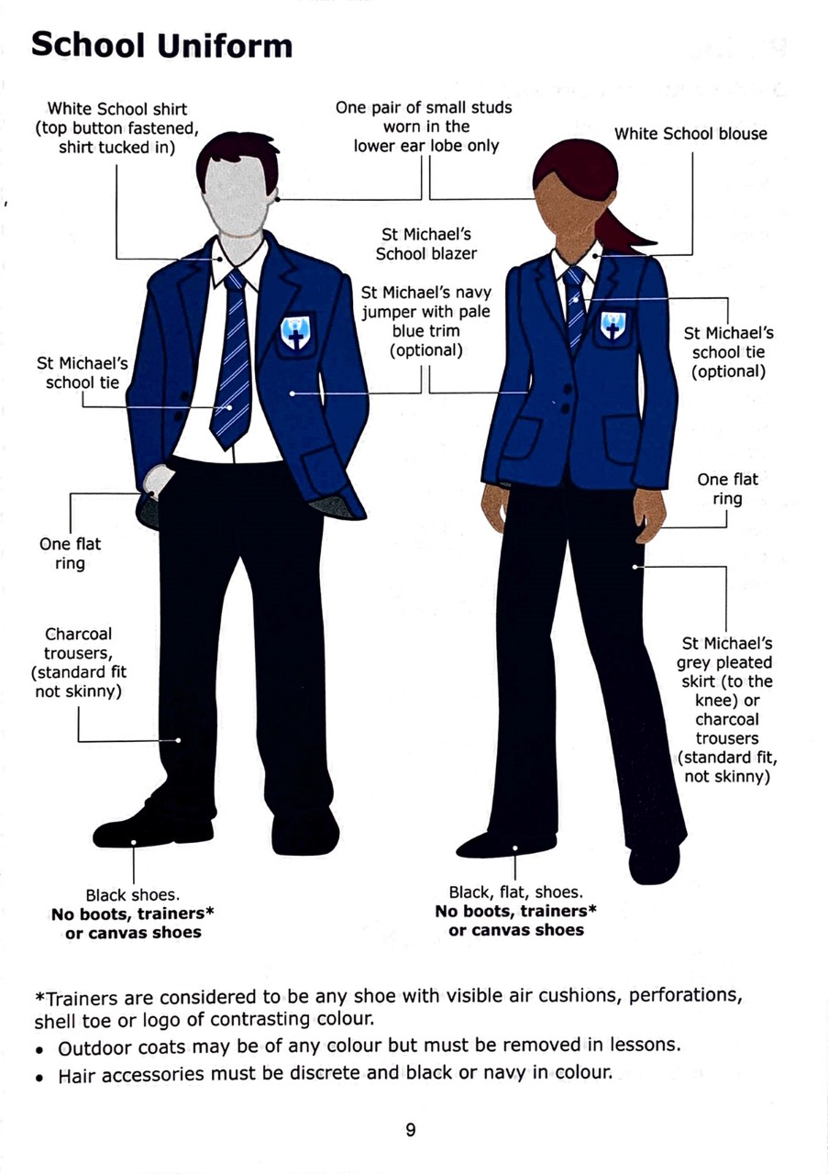
SCHOOL UNIFORM PICTURES
Notes:
This is in the planner

Slide 15
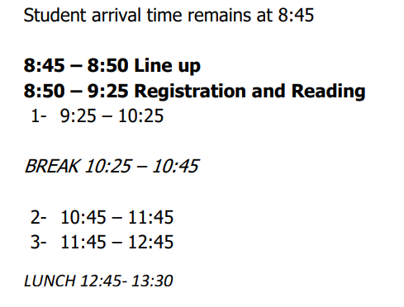
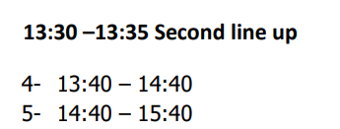
TIMES OF THE DAY

Slide 16
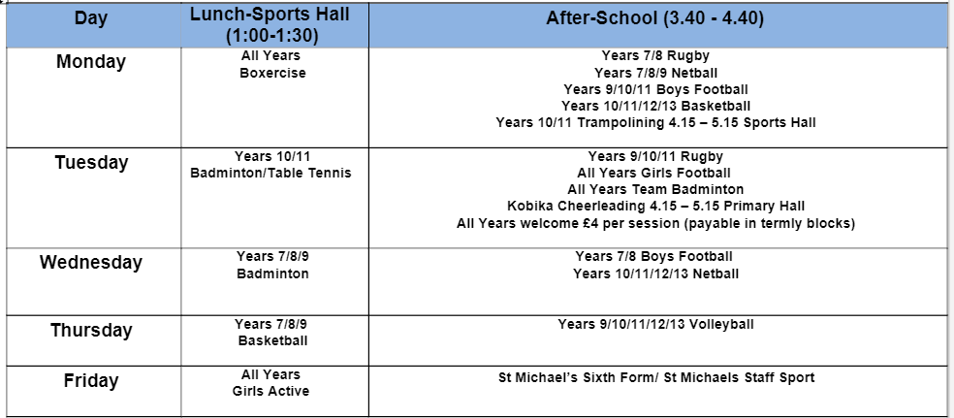

Slide 17
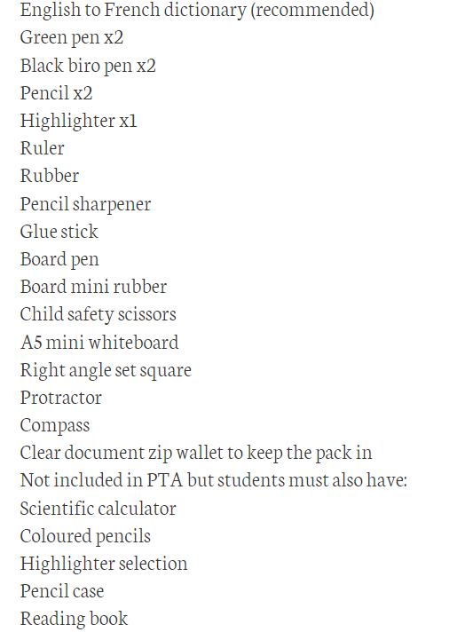
SMCS Equipment list

Slide 18
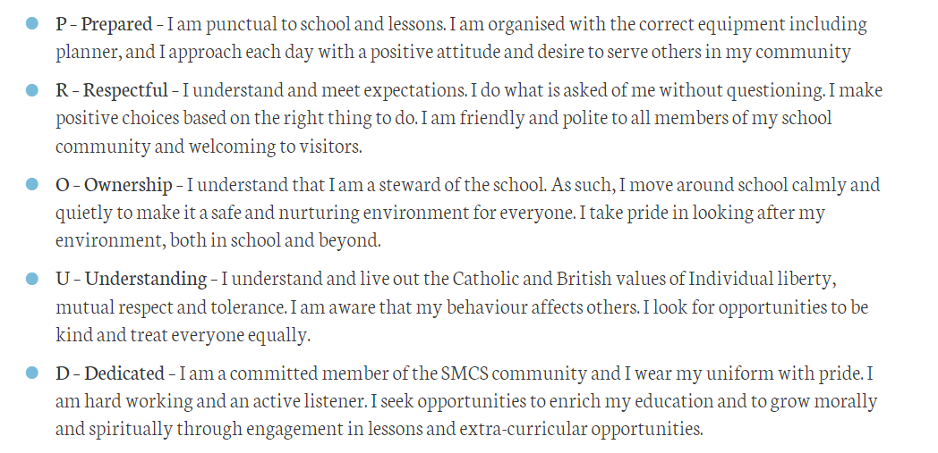
Expectations of all smcs students – PROUD

Slide 19
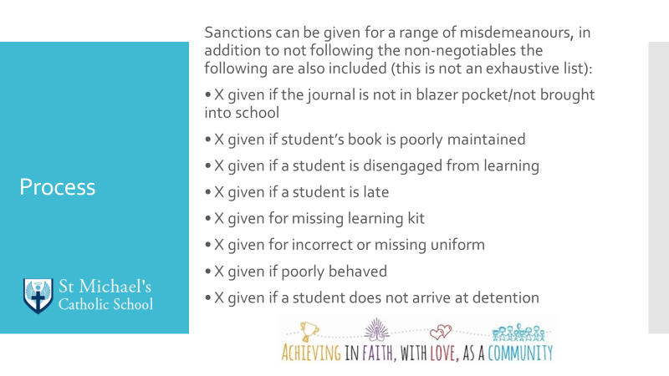
Behaviour Systems and high standards at all times

Slide 20
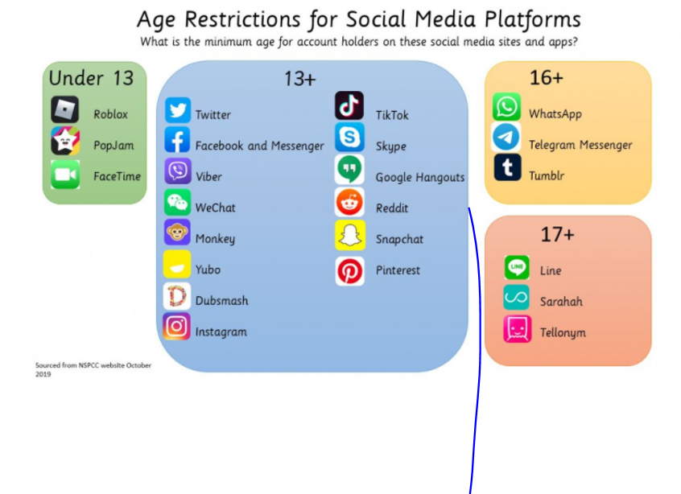

Slide 21
Contacting Your Child’s Form Tutor
7JohnTutor@stmichaelscs.org
7LukeTutor@stmichaelscs.org
7MatthewTutor@stmichaelscs.org
7MarkTutor@stmichaelscs.org
7PaulTutor@stmichaelscs.org

Slide 22
THANK YOU WE LOOK FORWARD TO Working with you and your child throughout their time at st. michael's

