Slide 1




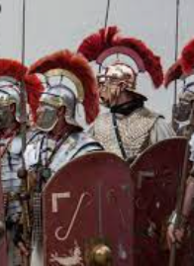


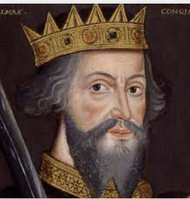

LEARNING JOURNEY
St Michael’s Catholic School
PIN BANK
The red box:
These road work boxes can be used to highlight a particular task, or link parts of the journey to the national curriculum.
Just copy and paste when needed and drag to map position, editing position of pin if necessary. Type over this text.
Simply drag a pin to add it to your journey
HK=Historical knowledge
HC=Historical communication
C=Causation
C+C= Change and Continuity
HE+ HI=Historical evidence and interpretations.
Knowledge
-What did the Romans’ bring to Britain?
-What was the impact of the Roman invasion short and long term on Britain?
END OF YEAR 7
11- What did the Romans contribute to High Wycombe?
HK/HC/HE+I/C +C
Knowledge
-Was King John really ‘evil’?
-How was the first parliament created?
- What was King Edwards’ relationship with Wales and Scotland?
The red box:
These road work boxes can be used to highlight a particular task, or link parts of the journey to the national curriculum.
Just copy and paste when needed and drag to map position, editing position of pin if necessary. Type over this text.
Knowledge
-Why did people go on crusades?
-How have Saladin and King Richard been interpreted in History?
10- How well did medieval monarchs keep control?
HK/HC/HE+I/C
HEADING
HEADING
9-Why do Historians still disagree about why people went on the First Crusade?
HK/HC/HE+I/C
Knowledge
-What were the medieval causes and cures?
-What were the causes and cures for the black death?
Knowledge
-What was the anarchy?
-What were the interpretations of Matilda and Elenore of Aquitaine?
HEADING
HEADING
8- How important were England’s medieval Queen’s?
HK/HC/HE+I
7- Why was Medieval England Plagued by ill health?
HK/HC/HE+I/C+C
Knowledge
-How important was religion to medieval England?
-What was the role of the church in Medieval society?
Knowledge
Was there a power struggle between the church and monarchs?
6- Are people right to be so negative about the Middle Ages?
HK/C+C
4- Why was the Church so important in people’s lives?
HC/HK/C
Knowledge
-What was life like in a medieval village and town?
-Were women treated as equals in medieval society?
5- Why was the Archbishop of Canterbury murdered?
HC/HK/C
3- How did William establish his control of England?
HK/C/HS+I/C+C
2-Why was England a battlefield?
HC/HK/C
1-Skills for a History detective
HK/HC/HS+I
CAR PARK
Why not
START
Y7
Knowledge
-How did William control England?
- How effective was William?
Knowledge
-Who were the contenders
-Why each contender should be King?
Knowledge
-What can sources tell us about the past?
-What is bias and chronology?

