Slide 1




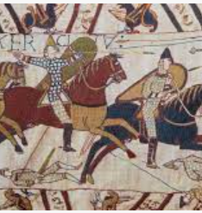
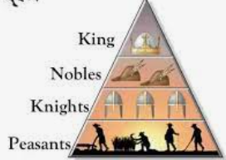

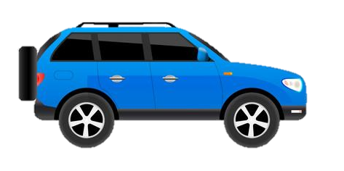

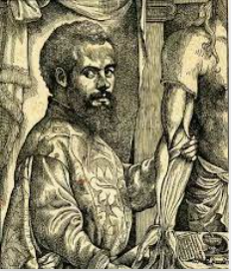


LEARNING JOURNEY
St Michael’s Catholic School
PIN BANK
The red box:
These road work boxes can be used to highlight a particular task, or link parts of the journey to the national curriculum.
Just copy and paste when needed and drag to map position, editing position of pin if necessary. Type over this text.
Simply drag a pin to add it to your journey
Knowledge
-What as the Saxon church like before 1066?
-What changes and reforms did King William make to the churches and monasteries?
-How did the Normand change education?
.A01- Historical communication/Second order concepts.
A02- Explain and analyse historical events.
A03= Analyse and Evaluate sources and make judgements.
A04-Analyse and evaluate interpretations. And make judgements.
END OF YEAR 11
7- Normans-Norman church and monasticism
The red box:
These road work boxes can be used to highlight a particular task, or link parts of the journey to the national curriculum.
Just copy and paste when needed and drag to map position, editing position of pin if necessary. Type over this text.
Knowledge
-What changes were made to the feudal system and the government?
-What were the economic and social changes?
HEADING
HEADING
Knowledge
The following aspects of the site should be considered:
-location -function
people connected with the site
events/developments from the depth study are connected to the site.
6- Normans-Life under the Normans
Knowledge
-What were the causes of the Norman Conquest
-What military battles were fought?
-How dd King William establish and maintain control?
HEADING
HEADING
5- Norman England, c1066–c1100 Historic Environment-Harrying of the North
4-Normans-The Norman Conquest and Control
Knowledge
-What was the modern treatment of disease?
- What was the impact of war and technology on surgery?
-How effective was modern public health?
3- Twentieth Century-c1900-today:Modern Medicine
2- Nineteenth century, c1800-1900: A revolution in medicine
1-Renaissance Britain- c1500=-1800 Beginnings of change
CAR PARK
Add found images to make it even more snazzy
Why not
START
Y11
Knowledge
-How did the germ theory develop?
- Was there a revolution in surgery?
-What were the improvements in public health?
-What was the impact of the renaissance on Britain?
-How was disease dealt with?
-How did they try to prevent disease?

