Slide 1





St Michael’s Catholic High School
Enrichment handbook
2025-26
SPRING term

Slide 2
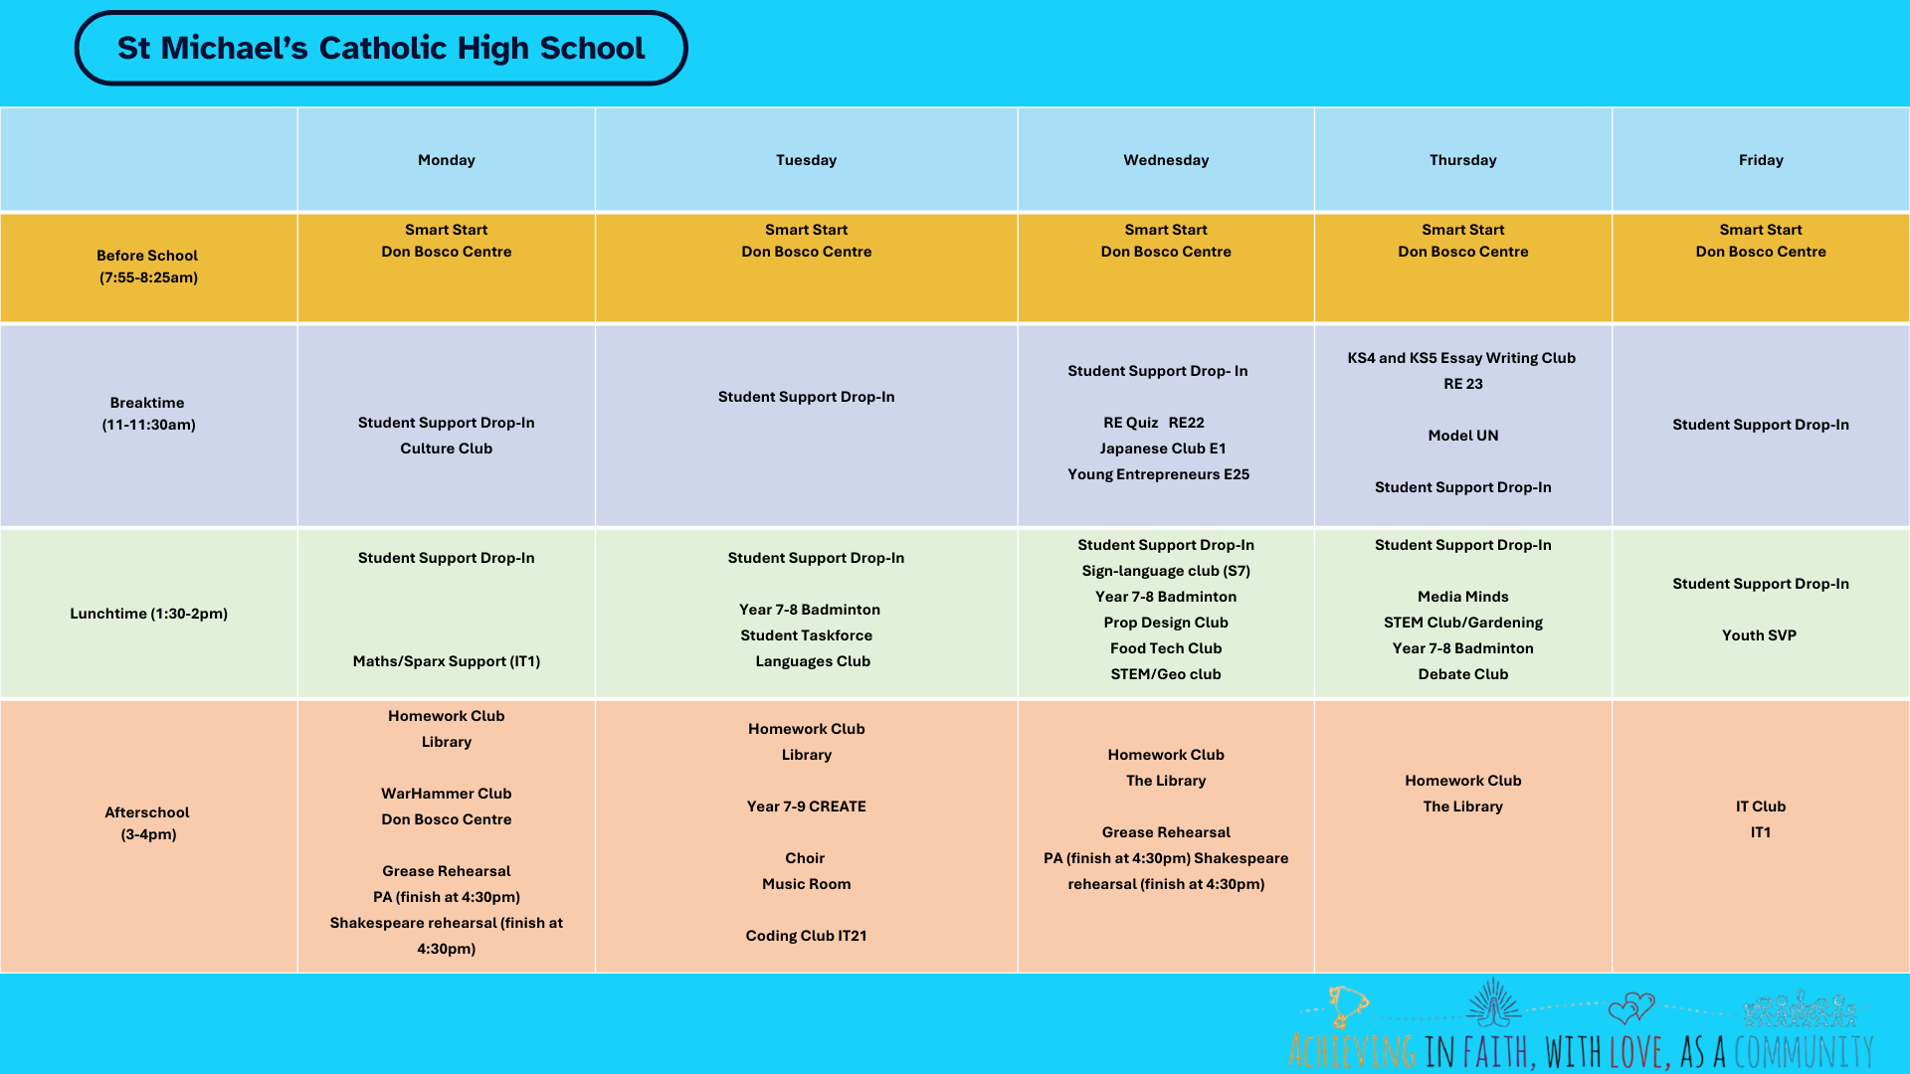

St Michael’s Catholic High School

Slide 3





St Michael’s Catholic High School
After School
Monday | All Years - Netball Years 9/10/11 Boys’ Rugby
Tuesday | ALL YEARS - Football Years 9/10 Badminton
Wednesday | Years 7/8 Boys’ Rugby All Years’ - Basketball Please note Sports’ clubs listed are afterschool

Slide 4


St Michael’s Catholic High School
Clubs in the Chapel
Breaktime
Monday
Prayer/Liturgy
Tuesday
Drop-in
wednesday
Bible Stories
Thursday
Word/Worship
Friday
Games
lunchtime
Tuesday
Christian Union
Friday
YOUTH SVP

