Slide 1
The Buckinghamshire job market
http://www.bucksskillshub.org/

Slide 2
Careers and Enterprise Company (Department for Education)
Priorities:
Raise Quality
Drive experience with Employers
Boost skills pathways
Tackle disadvantage
Connect careers to economic need
How does that affect you?
Biggest influencers on your child’s decision making
Employer interaction is key
More support for those who need it
Understanding the Bucks economy

Slide 3

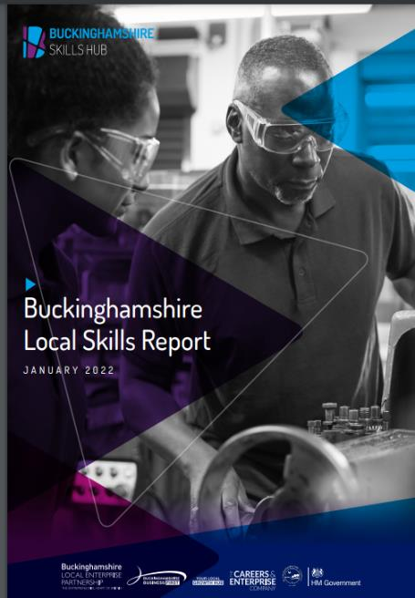
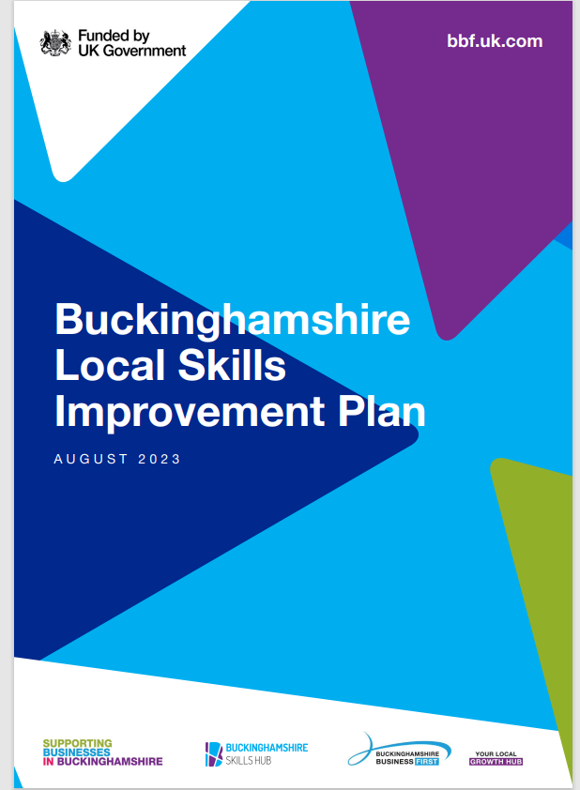
Local Skills Improvement Plan - Buckinghamshire Business First (bbf.uk.com)
www.bucksskillshub.org

Slide 4
The five sectors of the Buckinghamshire economy that employ the most people are…
Wholesale & retail
Hospitality
Education
Finance & insurance
Manufacturing
Construction
Admin & support services
IT / digital
Public administration
Transport & storage
Agriculture
Property
Energy & water
Health & social work
Professional, scientific & technical
Creative

Slide 5

































Some large local employers…

Slide 6









And some smaller ones (with big ambitions!)

Slide 7

The priority sectors in Buckinghamshire…
Cross-sector skills:
Digital Literacy
Green/
net zero
Work readiness
Construction
Digital
Engineering
Film & TV
Health & Social Care
Notes:
Employability skills, teamwork, communication, problem solving, literacy, numeracy, creativity & self management;

Slide 8

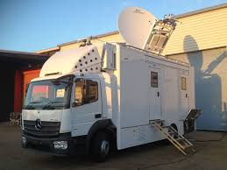

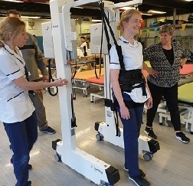
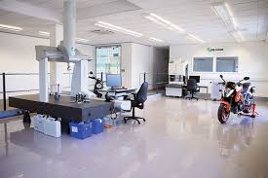



Areas of the economy our County specialises in…
From space propulsion, outside broadcasting, high-end TV and film and spinal injuries…
… to precision engineering, manufacture of measuring instruments, digital technology and wholesale of pharmaceutical and computing products.

Slide 9
Common Skills Issues in Bucks:
Skills mismatch: Between skills sought by employers and those held by residents.
Attracting talent: Challenges due to high housing costs, lack of vibrancy in urban centres, poor public transport to rural areas.
Retaining talent: High proportion of skilled residents leave for university or move out for better jobs.
Small businesses: 42% of employees work for companies with fewer than 50 people (32% nationally).
Recruitment difficulties: 18% of employers had hard-to-fill vacancies (15% nationally).
Skills shortage vacancies: over a third of vacancies are due to skills shortages.
Staff proficiency: 13% of employers had staff not fully proficient (national average 15%).
Training issues: 30% of employers with a skills gap cited lack of appropriate training; 58% funded or arranged training (national average of 60%).

Slide 10


FILM & TV
UK Film and TV sector is booming.
There are nearly twice as many creative industry jobs per head in Bucks than the national average.
Pinewood Studios, the home of the British film industry; the James Bond and Star Wars franchises; and Disney’s UK base, is located within Buckinghamshire.
The National Film and Television School in Beaconsfield is one of the top film schools in the world.
Other local companies include CTV Outside Broadcasts and Naked West: think Strictly Blackpool and royal weddings; The Apprentice and Grand Designs.

Slide 11


FILM & TV
Pinewood Studios:
For over 85 years, Pinewood Studios have been making films, enabling storytellers to bring their creations to life on big & small screens. (Taskmaster, Ru Paul’s Drag Race)
Home to classics including James Bond, Star Wars and the Marvel Cinematic Universe. (23 of the 25 007 films)
Pinewood Studios in south Bucks is home to the legendary 007 Stage, 23 stages, 3 dedicated state of the art TV studios, the unique permanently-filled Underwater Stage, acres of backlot production space plus post-production and lighting services.
It has plans approved to grow further over the next few years and will create thousands of new jobs.
Visit www.pinewoodgroup.com/

Slide 12
FILM & TV
Fastest growing occupations by employment (2019-2023)
Actors, Entertainers and Presenters
Top occupations by online vacancies (2024)
Graphic and Multimedia Designers
Musicians
Arts Officers, Producers and Directors
Authors, Writers and Translators
Arts Officers, Producers and Directors
Photographers, Audio-visual and Broadcasting Equipment Operators
Skills shortages and gaps
Virtual Production & VFX Adaptable and transferable skills: ability to work across production and post-production
Technical skills: ability to work with new software, Artificial Intelligence, and sustainable production practices
GCSE / A Level Options
Film studies: English language or literature, Art and design, IT and computing, Media studies / Film studies, Photography
More information is available at: UCAS
Digital Media production and technology: Art, Design technology, Computing, Engineering, Graphic design, Photography

Slide 13
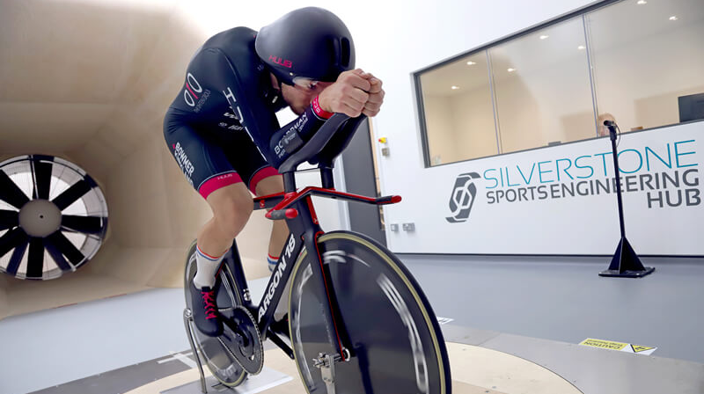
High Performance Engineering
From electric cars, 3D printing and sports engineering companies based at Silverstone Technology Park near Buckingham (opposite the Silverstone Formula 1 racing circuit) to world-famous aircraft ejection seat manufacturer Martin-Baker in the south of the county, Buckinghamshire is home to ground-breaking high-tech engineering companies.
Jobs within the sector include:
product developer
human factors engineer
programme manager
software engineer
geotechnical engineer
New property developments at Silverstone Park and Westcott Venture Park are attracting new high-tech businesses and are creating new jobs.

Slide 14


Engineering: Martin-Baker ejection seats
Visit https://martin-baker.com
Martin-Baker is the world leader in the design and manufacture of ejection and crashworthy seats. A family-run business, it has saved over 7,600 lives.
Martin-Baker says: “We believe in helping individuals grow... We are looking for talented and dedicated people that are interested in making a real difference.”
Jobs range from admin support to IT network engineer, calibration inspector to equipment maintenance technician.
Find out about its apprenticeship programme at https://martin-baker.com/careers/apprenticeships/

Slide 15

Engineering: Westcott Space Cluster
Space is one of the UK’s fastest growing sectors.
Westcott Space Cluster, near Aylesbury, is home to a growing number of space related-companies, developing new technologies include rocket propulsion, 5G comms & autonomous (‘smart’) systems like drones.
Big developments are planned on the Westcott site over next 10 years. a £5.9m boost in Nov 23, and likely to create 2,300 highly skilled jobs in manufacturing and over 1,000 on-site technical apprenticeships.
There are currently skills shortages for technicians and propulsion test specialists within the space sector. Studying STEM subjects at school is the best starting point for a career in the space sector.

Slide 16

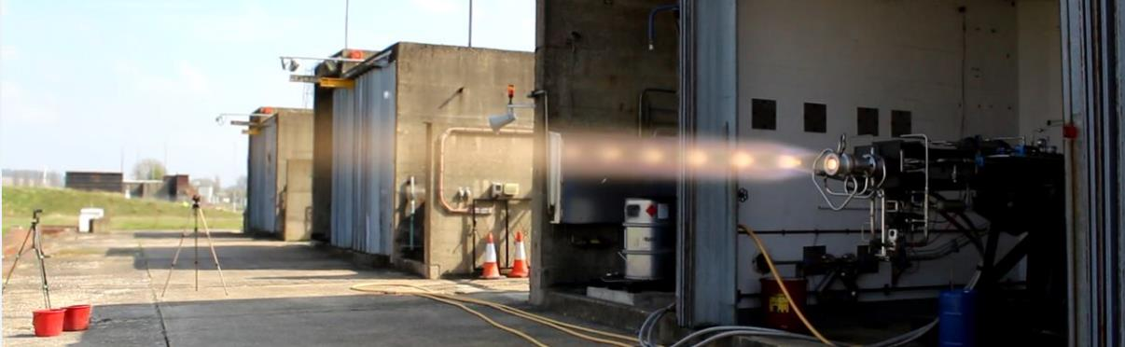
Engineering: Nammo, Westcott
Visit www.nammo.com/location/westcott/
Nammo Westcott supplies chemical propulsion to spacecraft manufacturers.
Rocket engines and thrusters are bought by commercial, defence and science markets.
In 2016 it was a Nammo Westcott engine that provided the insertion burn to allow NASA’s JUNO spacecraft to successfully enter into orbit around Jupiter.
Their Westcott employees work on development, production and testing.

Slide 17
High Performance Engineering
Fastest growing occupations by employment (2019-2023)
Metal Working Production and Maintenance Fitters
Top occupations by vacancies (2024)
Mechanical Engineers
Engineering Professionals - wide range of occupations in civil engineering, research & development, and science
Aircraft Maintenance and Related Trades
Assemblers and Routine Operatives
Production and Process Engineers
Engineering Technicians
Vehicle Technicians, Mechanics and Electricians
Telecoms and Related Network Installers and Repairers
Skills shortages and gaps
Digital Skills & Automation - working with alongside robot
Specialised engineering and installer skills – work experience is particularly important
GCSE / A Level Options
Aerospace engineer: Physics, Maths, IT or computing, Design technology
Engineering and Technology: Maths, Physics, Computing, Product Design
More information is available at: UCAS

Slide 18

Construction
Major infrastructure projects are underway in Buckinghamshire
These include: HS2, East-West Rail, CrossRail, M4 Smart Motorway
95,000 new homes required by 2045 in Buckinghamshire (according to the draft local plan)

Slide 19
Construction
Fastest growing occupations by employment (2019-2023)
Bricklayers
Top occupations by vacancies (2024)
Quantity Surveyors
Roofers, Roof Tilers and Slaters
Glaziers, Window Fabricators and Fitters
Construction and Building Trades – multi-skilled operators
Elementary Construction Occupations – labourers / groundworkers
Skills shortages and gaps
Shortages across various occupations, particularly experienced trades people, machinery operators, and civil engineering roles for HS2
Health and safety skills increasingly in demand.
GCSE / A Level Options
Maths, Physics, Design technology, Geography
More information is available at: UCAS

Slide 20

Digital
The digital sector has a significant influence in Bucks
Skills shortages exist across various occupations owing to new technology & the pace of change – AI and software development skills are particularly in demand
Relevant for virtually all businesses in Buckinghamshire!

Slide 21
Digital
Fastest growing occupations by employment (2019-2023)
Computer System and Equipment Installers and Servicers
Top occupations by vacancies (2024)
Programmers and Software Development Professionals
IT Business Analysts, Architects and Systems Designers
IT User Support Technicians
IT Network Professionals
IT User Support Technicians
Science, Engineering and Production Technicians
Skills shortages and gaps
Artificial Intelligence skills – both for developers and users
Cybersecurity – stricter requirements on digital security require more people with cybersecurity skills
GCSE / A Level Options
Computing and IT, Physics, Maths, Design technology
Art and Media studies – useful for digital marketing roles
More information is available at: UCAS

Slide 22
Health & Social Care
The largest employer in the county & the UK! With over 350 different careers.
BUT with acute recruitment and retention difficulties.
Good provision for clinical roles, the sector needs to attract more people into the 50% of jobs in non-clinical roles.
It needs to upskill the existing workforce especially in digital skills.

Slide 23
Health & Social Care
Fastest growing occupations by employment (2019-2023)
Physiotherapists
Top occupations by vacancies (2024)
Care Workers and Home Carers
Social Workers
Health Care Practice Managers
General Nurses
Midwifery Nurses
Skills shortages and gaps
Direct care: only 39% workers have a relevant qualification (Skills for Care, 2025)
Reported lack of digital skills to support admin tasks across healthcare jobs – ICT GCSEs are becoming more important
Nurses
GCSE / A Level Options
English, Psychology, Sociology, Biology, Chemistry, Health and Social Care
PE – useful for work in physical rehabilitation
More information is available at: UCAS
Notes:
NB: 28% of job postings listing qualifications require at least GCSE qualifications

Slide 24
Other occupations in demand
Chefs
Why important?
Restaurants need more chefs – some may close without them.
Facts:
Over 400 new jobs since 2019
837 job ads in 2024
Why it matters: Good hospitality attracts visitors and workers.
Large Goods Vehicle (LGV) Drivers
Why important?
Deliveries depend on drivers – many are retiring.
Facts:
515 job ads in 2024
Why it matters: Needed for moving products, both between businesses and to customers.
Gardeners & Landscape Gardeners
Why important?
Hard to find trained gardeners.
Facts:
+428 new jobs since 2019
314 job ads in 2024
Why it matters: supports with visitor and leisure attractions
2,280 employed in 2024

Slide 25
What else is missing?
Work-readiness model from employer feedback:

Slide 26


Slide 27

Find out more on our website:
A one-stop shop for all skills and career-related advice in Buckinghamshire. www.bucksskillshub.org
Thank you. Any questions?

