Slide 1

Meet the Team
St. Michael’s Catholic School
Primary Phase
2025-2026

Slide 2

What is new for 2025-26?
New wrap around care provider – JR Sports
Continuing additional PE lessons – one half term per year group.
Swimming for Y4 and Y5.
Enhanced play provision at lunchtime – equipment and zones.
Continuing to provide extra curricula opportunities across the year (e.g. workshops, theatre production).
A change to home learning expectations – more to follow.
Continuing to provide opportunities for self and peer-assessment for children to develop independence and resilient learning skills.
Interventions will continue to be put in place. E.g. White Rose Maths Intervention to support key mathematical skills.
Continuing to celebrate the 'Pilgrims of Hope' Jubilee Year.
New Religious Education Directory is being introduced in Y2 and Y5 – currently rolled out to YrR, Y1 and Y6.
Improved parent engagement opportunities – workshops.
Phased building work imminent.
Notes:
Parent workshop for phonics to be delivered in September 2022.

Slide 3
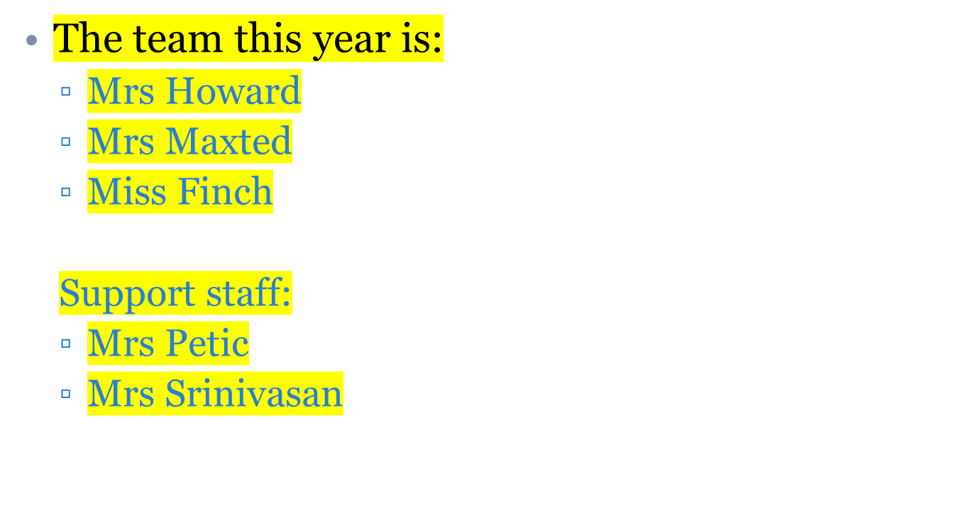
Welcome to Year 3

Slide 4
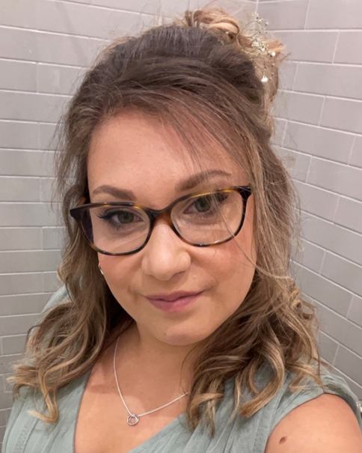
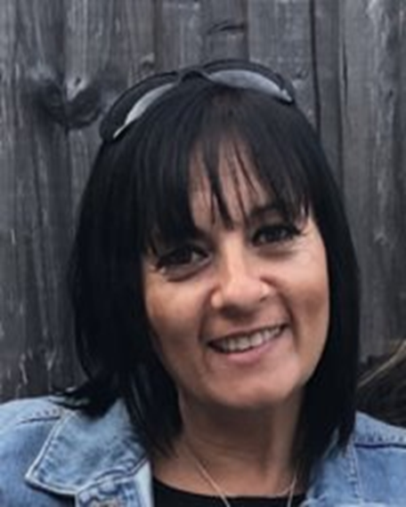
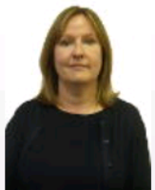
3G- Miss Finch
3R - Mrs Howard & Mrs Maxted

Slide 5
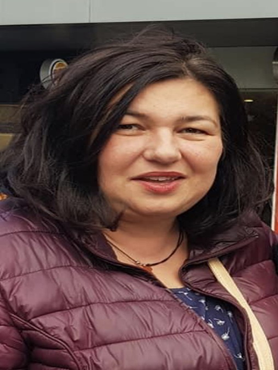
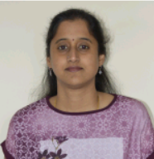
Support Staff
Mrs Petic
Mrs Srinivasan

Slide 6
Provisional Timetable
Your Name | Monday | Tuesday | Wednesday | Thursday | Friday
Registration 8.45 – 8.55 | English HW due in/ 10 Garage Sessions due in
AR/Phonics 8.55 – 9.15 | AR/Guided Reading | AR/Guided Reading | AR/Guided Reading | AR/Guided Reading | AR/Guided Reading
Session 1 9.15 - 10.15 | Maths | Maths | Maths | Maths | PE
Assembly 10.15 -10.30 | Collective Worship | Prayer & Praise | KS2 Assembly | CST/RE | Celebration Assembly
Break 10.30-10.45
Story 10.45 -11.00 | Story | Story | Story | Story | Story
Session 2 11.00-12.00 | English Spelling Test | English | English | English | ICT
Lunch 12.00 -13.00
Registration 13.00 -13.15 | Handwriting | Handwriting | Handwriting | Handwriting | Handwriting
Session 3 13.15 – 14.15 | Spanish | RE | RE | Science | Maths/TT Test
Session 4 14.15 – 15.15 | Humanities | ART/DT/Music | PSHE | Science | English
End of Day Collection 15.15 – 15.30
Notes:
Show parents the timetable from this year. Explain that although the subjects may move around the allocation of time will be the same. PLEASE SHOW CURRENT TIMETABLE AS AN EXAMPLE AND EXPLAIN TO PARENTS THAT THE NEW TIMETABLE WILL BE GIVEN OUT IN SEPTEMBER

Slide 7
PE days - FRIDAYS
Our PE lessons are taught by P.E teachers from the secondary phase.
  This will be confirmed in September and children will be given a timetable
  For PE lessons, children will need:
P.E tops
Navy shorts
Tracksuit – plain navy (no labels or colours)
Trainers (for outdoors).
Additional PE lesson will be taught for one half term per year for each year group. Children will need to be in school PE kit. This will be communicated to parents in good time.

Slide 8
Home learning KS2:
The children will receive home learning activities on Classcharts:
This year non negotiables!
Daily:
Reading and book talk – recorded in reading records / planners. Regular AR quizzing.
Weekly (set every Monday and due the following Monday):
TTRS (Times Tables Rock Stars) weekly practise.
Spelling home learning.
WRM weekly quiz.
Adhoc:
On occasion, teachers will set topic specific homework or projects to enhance learning in the classroom.

Slide 9
Home learning
Please support your child with his / her homework. This may be sitting with them to help; hearing them read or keeping them on track for handing it in on time. If your child does not understand some aspect of their homework, please send them in to ask us.

Slide 10
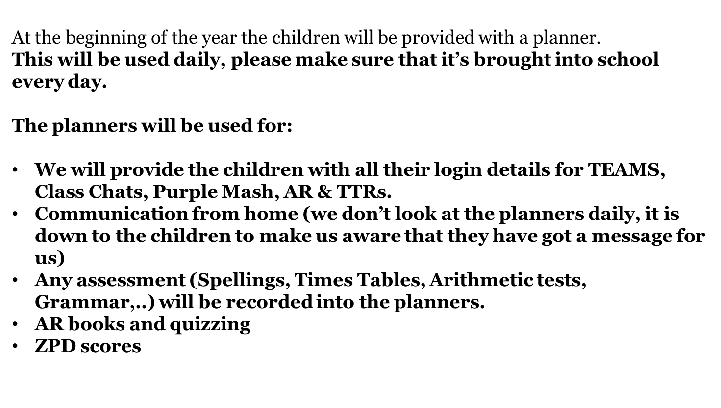
Planners

Slide 11
Assessment and Reporting:
Teachers will continue to assess pupils’ understanding in a range of ways – including questioning, feedback, end of topic tests and termly standardised assessments.
Pupil Progress Updates will be sent home at the end of the Advent and Lent Terms.
An End of Year report will be sent home during the Pentecost Term and any statutory data will be reported e.g. phonics, MTC, KS2)
New attendance reports will be sent home on a termly basis.
Notes:
Explain to parents that the way teachers are assessing pupil's work is changing to support immediate feedback in lessons and a move away from traditional marking in books. This is now seen as the most effective way to aid pupil progress. Explain further as necessary.

Slide 12
Trips and visits
We will give you good notice for trips so that payments can be processed in time for your child to attend on ParentMail.
Please complete the annual consent form (MS Form) when they are sent out but a specific consent form for any trip must also be completed otherwise, we cannot take your child.
Please ensure that you keep us updated with any changes to your details – address, phone number, medical etc…
Notes:
Year 6 to talk to parents about residential. Year 5 to talk to parents about Longridge.
Although we ask for voluntary contributions because we are a state maintained school, budgets do not allow for costs to be covered and therefore we are reliant on 100% parental contributions for trips to go ahead.

Slide 13
Highlights of Year 3
•Trips & Workshops (TBC)
•Year group assembly
•Role models for KS1
•CLASSCHARTS for homework
•KS2 planners
•Last term share upper KS2 playground
•First Holy Communion celebrations
•Spanish

Slide 14
Important dates in Year 3
Class assembly – to be confirmed
Trips & Workshops (TBC)

Slide 15

Stationery (KS2)
All KS2 students will require:
2 drawing pencils and a pencil sharpener.
2 blue handwriting pens - Staedtler Blue Handwriting Pens are best, available on Amazon.
Eraser.
Whiteboard pen.
Pritt Stick.
Pack of coloured pencils / pens.
30 cm clear ruler.
All items to be clearly named.
Notes:
Please stress importance of providing stationery to parents. No stationery will be given to children.

Slide 16
Not required.
The following items will be provided:
Scissors
Assessment stationery
Felt tipped pens are optional.
Pocket dictionary and thesaurus (optional) but advised.

Slide 17
General routines
School starts promptly at 8.45am so please ensure that children are here on time. The gate will open at 8:25am and close at 8:45am.
All children leave at 3:15pm Please let us know about changes to end-of-day arrangements in writing.
It is important that you are prompt to collect your children. Teachers often have meetings at the end of the day.
Once you have collected your child, please keep them with you and exit the site as soon as possible to ease congestion.

Slide 18
Building Strong Partnerships: Open Communication & Mutual Respect
We are incredibly grateful for the trust you place in us to educate and care for your children. Our goal is to foster an exceptional learning environment, and a strong partnership with you, our parents, is key to achieving this.
We are always here to listen. Please know that we are always willing to listen to any concerns you may have, no matter how small or big. We encourage open dialogue and believe that by working together, we can best support your child's journey.
Mindful Communication & Mutual Respect: While we welcome open communication, we also ask that all interactions be conducted with mutual respect. We understand that emotions can sometimes run high, especially when it comes to your children. However, we have a zero-tolerance approach for any form of abusive language or behaviour towards our staff, whether in person, over the phone, or in written communication.
We believe that by communicating thoughtfully and respectfully, we can maintain the positive and supportive relationships essential for your child's success. Thank you for your understanding and cooperation in creating a respectful and collaborative community.

Slide 19
How we communicate with you
Yearly dates overview from Mrs Collins (which you will receive in the first week back to school)
Termly year group newsletters
Fortnightly letters from Mrs Collins with key dates and information
Letters via Parentmail (which let you know about other events, trips or important information)
Seeing you in the playground / by telephone if anything has cropped up during the day
KS2 Planners
Classcharts announcements for class information/messages.
Appointments if needed
Parents’ evenings - October 2025 and March 2026.
End of Term Attainment Reports

Slide 20
How to communicate with us
Teachers are on the playground at the end of the day for informal discussions (afternoons work better than mornings)
Key stage emails. ks2-4701@stmichaelscs.org
Making an appointment, if an issue is likely to need further discussion.
Parents’ evenings.
Reporting absence: reporting-absence@stmichaelscs.org
For urgent changes, please telephone the school office.

Slide 21
If you have a query:
Stage 1: Contact the class teacher in the first instance. They are your primary point of contact and are best equipped to address the majority of issues.
Stage 2: If the issue remains unresolved, contact Mrs Tyson, the Head of Key Stage 2, via the key stage email address. She will work with the class teacher and yourselves to provide further support.
Stage 4: If, after Stage 3, you remain unhappy with the steps the school has taken, the issue will then be escalated to Mrs Collins. Please note, it is very rare for an issue to reach this stage.
Stage 3: If your query or issue remains unresolved after Stages 1 and 2, it will be escalated to Mrs Maxted, our senior Assistant Head. She will investigate the issue thoroughly, reviewing all steps already taken to find a resolution.
Stage 5: Should the issue remain unresolved after stage 4, a meeting will be arranged with both Mrs Collins and our Executive Headteacher, Mrs Baker, to gain a comprehensive understanding of the outstanding concerns, steps already taken and outcome reached. If, following this meeting, the issue persists, you will then need to initiate a formal complaint by following our established complaints procedure.
We strive to resolve all issues as soon as they arise. While the outcome may not always be a decision you agree with, we ask for your respect as we work together. Our preferred method of communication is a face-to-face meeting or telephone call, as emails can often misconstrue meaning and inadvertently escalate a situation.

Slide 22
Behaviour
Class Charts is used to track positive behaviours for all year groups. Behaviour points (negative) are only recorded for years 5 & 6.
Community credits (positive) are recorded for each child.
You can login to Class Charts to track your child’s behaviour progress.

Slide 23
Parent Rep:
Each class has a Parent Rep.
The parent rep will be first point of contact for the teacher to communicate with the parents on whole class matters e.g., assemblies, for organising extra help for class trips etc.
This doesn’t replace the usual lines communication but will be an additional link which we hope you find useful.
The class rep will have responsibility of sharing information with parents e.g., WhatsApp
Termly parent rep meetings with Mrs Collins and Mrs Maxted, to discuss parental feedback.
If you are interested in becoming a class rep, please let us know.

Slide 24
Uniform
Some reminders are:
  Please label all items so that anything lost can be returned.
  No jewellery is permitted other than stud earrings.
  Blue or white hair decorations only and these should not be overly decorative.
  Proper school shoes only are permitted. Children may not wear trainers. Plain black, leather ankle boots are permitted to be worn in the winter months.

Slide 25
Snacks and lunches
Children will continue to have hot lunches – if requested – in the Primary Hall. Please order lunches for the week through Innovate. The cut-off date for orders is midnight each Saturday.
Any sweets / cakes etc. for birthdays or other special occasions will be given out at the end of the day in case there are children with allergies.
Children to bring a named water bottle to school. Water is also provided in all classrooms.
You may provide children with a healthy snack in KS2 for morning break.

Slide 26
Any questions?
If you have any questions, please email into the Key Stage emails.
KS2-4701@stmichaelscs.org
Wishing you all a relaxing and enjoyable summer break.

Slide 27

We hope to have an enjoyable and productive year with you and all the children.
If you have any questions, please do not hesitate to contact us.

