Slide 1


Travel & Tourism
Lv3 Extended Certificate

Slide 2
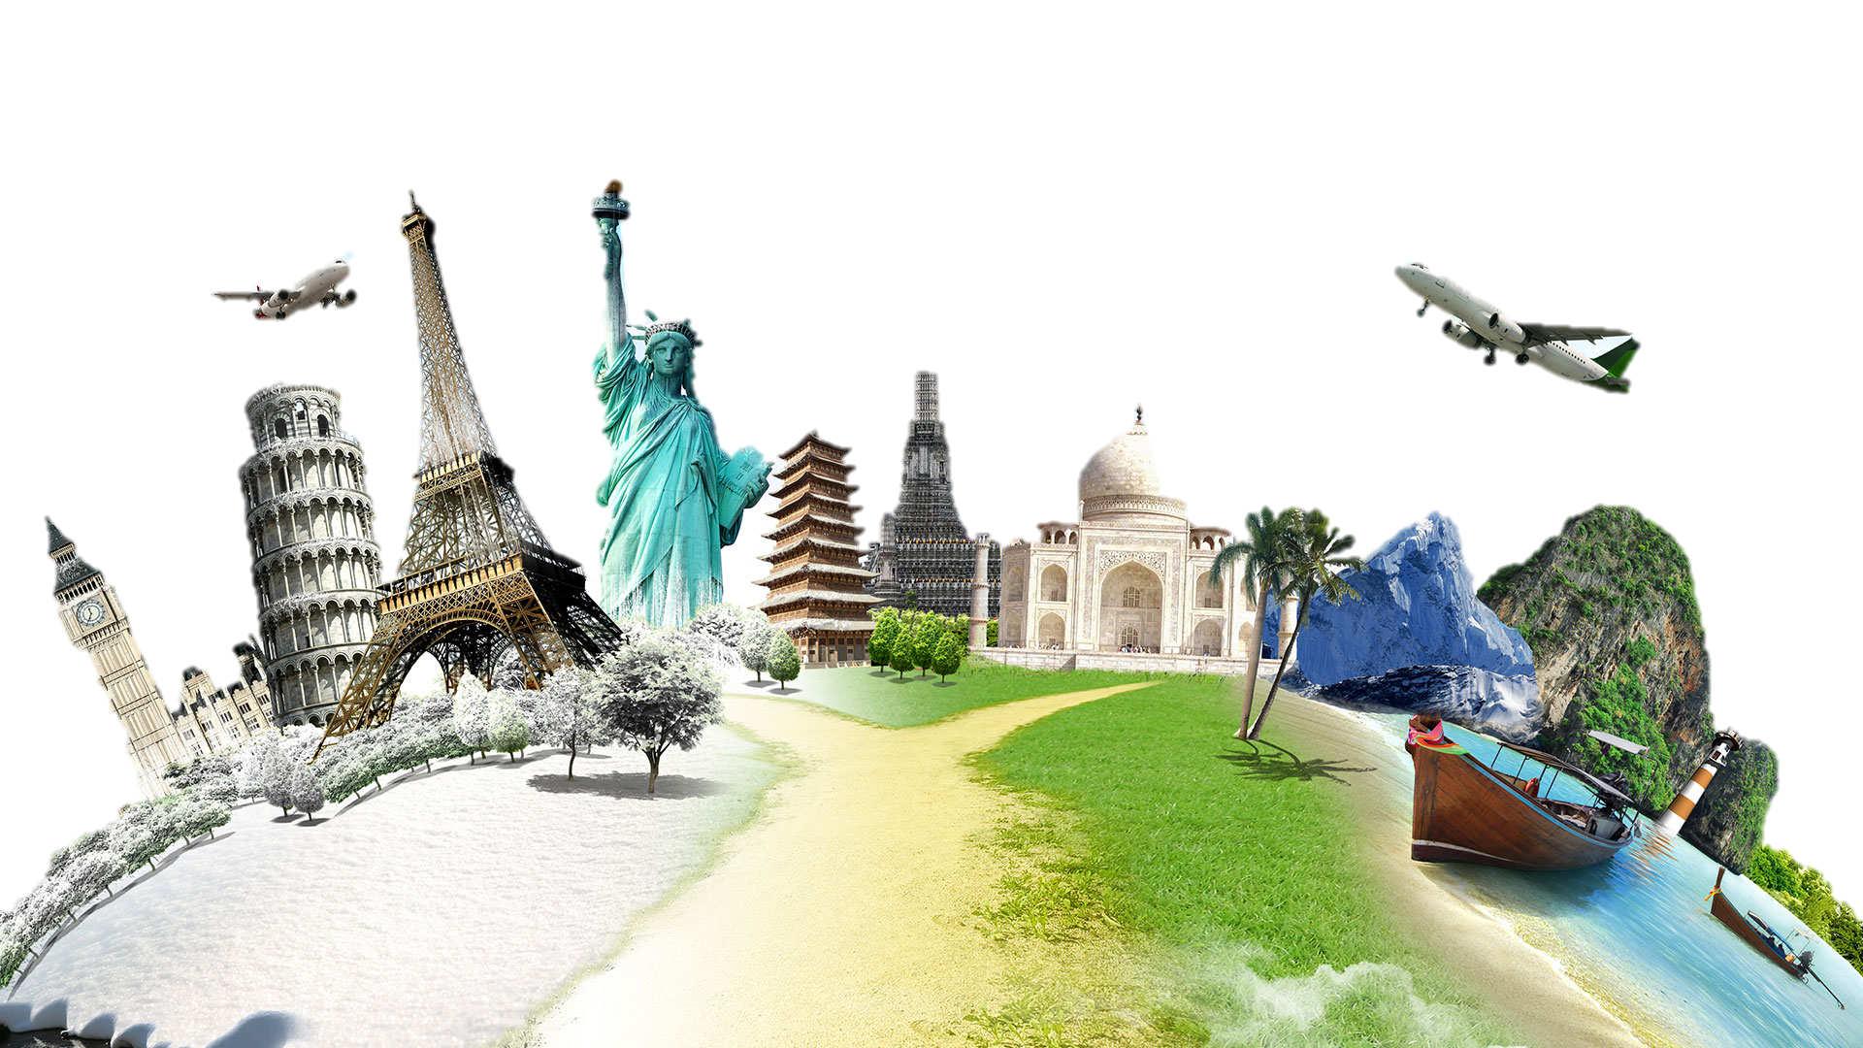
The tourism industry and includes:
An overview of the tourism industry
The key tourist destinations & why they are appealing
How tourism is marketed
What attractions appeal to people and why
These will be looked at from various perspectives & needs e.g.
Family needs vs individuals
Support for varying disabilities
Differences between budgets

Slide 3
Your summer task is to write a short report on a holiday you have been on (or are going on during the summer).
This needs to include:
The destination & why that was chosen
Where this was booked (travel agent/online etc)
Who you are going with (family? Friends? etc)
What type of holiday it is (beach, adventure, glamping etc)
Your methods of transport (getting there and transport on days out)
What activities you did/will enjoy and why they appeal.
The accommodation you stayed in
Services that were needed whilst there (shops, restaurants etc)

Slide 4
Challenge yourself
If you have completed the previous task, but want to challenge yourself to test skills at the higher levels you will be assessed at, answer the following questions:
What aspects would need to be changed for a different demographic
e.g. what would need to change if it was an elderly couple or a person with physical disabilities going.
What factors would change if you went to a very different destination
e.g. if you went on a beach holiday in southern France, how would this trip be different to a sightseeing tour to Thailand.

Slide 5
How to do this?
This report can be done any way you want:
Written in paper,
Word document
PowerPoint slideshow
Just remember it needs to be brought in on the first lesson of the new term, so make sure it is ready.
If you have any questions, please e-mail:
Pmorgan-Russell@stmichaelscs.org

