Slide 1
CRIMINOLOGY
TRANSITION WORK
This is a detailed and comprehensive assignment that you have been given. Do not rush it. We advise that you complete the tasks gradually rather than leaving it all until the final week of your break.
You should expect to spend longer on these tasks than any homework you have completed before. L3 Criminology will be a significant step up from the work you have completed in Year 11.
Present the tasks in any format you like and bring it with you to your first lesson. If you are completing this work on a computer, please print or send it to SLahaware@stmichaelscs.org
 | TASK | ✓
1 | CRIMINOLOGY IN THE MEDIA Choose at least three documentaries to watch from the list and make a note of the key facts
2 | SERIAL KILLER FACT FILE Research a serial killer of your choice and produce a fact file
3 | ALL ABOUT HATE Answer the questions using the articles provided to find out more about hate crime
4 | WHAT DOES CRIME LOOK LIKE IN DIFFERENT AREAS? Use the crime maps to look at the different in amount and types of crime across different areas
5 | KEYWORDS Research the keywords and create a glossary
6 | CAMPAIGNS FOR CHANGE Research two of the campaigns and make notes according to the criteria

Slide 2



Watch at least three!
TASK 1: CRIMINOLOGY IN THE MEDIA
Did you know that approximately 20% of films are crime related and around 46% of media reports focus on violent/sexual crime? With this mind, it makes sense that some people feel that crime is all around them. This task will widen your knowledge of the different ways crime is portrayed in the media. Pick whichever of the following documentaries to watch as part of your introduction to criminology. Be sure to make a note of key events.
NETFLIX
Amanda Knox
Disappearance of Madeline McCann
When they see us
Confessions of a killer: The Ted Bundy Tapes
Making a Murderer
The Innocence Files
Evil Genius
The People vs OJ Simpson
Staircase
The Trials of Gabriel Fernandez
Killer Inside: The Mind of Aaron Hernandez
13th
Abducted in plain sight
American Murder (The Family Next Door)
YOUTUBE
Belmarsh: Inside Britain’s Toughest Prison
  (https://www.youtube.com/watch?v=mLRBpf-Ws6k)
Murder At Columbine High School
  (https://www.youtube.com/watch?v=D9mUpUHk3nE)
Hillsborough: anatomy of a disaster
  (https://www.youtube.com/watch?v=PYNeoTXe-SE)
Defending Violent Criminals
  (https://www.youtube.com/watch?v=Q15bAd8s08I)
Dr Death: Britain’s Biggest Serial Killer
  (https://www.youtube.com/watch?v=3-KVuVjmjmU)
Michelle Carter – Can Words Kill
  (https://www.youtube.com/watch?v=MfAG4O7ojxE)
Myra Hindley – Britain’s Most Hated Woman mmm(https://www.youtube.com/watch?v=NQ8eKB5fJRk)
The Boys Who Killed a Child (Jamie Bulger)
(https://www.youtube.com/watch?v=TrkQe4tyJnQ)
As you progress through this course, you will be able to look back at what you have watched and identify different aspects of criminology within it.

Slide 3
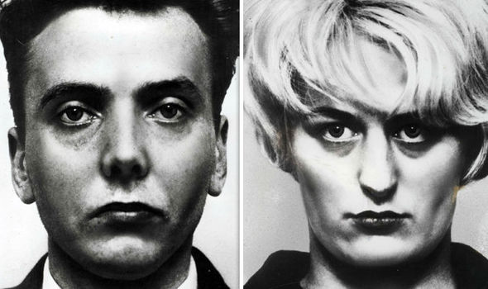
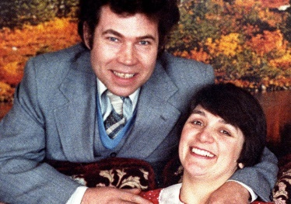
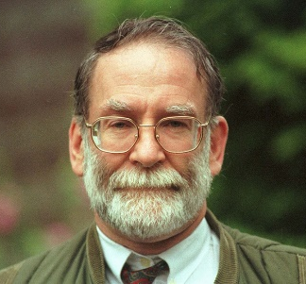
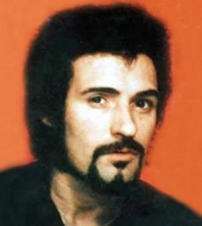
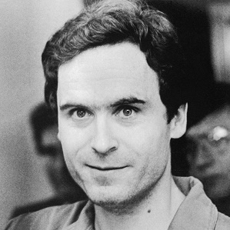
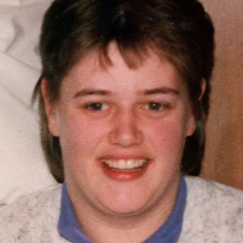
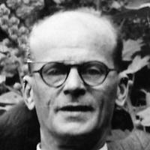
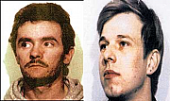
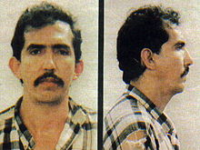
TASK 2: SERIAL KILLER FACT FILE
Although criminology isn’t all about gruesome serial killers, it will be useful for you to have some prior knowledge of this type of crime before you study the course. During Year 12, you will learn various causes of criminal behaviour and you will be able to link these to various serial killers. Choose a serial killer from the selection (or choose your own!) and research information according to the criteria below.
CRITERIA
What is their background?
  Where did they grow up? What was their family like? What was their life like before/during their crimes?
What crimes did they commit?
  How many people did they murder? How did they murder? What did they do with the bodies?
Who were their victims? Did they have a certain ‘type’?
Were they caught? If so, how were they punished?
Is there anything which might explain their behaviour? i.e. any head injuries, childhood abuse?
Ian Brady and Myra Hindley | Fred and Rose West | Harold Shipman
Peter Sutcliffe | Ted Bundy | Beverley Allitt
John Christie | John Duffy and David Mulcahy | Luis Garavito
If this task is a bit too upsetting/gruesome for you – please stop

Slide 4

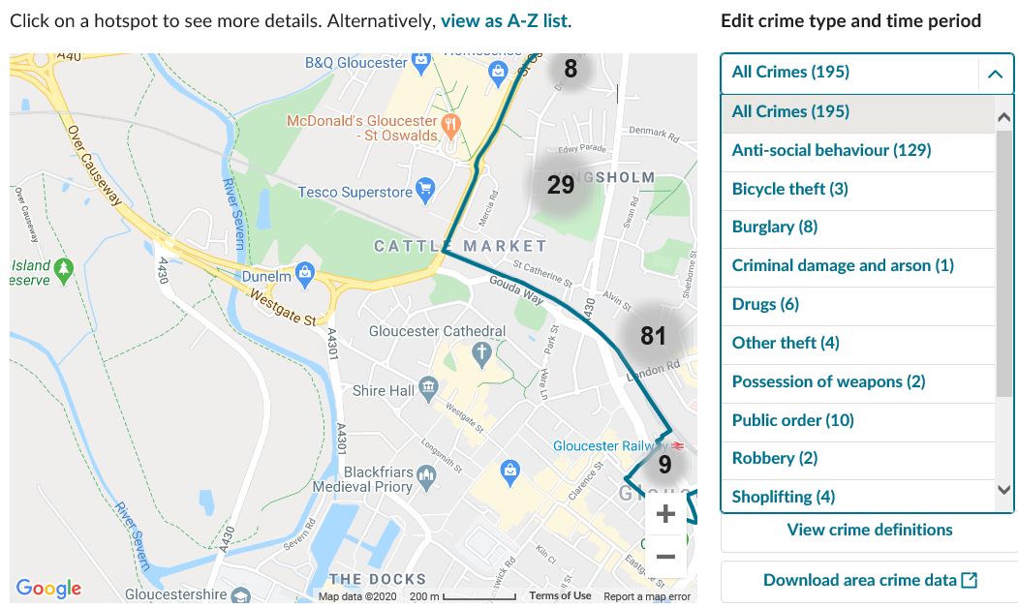
Task 2: All about hate crime•
TIP: Enter “UK” after your search to ensure you get relevant information – so instead of “hate crime” search “hate crime UK”
TASK 3: ALL ABOUT HATE
Since the public vote on BREXIT, there has been a marked increase in the amount of hate crime in the UK. There are various types of hate crime and it can be really upsetting to be a victim. This task will allow you to look at it in more detail and find out some real life examples. Use the articles and videos in the boxes below to help you complete the following tasks.
CRITERIA
What is hate crime? What are the different categories of hate crimes?
Find two examples of victims of hate crime and write a summary of each case
  Who was the perpetrator? Who was the victim?
  What crimes were committed?
  Did the perpetrator get punished? How?
Find two examples of support groups who help victims of hate crime and outline their aims and objectives
https://www.independent.co.uk/news/uk/crime/brexit-hate-crime-eu-citizens-xenophobia-racism-police-bracing-march-2019-article-50-a8590921.html
https://www.victimsupport.org.uk/crime-info/types-crime/hate-crime
http://www.stophateuk.org/
https://www.youtube.com/watch?v=B03jduD9N5o&safe=active
TASK 4: WHAT DOES CRIME LOOK LIKE IN DIFFERENT AREAS?
You will already know that different areas of the UK will have different crime rates but did you know that different areas have different types of crime? Think about the difference between urban, built up areas compared to rural areas – what would the difference in types of crime be? Use the two links below to look at the amount and types of crime that occur in Birmingham City Centre compared to Kingsholm and Wotton, a small area in Gloucester.
https://www.police.uk/pu/your-area/west-midlands-police/city-centre/?tab=CrimeMap
https://www.police.uk/pu/your-area/gloucestershire-constabulary/kingsholm-and-wotton/?tab=CrimeMap
Use the dropdown menu to see the different types of crime!
TIP: When looking at crime data, just stick to April 2021. This means when we discuss your findings in lesson, you should all have found the same pattern.

Slide 5
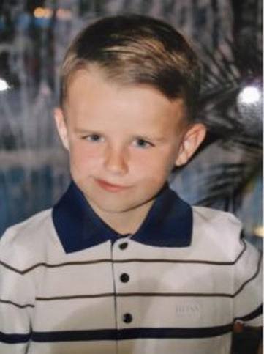
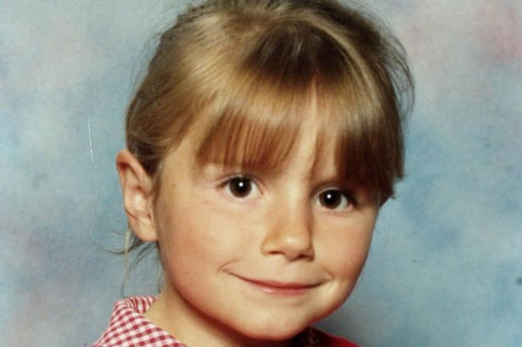
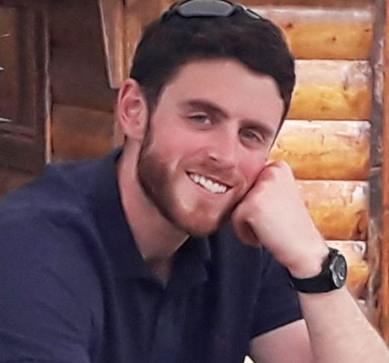
Task 2: All about hate crime•
TIP: Enter “Criminology” after your search to ensure you get relevant information and keywords defined from a criminology point of view.
TASK 5: KEYWORDS
Knowing your keywords is very important in Criminology. We often find that the answers getting top marks are the answers that contain keywords used appropriately and effectively.
Create a keyword glossary of the words below. If possible, try to use examples.
Crime | Deviance | White-collar crime
Technological crime | State crime | Moral crime
Domestic abuse | Hate crime | Honour crime
Ripple effect | Decriminalisation | Legalisation
TASK 6: CAMPAIGNS FOR CHANGE
A big focus of Unit 1 in Criminology is looking at how laws, policies and procedures have changed over time. You will also get the chance to plan your campaign. It therefore makes sense for us to start the course with a good set of knowledge about what existing campaigns are out there. Choose two of the following campaigns to research and makes notes using the criteria below.
CRITERIA
Why did this campaign start?
What was the aim of the campaign? What did they want to achieve?
How did they do it? What methods were involved? i.e. TV interviews, petitions
Was the campaign successful? Has it changed law/policy/procedure? Did it raise awareness?
CAMPAIGNS
Sarah’s Law
Double Jeopardy Law
Dignity in Dying
Snowdrop Campaign
Slow Down for Bobby
Harper’s Law

