Slide 1






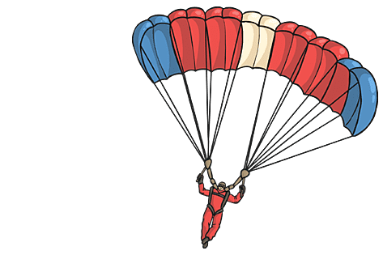
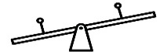
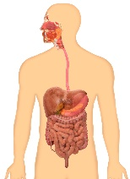
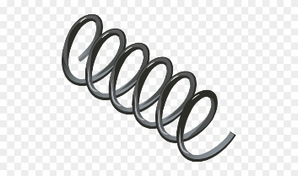

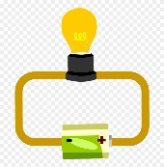
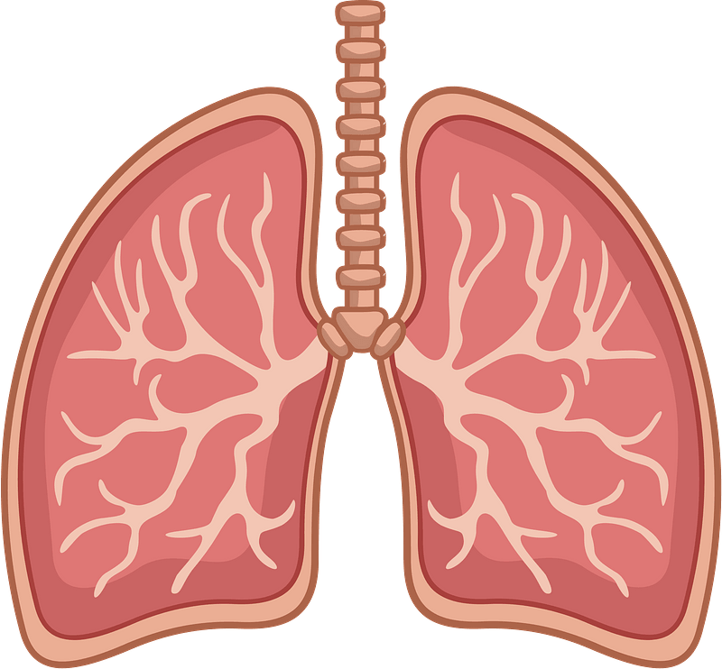
Year 8 LEARNING JOURNEY
St Michael’s Catholic School
Assessment:
Retrieval quiz
6 mark question
Radiation
Sound
Genetic: family pedigree
Genetic: punnett squares
Inheritance & DNA
Working Scientifically Skills:
Displaying data
Drawing conclusions
Evaluating experiments
Use of formulae (FIFA)
Recording results
Displaying data
Identifying trends,
Making observations
Year 9
Sound, light and waves
Extinction
Modelling waves
Light
Evolution
Literacy
Conservation of mass
Exothermic & Endothermic reactions
Literacy
Energy transfer by radiation
Reactions
Evolution and inheritance
Natural selection
Energy transfer by particles
Atoms in reactions
Types of reactions
Work and energy
Photosynthesis
Biotechnology
Pressure
Turning forces
Literacy
Work, heating and cooling
Respiration and photosynthesis
Squashing and stretching
Plant minerals
Leaves
Aerobic and anaerobic respiration
Friction and drag
Unhealthy diets
Digestion
Compounds
Polymers
Nutrients
Elements and periodic table
Contact Forces and pressures
Food tests
Enzymes
Atoms
Chemical Formulae
Periodic table
Elements
Alcohol
Smoking
Magnets
Circuits
Breathing and digestion
Magnets Electro-magnets
Potential difference and current
Drugs
Breathing and gas exchange
Electromagnets
Potential Difference, current and resistance
Department Intent: To enable students to make evidence based, ethical and moral decisions so they can develop their scientific knowledge and skills

