Slide 1

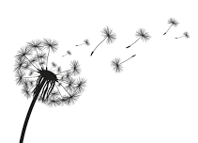
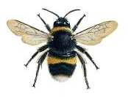


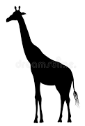

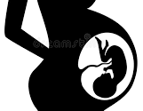
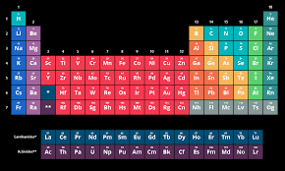
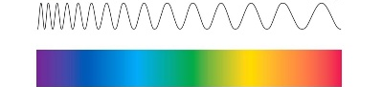

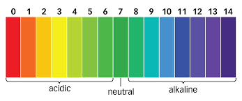
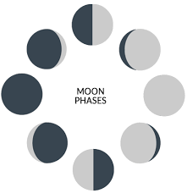
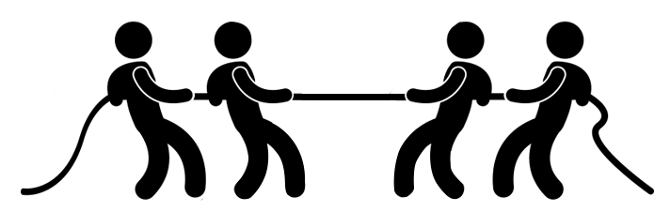
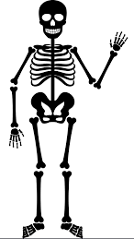
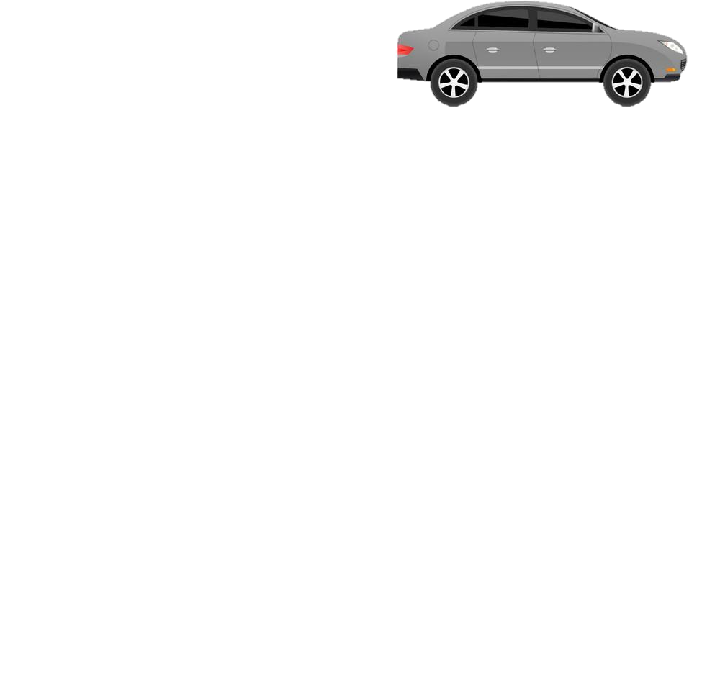


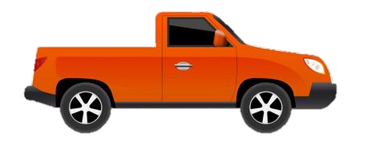
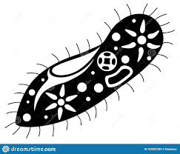
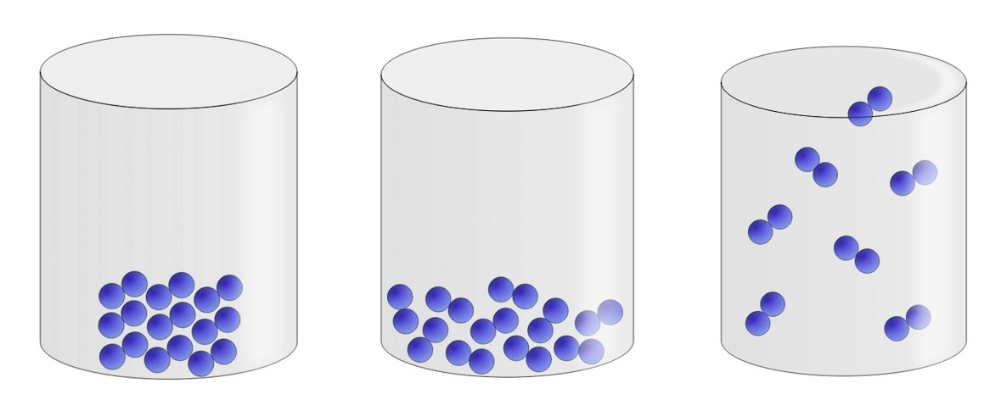

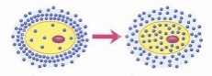


Year 7 LEARNING JOURNEY
St Michael’s Catholic School
PIN BANK
Simply drag a pin to add it to your journey
Seed Dispersal
Ecosystems & competition
Food chains & webs
Interdependence and plant reproduction
Earth Structure and rock cycle project
Year 8
Plant reproduction- Pollination, Fertilisation & germination project
Recycling
Extracting metals
Assessment:
Retrieval quiz & 6 mark question
The red box:
These road work boxes can be used to highlight a particular task, or link parts of the journey to the national curriculum.
Just copy and paste when needed and drag to map position, editing position of pin if necessary. Type over this text.
Earth (universe)
Variation & Adapting to change
Human reproduction
The ear
Reflection
Variation & Human Reproduction
Sound and light
Neutralisation& Making salts
Refraction
HEADING
Adolescence & Puberty
The menstrual cycle
Sound
Light
The eye
What am I learning:
Chemical reactions
Chemical reactions of metals & non-metals
Solar system and The Night Sky, Phases of the Moon and Seasons project
Speed, Distance & Time
Balanced & Unbalanced Forces
Strong & weak acids
Metals & Non- metals, acids & alkalis
Speed, Gravity, (Universe)
Acids & Alkalis & the pH scale
Inside particles & the periodic table
Properties of Metals & non-metals
Gravity
Levels of Organisation
Pure substances & mixtures
Separation Techniques (filtration, evaporation, distillation, chromatography).
Observing cells
Movement & The Skeleton
States of matter & the particle model changes of state
Diffusion
Cells & Movement
Unicellular organisms
Plant, animal and specialised cells
Movement of substances
Changes of state
Solutions & solubility
The Particle Model & Separating Mixtures
Current
CAR PARK
Energy resources
Resistance
Why not
Energy costs and energy transfer
Potential difference and current
Starting Science and Working scientifically i
Energy transfers and dissipation
Assessment:
Retrieval quiz & 6 mark question
Power
Food and fuels
Potential Difference
Circuits
Department Intent: To enable students to make evidence based, ethical and moral decisions so they can develop their scientific knowledge and skills

