Slide 1

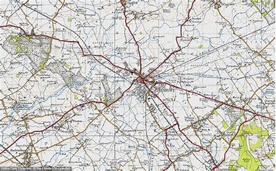
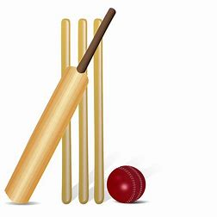
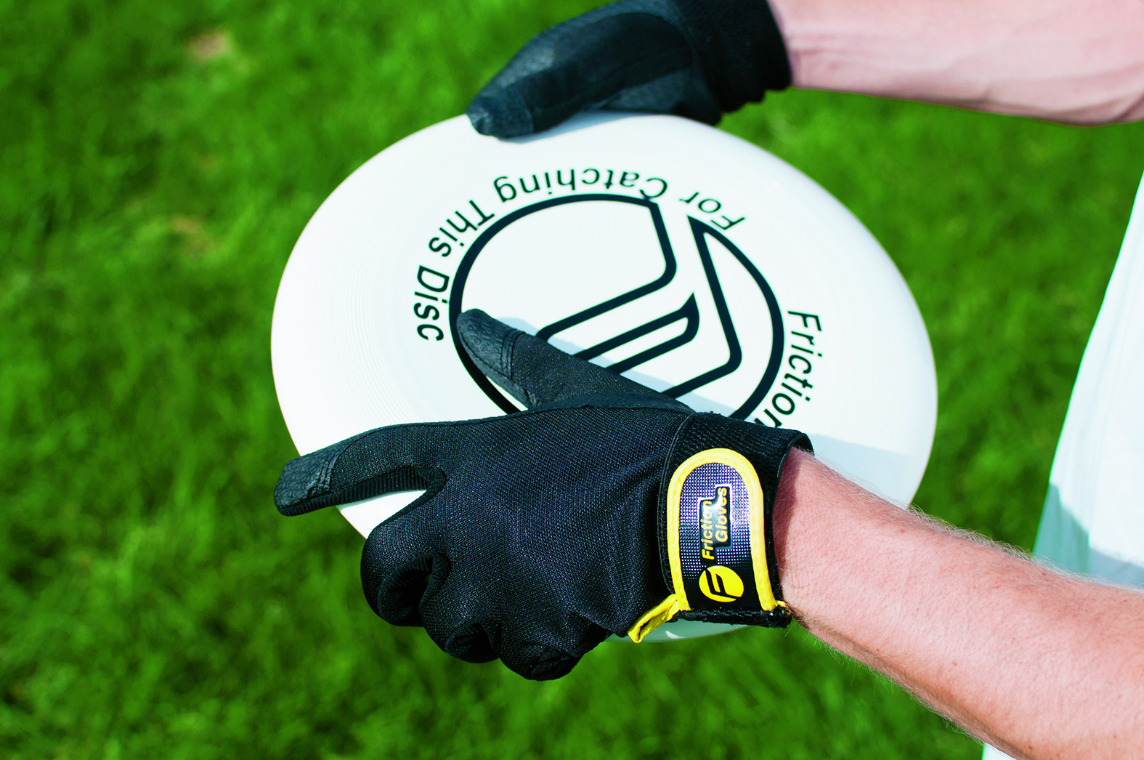




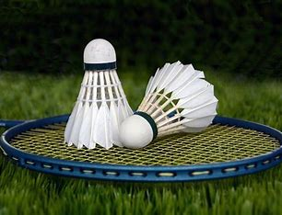





Year 7 Core PE
Learning Journey
To establish confident movers and explore fundamental skills in a sporting context and developing physical literacy.
Game Play
Rules
Batting
Serve
Tennis
Year 8
PE
Assessment 10
Middle distance
Striking and Fielding
Bb=ackhand/ forehand
Assessment 9
Assessment 11
Fielding
Sprints
Volley
Throwing Events
Middle Distance
Problem solving
Assessment 7
Teamwork
Summer term
Bowling
Decision making Game play
Sprints
Communication
Cricket
Relay
Tthrowing Events
OAA
Leadership
Assessment 8
Jumping Events
Passing
Rules
Handball
Game play
Dribbling
Assessment 6
Passing
Aathletics
Game play/ Decision Making
Assessment 5
Rules
Cannons/ Unison
Aattacking/ Defending
Receiving
Spring
term
Rolls
Movement/ Sequencing
Levels
Rugby
Rotation
Dance
Expression/ Performance
Serve
Rules/ Tactics
Assessment 4
Aaesthetic
Assessment 3
Assessment 2
Gymnastics
Ssequence
Table Tennis
Decision Making
Game Play
Accurate replication
Forehand/Backhand push
Attacking/ Defending
Game Play
Teamwork
Passing
Set/ Dig
Assessment 1
Leadership
Ddribbling
Autumn term
Football
Netball
Volleyball
Communication skills
Introduction to PE
Passing
Serve
interceptions
Smash
Spike
Netball
‘The PE curriculum aims to support students in developing GOOD HABITS for LIFELONG PARTICIPATION, encouraging ASPIRATION, LEADERSHIP and CHARACTER DEVELOPMENT through a wide variety of educational experiences and enrichment activities.’

