Slide 1


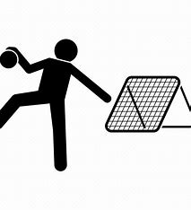
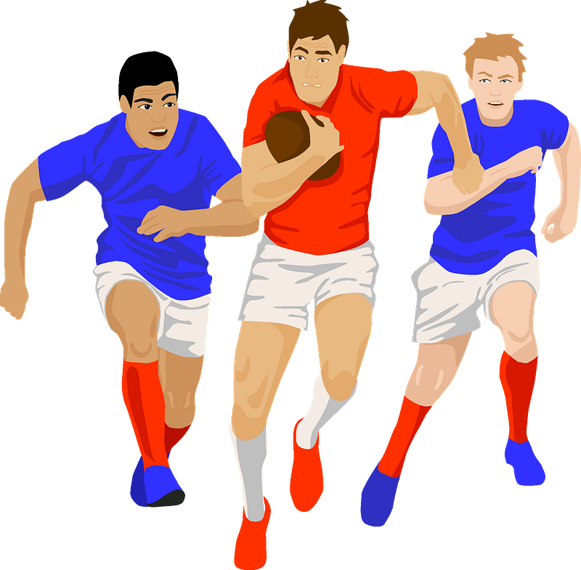

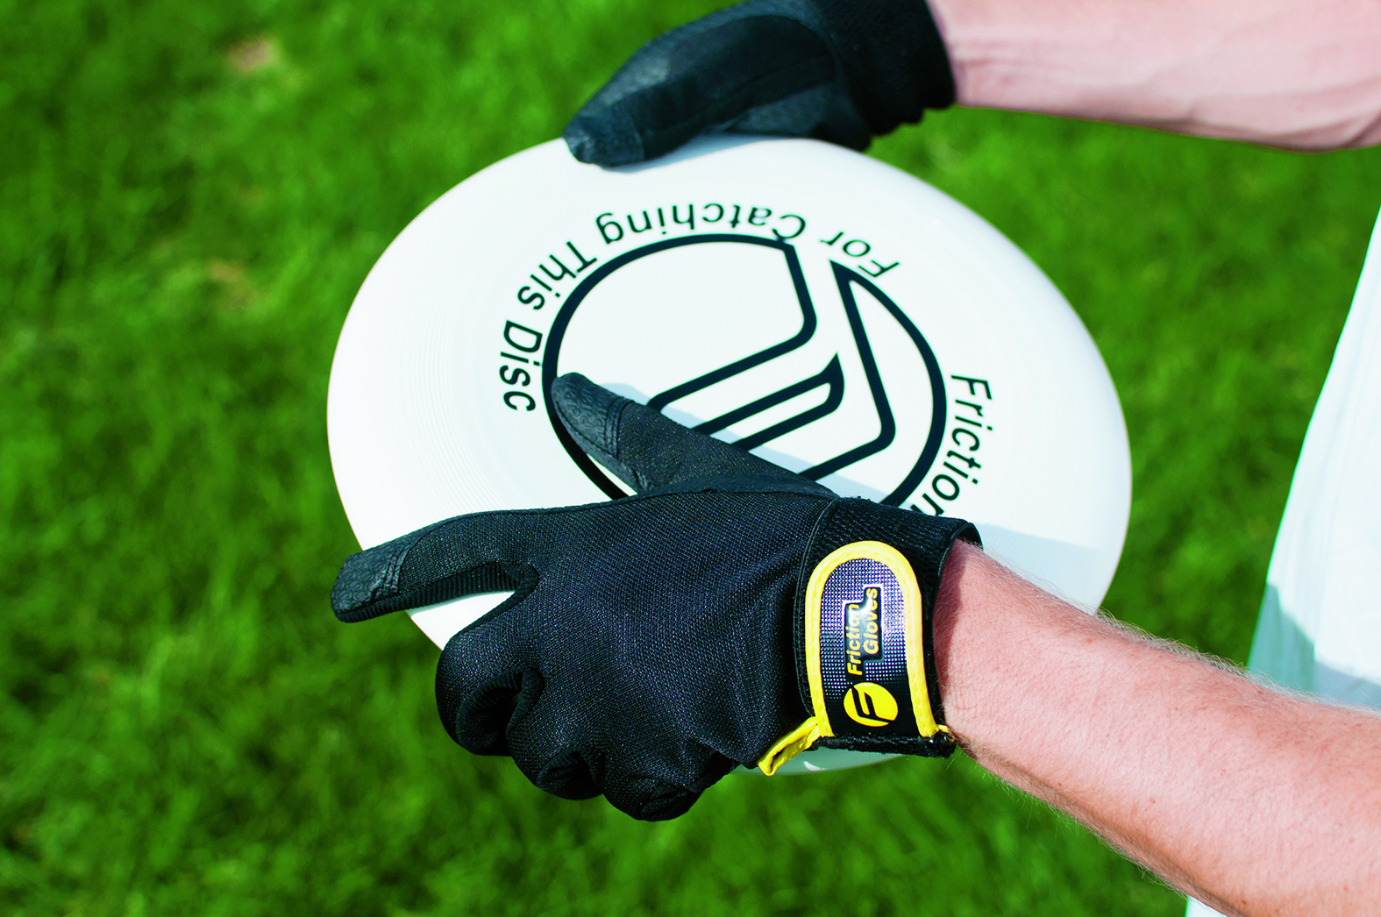

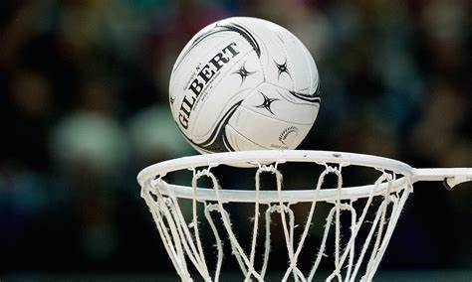
Year 11 Core PE
Learning Journey
Being Active for life – embedding active, healthy living routines and exploring leadership skills
Assessment 4
Year 12 PE
Choice of Activities for Summer Term
Summer term
Performance
Balance
Returning
Volleyball
Travel
Defensive strategies
Tactics
Spikeball
Set/ serve/ Spike
Dynamics
Gym/ Dance
Competition
Serving
Game play
Dig
Attacking strategies
Serve
Positioning
Shooting
Passing
Receiving
Passing
Defending
Assessment 3
Passing
Football
Scoring
Tactics in game play
Dribbling
Basketball
Attacking
felding
Defending
Badminton
Backhand Shots
Tactics and Strategies
Rounders
Spring
term
Assessment 2
Tactics
Game Play
Forehand Shots
Game Play
Tchoukball
Game Play
Game Play
Passing
Assessment 1
Rules
Rules
Autumn term
Tactics and Strategies
Ultimate Frisbee
Passing/Moving
Tactics and Strategies
Netball
‘The PE curriculum aims to support students in developing GOOD HABITS for LIFELONG PARTICIPATION, encouraging ASPIRATION, LEADERSHIP and CHARACTER DEVELOPMENT through a wide variety of educational experiences and enrichment activities.’

