Slide 1


Sixth Form Prospectus
September 2025 Entry
“I have come so that you will have life, life in all its fullness” (John 10:10)

Slide 2
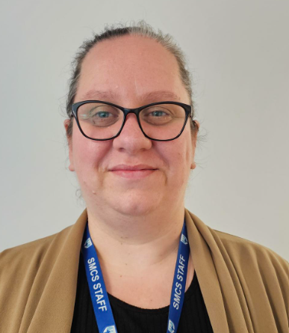
Welcome to St Michael’s Catholic School Sixth Form
I am delighted to welcome you to St Michael’s Catholic School. Sixth Form is a key part of our school and plays a vital role in the school as the example and leaders of our community.
It is my firm belief that education is a person’s passport to the life that they wish to lead and to the freedom of choice that they want to achieve. At St Michael’s all members of our community strive, day in, day out, to get the best not only out of others but of themselves. At the end of their time at Sixth Form, our students are equipped with the tools to allow them to realise their ambitions. Alongside academic progress, we nurture the spirit of our learners through the embodiment of our Catholic ethos and Mission to “Achieve in Faith with Love as a Community.
Sixth Form is a very important step on a student’s educational journey and we focus on our learners at every step leading to and beyond Sixth Form. Beginning in some cases at Reception and continuing all the way to GCSE, we work hard to unlock the best possible outcomes for the young people that we teach to enable them to continue their education with us. We know that the jump to post-16 education is a big one and our teaching staff will be there, every step of the way, to make certain that our learners thrive.
Our Catholic community provides many opportunities for Sixth Form students to grow beyond their academic development. St Michael’s provides a number of enrichment programmes to promote wider interest, Sixth Form games, allowing our students to learn key teamwork skills while providing a space for exercise and the Extended Project (EPQ) where students can unpick some of the bigger moral and philosophical ideas of life, using their own research.
I look forward to welcoming you to our Sixth Form Community.
Mrs Steph Kimsesiz
Head of Sixth Form
skimsesiz@stmichaelscs.org

Slide 3
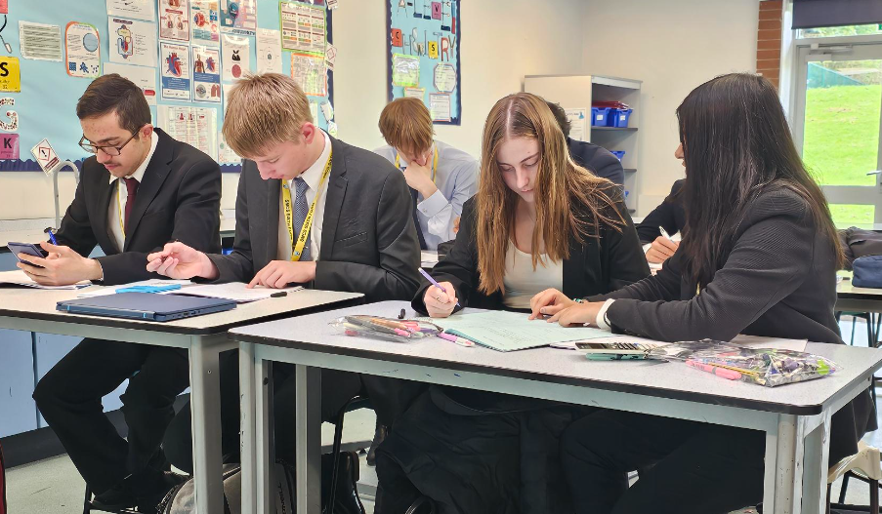
Our Sixth Form Intent
“To develop knowledgeable, socially conscious, critically literate young adults whose wealth of spirit gives them the moral confidence to be proactive citizens.”
As a member of Sixth Form, you will be expected to cherish and uphold the core values of our School Mission, Achieving in Faith with Love as a Community. Our mission challenges to work hard, to value learning, to understand that God is with you every step of the way and to show love towards all members of the community of St Michael.
We aim for our students to;
Be independent young adults with the necessary skills to organise their time in an efficacious and mature manner.
Be motivated to achieve their absolute best through hard work and perseverance, especially in times of difficulty.
Embrace and respect the specific Catholic charism and ethos of St Michaels and to grow spiritually throughout their time here.
Be active with the life of the school be that through charitable events, mentoring or leadership.
Leave St Michael’s with results that allow them to confidently move to their preferred next step.
Be a beacon of kindness within the context of our School Mission, to Achieve in Faith with Love as a Community
Be the absolute example to all lower school pupils, providing for them a roadmap to becoming successful young adults.
Be ambassadors for St Michael’s not only within the walls of the school but in the community.
Build positive relationships with all members of the St Michael’s community be they Student or Staff

Slide 4
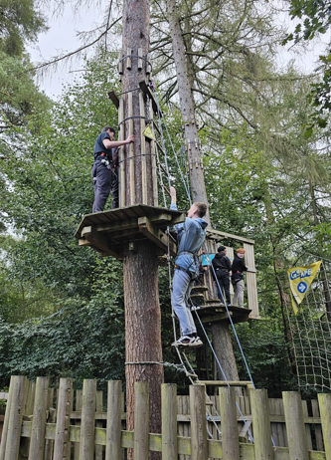
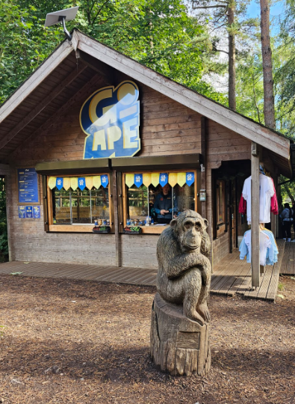
Opportunities for Growth
Sixth Form students must commit fully to our community and engage with the many further opportunities which we offer.
Alongside taught lessons, students have timetabled, directed and independent study time. We offer a broad range of enrichment opportunities ranging from academic to spiritual. All students will complete the Extended Project Qualification (EPQ). This is a project which is highly recognised by further education institutions and UCAS.
All Sixth Form students take part in Sixth Form P.E. A protected and timetabled session, running every week to give Students the opportunity to take exercise as well as further learning skills such as teamwork and communication. Exercise has the added benefit of having a positive impact on mental health.
At St Michael’s, each form will have a half-termly registration in the school Chapel for quiet and purposeful reflection. There are many further opportunities for Sixth Form enrichment through mentoring younger students, not only in the Secondary phase but at Primary also. In addition, there is a broad number of subject trips, university visits, careers fayres, talks and UCAS events that Students attend as part of our enrichment offer.

Slide 5
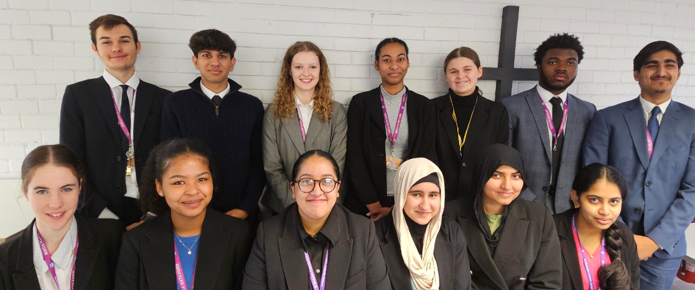
Sixth Form Leadership
We want our Sixth Form students to be the absolute example to every pupil in the school. We encourage them to have high aspirations for themselves and to inspire these aspiration in others.
Every step of the way, we instil the importance of leadership in our students. This teaches our Students to be confident in their decisions and builds in them a strength of spirit which can be taken anywhere. Students lead on Charity, Mentorship, Social Justice, behaviour, attendance, appearance and attitudes. Embedded within this ethos is our Student Leadership Team. These individuals applied for leadership positions, prepared a presentation, and took part in a vigorous interview process. I am proud to say that they are the embodiment of our School Mission and the values that we expect to see lived out in our Sixth Form community. The insights of our Sixth Form are valued and, on many occasions, meaningful change to the lived experience of our Students have been made in response. Student voice is routinely consulted within the Sixth Form as it is our belief that Sixth Form students should be active participants in their own lived experience while at St Michael’s.
With that said,
“Students conduct themselves well as young adults. They dress smartly and appear professional. They are proud to act as ambassadors for the school but are not afraid to ask questions and strive for improvement” (Ofsted, 2019)

Slide 6

Sixth Form Curriculum
St Michael’s offers a range of courses and enrichment opportunities, providing students with a breadth of choice to explore their passions.
A-Level
GCE A-Levels are a two year, Level 3 academic qualification. Students will sit exams at the end of their second year of study. Most A-Levels are purely linear exams at the end of the course but some have a coursework element. Our students will no longer sit AS levels at the end of Year 12. It is assumed that a great deal of the A-Level content is through extended study and independent learning, much like study in a higher education setting.
BTEC National Extended Certificate
The BTEC courses that we offer are an applied Level 3 qualification, equivalent to one A-Level. It is a vocational qualification encompassing a more practical approach to your studies. Two years of study must be completed to obtain accreditation. BTEC is as challenging as A-Level and equivalent in terms of UCAS points. The BTEC qualifications are assessed through a mixture of exams and coursework.
Extended Project
Recommended by leading employers and universities we are privileged to deliver The Extended Project Qualification (EPQ) as an enrichment to all our sixth form students. It is an 18 month (Level 3) study programme that provides an opportunity for you to pursue your own academic interests in a spiritual or ethical topic. You will undertake independent research and hone your dissertation writing skills, referencing and the opportunity to gain (up to) 24 UCAS points for your university applications and developing a range of independent research and presentation skills important for university study and the World of Work.
Core Maths
Core Maths is two year Level 3 qualification, equivalent to an AS- Level. It explores the application of Mathematical skills to a variety of industry-based contexts. It weaves together topics at GCSE level to other areas within A-Level study such as Psychology and Economics.

Slide 7
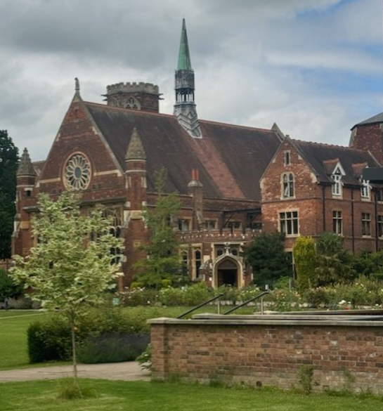
Sixth Form Curriculum
St Michael’s offers a range of courses and enrichment opportunities, providing students with a breadth of choice to explore their passions.
Sixth Form Games
At St Michael’s, we believe that it is our sacred responsibility to take care of our students academically, physically, emotionally and spiritually. Sixth Form Games gives space for students to take exercise and build good habits of teamwork and cooperation with the added benefit of having a very positive impact on mental health.
Sixth Form Work Experience
University and the World of Work are competitive and occasionally difficult to gain a foot hold in. St Michael’s recognises this and as such, all our Sixth Form students are put on work experience placements. These real-life opportunities provide greater depth for university applications and job applications alike. Work experience is completed at the end of year 12 once Pre-public Exams have finished.
The Scholar’s Programme
We nurture those with God given gifts and talents to excel in their education in while at St Michaels. The Scholar’s Programme is a bespoke range of experiences designed to stretch those who are our most ambitious students. St Michael’s sixth Form works closely with institutions such as The University of Oxford, The University of Cambridge, Royal Holloway and Eton College, to name a few. The opportunities focus the skills of our Scholars and allow them to seize the most coveted life opportunities there are.
Core RE
At St Michael’s, we believe that it is our sacred responsibility to take care of our students academically, physically, emotionally and spiritually. As a Catholic school 5% of a students timetable in sixth form will be Core RE. We follow Catholic teaching principles and deliver a diverse curriculum.

Slide 8
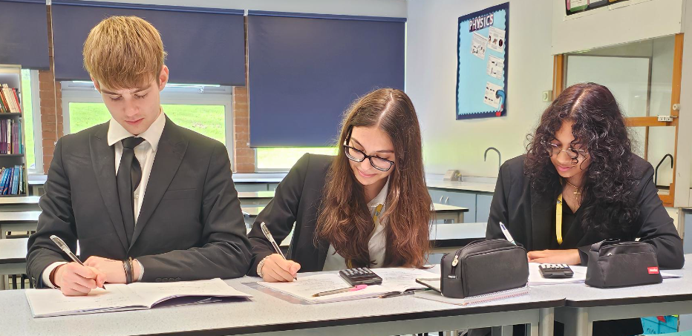
Choosing the Right Courses for You
Through the application and interview process, the Sixth Form team are here to help you make informed choices which suit you.
Already set on your A-levels for two years? Or struggling to decide? Choosing your subjects can be a tough decision and one worth taking time to research. At St Michael’s, we suggest that you consider:
What you enjoy as passion for the subject will drive you to work hard. It is what university admissions officers and employers alike are looking for in future candidates.
What you are good at as you will be able to build on the momentum carried through from a solid foundation of study at GCSE.
What your goal is and how best to reach it as there will be certain subjects and combinations of subjects that are requirements for further study, employment or apprenticeships.
How open you would like to keep your options. If you are not sure on your end goal, then it is often best to choose subjects that leave options open (i.e. facilitating subjects).
Furthermore, Which? University suggests six steps that will help you make a smart decision about which subjects to take at sixth form level:
1. Taking certain A-level subjects will open up more university course options
Your teachers or careers adviser may talk to you about facilitating subjects; but what are they exactly? Facilitating subjects are a handful of A-level subjects commonly asked for in universities’ entry requirements, regardless of the course you’re applying to this makes them a good choice to keep your degree options open. The facilitating subjects are: Biology, Chemistry & Physics, English, Geography, History
Mathematics and Modern and classical languages

Slide 9
Choosing the Right Courses for You
If you don’t know what you want to study at university, it can pay off later to take one or two of these. Be aware, some universities openly discourage students from taking certain combinations of A-level subjects, particularly when subjects are very similar like business studies and economics – something to bear in mind when you're making A-level choices. And as you’ll see below, some degree subjects or specific universities will ask for certain A-level subjects in their entry requirements.
A-levels are a lot tougher than GCSEs
  The reason you take a particular subject at A-level will come down to one (or more) of these three scenarios (usually):
  you need it to pursue a particular career
  it’s a subject you enjoy and are good at
  it’s a subject you’ve not studied before but you think will suit you
Either way, be prepared for a big jump in the level of difficulty when you transition from GCSE to A-level (or any other Advanced level qualification for that matter). You’ll also see differences in the way you’re taught and in what is expected of you.
Certain university courses will look for specific A-levels
This is really important if you have a particular degree in mind. You won’t be able to apply to some degree courses without having taken some specific A-levels (and scored the right grades in them too, of course). Below are a few examples to give you an idea of what to expect (some are no- brainers):
  Pharmacy must have: chemistry, plus at least one from biology, maths and physics
  English must have: usually English literature, maybe English literature and language or English language
  Geology / earth sciences must have: at least two from maths, physics, chemistry and biology
  Economics sometimes need: maths, very rarely do you need economics
Some courses and universities have lists of subjects they don’t accept
Particular courses – take, for instance, an architecture course at the University of Bath – will view certain A-levels as less effective preparation for university studies than others. Similarly, some universities – such as the University of Sheffield – actually list which A-level subjects they prefer.
Others, like the London School of Economics and Political Science (LSE), have ‘non-preferred’ subject lists. If your subject choices don’t match up, you shouldn’t necessarily discount the course, or be put off from taking a creative or vocational A-level subject you’re really interested in. Just make sure you're satisfying any entry requirements with the other A-level subjects you're taking. Taking a subject such as history of art, classical civilisation, economics, geology, government and politics, law, media studies, philosophy, psychology, religious studies and sociology in conjunction with at least one (ideally two) of the facilitating subjects listed above shouldn’t be an issue, if you get the grades.

Slide 10
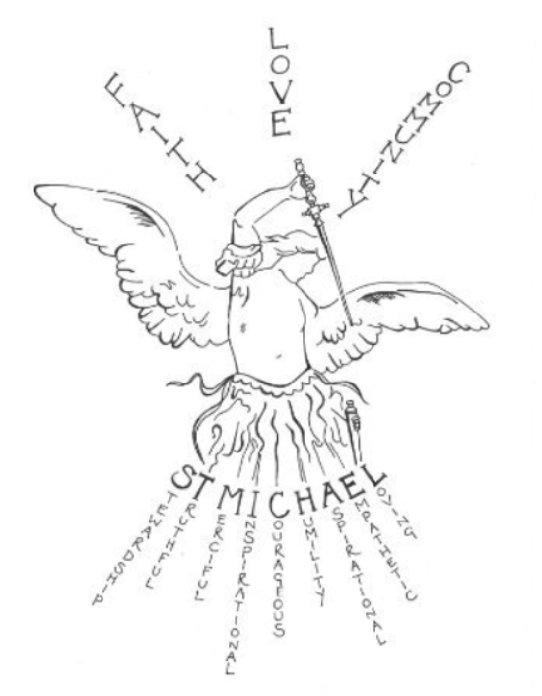
Choosing the Right Courses for You
Through the application and interview process, the Sixth Form team are here to help you make informed choices which suit you.
Know myth from reality
Don’t take everything you hear at face value or based on what a friend/older sibling etc. says – the reality might be quite different. It's always worth investigating things yourself so you get the full picture. While entry requirements are often a minimum set of criteria you have to meet, a university may view you differently from another candidate based on your personal statement or your portfolio if your predicted grades just miss the mark. Don't rely on preconceived assumptions or what you hear through someone else from their experience. Double- check your facts with the university or department themselves.
Many universities and courses will consider you whatever you choose
Question: Accountancy, anthropology, archaeology, banking, business studies, classical civilisations, hospitality, information science, law, management, marketing, media studies, philosophy, politics, psychology, public relations, religious studies/theology, retail management, social work, sociology, surveying, television, travel and tourism…
What do these subjects have in common? Answer: They will all consider a very wide range of A-level choices and do not normally have essential subject requirements! So don't get too bogged down in essential A-levels you have to take.
(Accessed 27.08.23 - https://university.which.co.uk/advice/a-level- choices/six-things-you-need-to-know-before-making-your-a-level- choices)

Slide 11
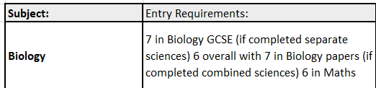
Sixth Form Entry Requirements
Our aim is to ensure that you are on a study programme that best supports your future career goals and learning aims to ensure the greatest success in your Sixth Form study.
Our Sixth Form minimum entry requirement is five grade 4s including English and Maths. All students must have at least five grade 4+ at GCSE to be able to access level 3 courses.
Once you have reached the minimum requirement, each subject has its own entry requirement. All courses run on the basis of popularity and space within that individual subject.
Each student will study PSHE, Core RE, EPQ and School games alongside their 3 chosen A Levels.

Slide 12
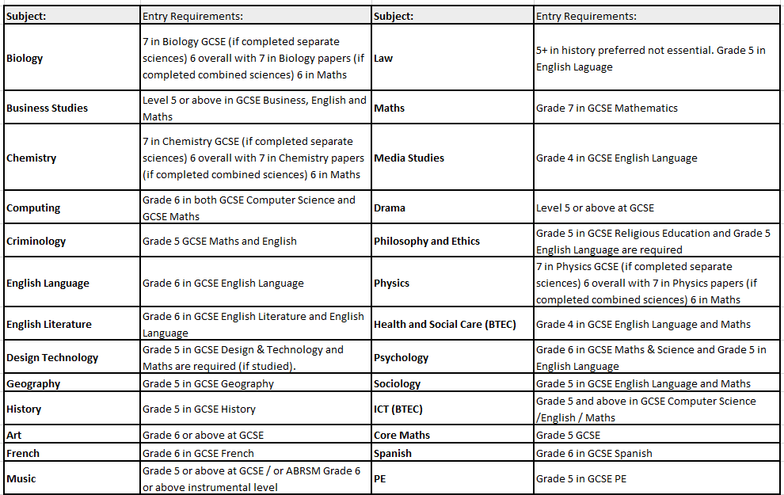
Sixth Form Entry Requirements
Our aim is to ensure that you are on a study programme that best supports your future career goals and learning aims to ensure the greatest success in your Sixth Form study.

Slide 13
Provisional Sixth Form Blocks
Our aim is to ensure that you are on a study programme that best supports your future career goals and learning aims to ensure the greatest success in your Sixth Form study.
Each student will study PSHE, Core RE, EPQ and School games alongside their 3 chosen A Levels.
Students should select 3 subjects – one from each block A-D (this would mean 1 block should be blank)
If students need to resit GCSE English or GCSE Maths they will be selected in Block E (enrichment) If a student is interested in Core Maths this should also be indicated in Block E.
Block A | Block B | Block C | Block D | Block E
Art, Craft and Design | Biology | Business Studies | Criminology | Core Maths
Chemistry | Computer Science | English Language | Maths | Resit English
History | Drama | Geography | Music | Resit Maths
Media Studies | English Literature | Law | Philosophy & Ethics
Physical Education | ICT BTEC | Physics | Psychology
Psychology | Product Design | Criminology | Spanish
Business Studies | Sociology | Biology | French
Health & Social Care BTEC | Travel & Tourism BTEC |  | A Level Theatre Studies
 | BTEC Performing Arts

Slide 14
Applying to St Michael’s Sixth From
“I am proud to be the head of such a vibrant and diverse Sixth Form Community. We are a Sixth Form of high and unwavering standards of teaching, conduct and spiritual growth. Here at St Michael’s we will develop the whole learner, body, mind and soul”
(Mrs Kimsesiz, Head of Sixth Form)
Thank you for your interest in St Michael’s Catholic School. We are delighted that you are considering a place with us.
Sixth Form admissions are open for September 2025 to current members of our community and to applicants from other schools.
Next Steps: Application Form Link https://forms.office.com/e/yTUzE3Q1ap
Complete an application form before the deadline on 24th January 2025
We will contact you to arrange an interview, at this point you can discuss the courses you have chosen
If you are successful, you will be given a conditional offer which you can accept once you receive your GCSEs.
We will use the email addresses provided on the application form to communicate with external applicants.
If you have any questions let us know on skimsesiz@stmichaelscs.org
Mrs Steph Kimsesiz, Head of Sixth Form

Slide 15


St Michael’s Catholic School
Daws Hill Lane, High Wycombe
HP11 1PW
(01494 535196)
www.stmichaels.bucks.sch.uk

