Slide 1


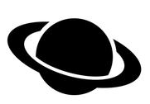

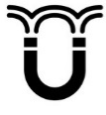

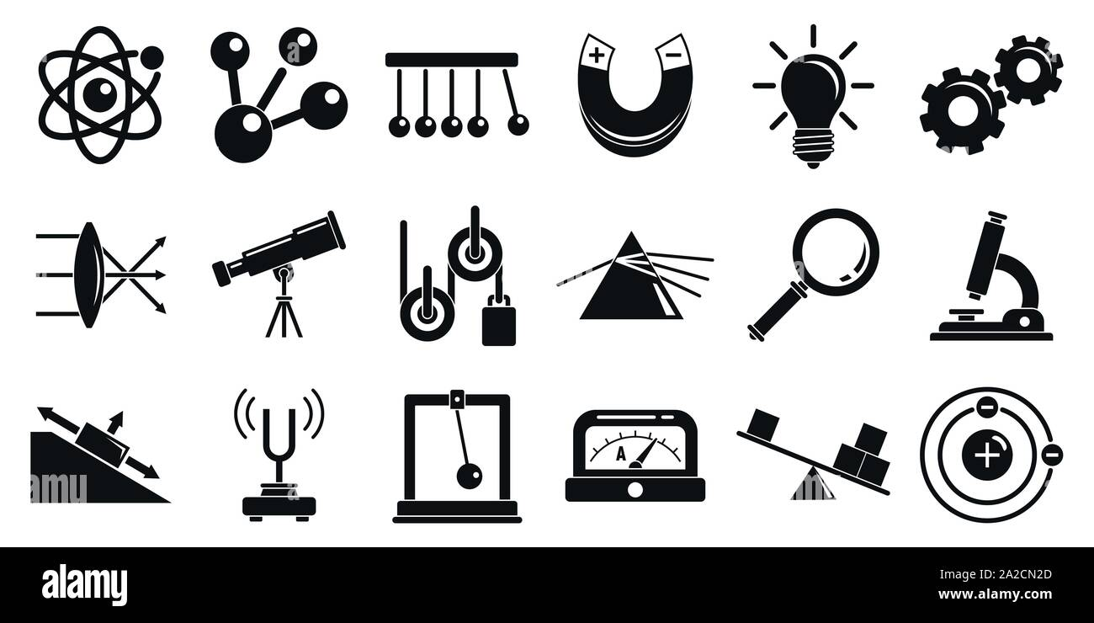


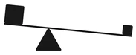
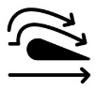


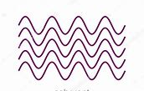


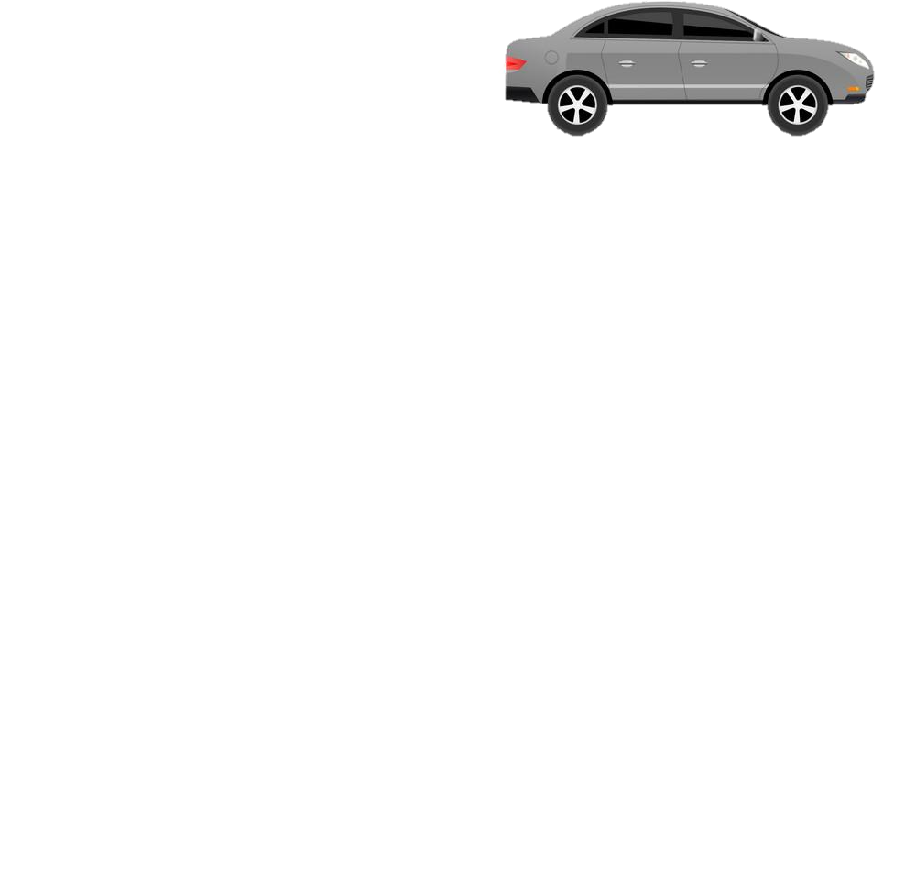


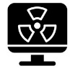

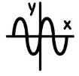
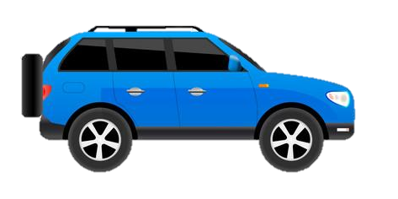
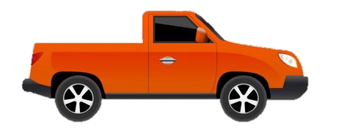



GCSE Physics Learning Journey
St Michael’s Catholic School
PIN BANK
Simply drag a pin to add it to your journey
End of course revision and exams
Planets, satellites and orbits
Star Lifecyle
P16: Space
Motor and generator effect
P15: Electromagnetism
Lenses
Colour
Refraction of light
A level Sciences – Biology, Chemistry and Physics​
Apprenticeships​
BTEC Level 3
P14: Light
Uses for electromagnetic waves
Beginning and future of the universe
Solar system formation
Transformers
Magnetic fields
RP9: Reflection and refraction of light
Infrared
Electromagnets and electromagnetic induction
P13: Electromagnetic waves
RP10: Absorption and emission of IR radiation
Speed and distance -time graphs
RP6: Force and extension
RP7: Force and acceleration
Impact forces and car safety
Electromagnetic spectrum
Velocity and acceleration
Momentum
P11: Force and pressure
P12: Waves properties
Seismic waves
P9: Motion
Sound waves and their use
RP8: measuring waves in a liquid and solid
HEADING
Centre of mass
Velocity-time graphs
P10: Force and motion
Reflection and refraction
  Resolution of forces
Weight and terminal velocity
Forces and breaking
Wave properties
Pressure
and
surfaces
Atmospheric pressure
Up thrust and floatation
What am I learning:
Resultant forces
Moments
Gas temperature, pressure and volume
Atmospheric pressure
RP5: Density
Nuclear fission
Half lives
Uses for radiation
P7: Radioactivity
Internal energy and latent heat
Vectors and scalars
Year 11
States of matter
P8: Forces in balance
P6: Molecules and matter
Nuclear fusion
Alpha, Beta and Gamma radiation
Atoms and radiation
The national grid
Alternating current
Appliances, cables and plugs
RP2: Heating and insulation
P3: Energy resources
Energy resources
P4: Electric circuits
Current and charge
Potential difference
Static
P5: Electricity in the home
Energy demands
Energy and the environment
Modelling circuits
RP3: Resistance
RP4: Component characteristics.
Heating and insulating buildings
RP1: Specific heat capacity
P2: Energy transfers by heating
Work and power
Conservation and dissipation
P1: Conservation and dissipation of energy
CAR PARK
Why not
Physics
Specific heat capacity
Energy and efficiency
Infra Red radiation
Conduction
Energy stores and pathways
Department Intent: To enable students to make evidence based, ethical and moral decisions so they can develop their scientific knowledge and skills

