Slide 1




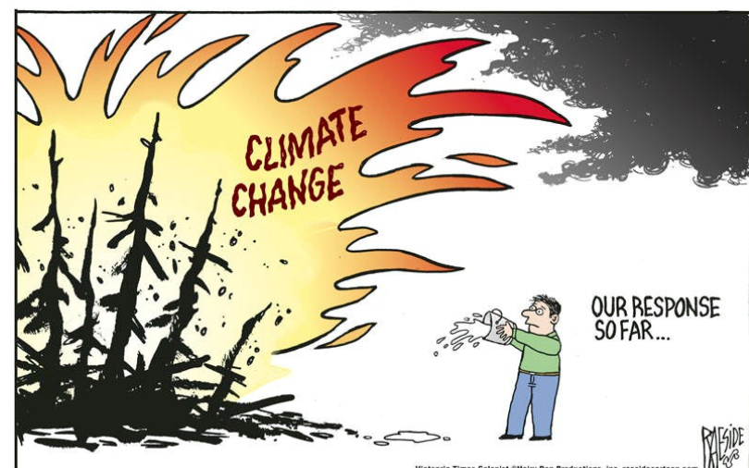



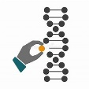







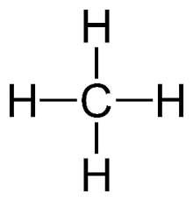
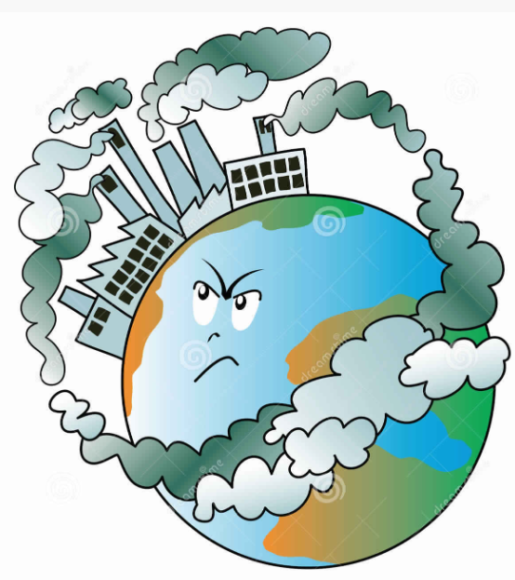



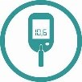













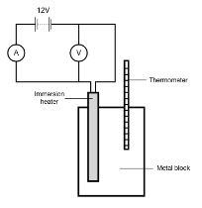


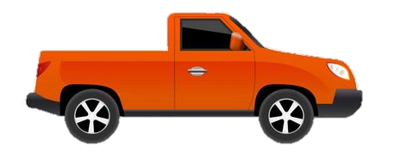



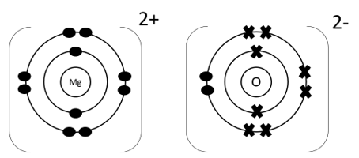

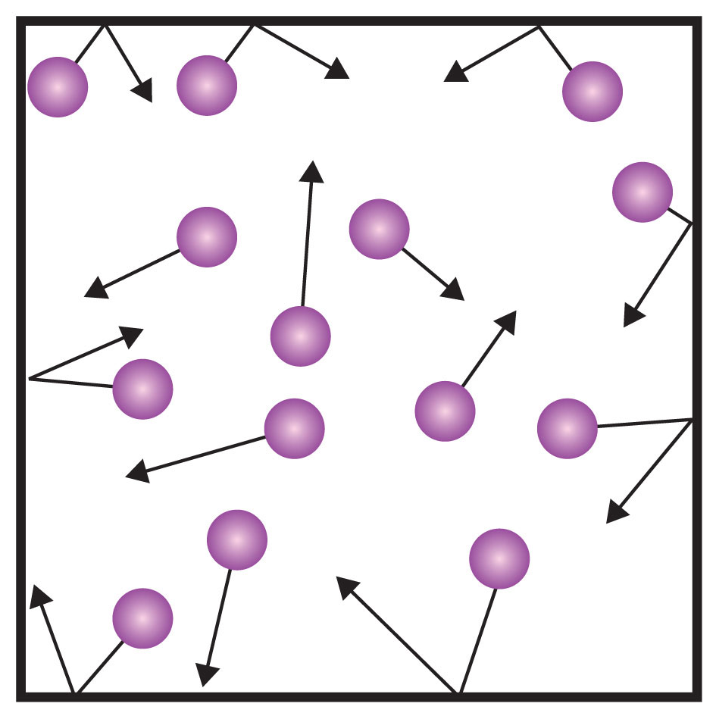

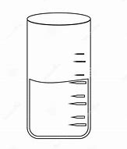

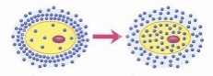
KS4 Trilogy Chemistry Learning Journey
St Michael’s Catholic School
PIN BANK
Simply drag a pin to add it to your journey
A level Sciences – Biology, Chemistry and Physics​
Apprenticeships​
BTEC Level 3
End of course revision and exams
Material recycling
Life cycle assessments
Extracting metals
From ores
The Earths atmosphere
RP: Water purification and
analysis
Selective breeding
Treating waste
water
RP: Calculating Rf values
C11 The Earth’s atmosphere
Global climate change
Water safe
to drink
Water cycle
C 10 Chemical analysis
Analysing chromatograms
Finite and
renewable
resources
HEADING
Pure substances
And mixtures
Testing for gases
History of our atmosphere
Our evolving atmosphere
Greenhouse gases
Atmospheric pollutants
C 12 The Earth’s
resources
Ecosystems
Cracking hydrocarbons
Burning hydrocarbon fuels
What am I learning:
Fractional distillation
RP Rate of reaction
Factors affecting rate of reaction:
Surface area, temperature, catalysts, concentration
Reaction profiles
RP: Investigating temperature changes
Hydrocarbons
Year 11
C7 Energy changes
RP9: Chromatography
Dynamic equilibrium and altering conditions
Rate of reaction
and collision
theory
Bond energy calculations
Exothermic, endothermic reactions
RP: Electrolysis
C9 Crude oils and fuels
Reversible reactions and their energy
C8 Rates and equilibrium
C6 Electrolysis
Extraction of aluminium
Covalent bonding and structure of simple molecules
Relative mases and moles
Equations and calculations
C5 Chemical changes
Salt from metals and from insoluble bases
Electrolysis
Of aqueous solutions
Expressing concentrations
Extracting
metals
Neutralisation and pH scale
Strong and
weak acids
Electrolysis of molten compounds
Ionic bonding and giant ionic structures
Introduction to electrolysis and changes at the electrodes
Giant covalent structures, fullerenes and graphene
Metallic bonding and giant metallic structures
C4 Chemical calculations
From mases to balanced equations
Reactivity series;
displacement reactions
RP: Making salts
Atoms and ions
Fractional distillation and paper chromatography
CAR PARK
Group 1 Alkali
Development of
periodic table
Structure of the atom
Atoms and Chemical equations
Electronic structure
Why not
Chemistry
C3 Structure and binding
Group 7 Halogens
Electronic structure
and PT
C2 Periodic table
Atoms and isotopes
History of the atom
Separating
mixtures
C1 Atomic structure
RP4: Osmosis
Department Intent: To enable students to make evidence based, ethical and moral decisions so they can develop their scientific knowledge and skills
RP2: Specific heat capacity

