Slide 1


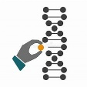


















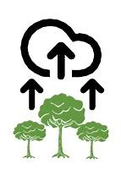



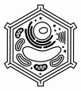

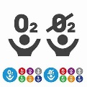
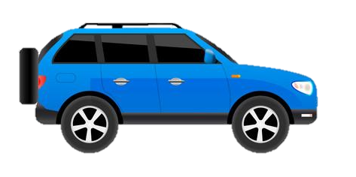
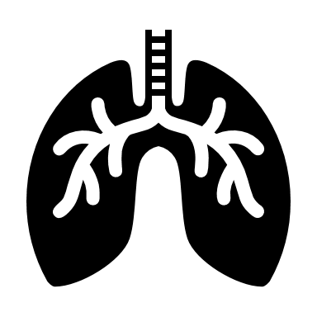
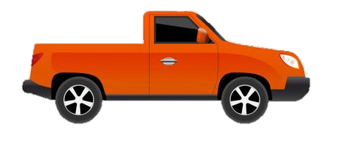

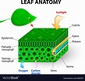


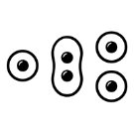
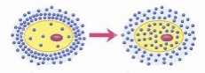


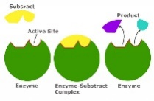

KS4 Trilogy Biology Learning Journey
St Michael’s Catholic School
PIN BANK
Simply drag a pin to add it to your journey
A level Sciences – Biology, Chemistry and Physics
Apprenticeships
BTEC Level 3
End of course revision and exams.
Genetic engineering
Natural selection and Evolution
Variation and Classification
Ethics of genetic technology
Selective breeding
B13-14 Variation, evolution and genetics
Inheritance
Gene expression
and mutations
B10 Nervous system
RP 6: Reaction time
B11 Hormonal coordination
Blood glucose and diabetes
B12 Reproduction
Year 11
DNA and
the genome
Reflex arc
Types of reproduction
Reproduction, menstrual cycle, controlling fertility and fertility
Global warming and biodiversity Land, air, water pollution
Negative
feedback
Meiosis
Material recycling and carbon cycle
Adaptation
Ecosystems
Diabetes
Heart disease
B7 non communicable disease
Defence responses and vaccination
B6: Preventing, treating
and treating disease
Feeding relationships
Plant defences
RP7: Measuring population sizes
Human defences
Competition
B15-17 Ecology
Cancer
and carcinogens
Smoking
Drugs and clinical trials
Antibiotics and painkillers
Viral,
bacterial,
fungal
diseases
Plant cells, tissues and organs
Photosynthesis and factors affecting it
RP5:light intensity and Photosynthesis
Health and disease
Preventing
bacterial growth
and infections
The heart
Transpiration
Aerobic
Respiration
Exchange surfaces
B5: Communicable diseases
B8 : Retrieval test
Breathing
B8: Photosynthesis
B9: Respiration
Blood and blood vessels
B4:Organising animals and plants
How plants use photosynthesis
Anaerobic respiration
Liver
metabolism
RP4 : Food tests
Plant and animal cells
CAR PARK
Structure of the digestive system
B2:Cell division
RP2 : Osmosis
RP1 : Looking at cells
B1:Retrieval test
Why not
RP3 : Enzyme activity
Biology
B3:Revision
B2:Revision
Food chemistry: enzymes
B3:Organisation and the digestive system
Microscopes
B1: Cell struture and transport
Stem cells
Growth and differentiation
Movement
In Cells: Diffusion, osmosis,
active transport.
Department Intent: To enable students to make evidence based, ethical and moral decisions so they can develop their scientific knowledge and skills
B1:Revision

