Slide 1

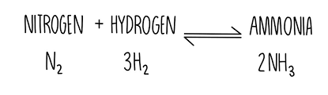




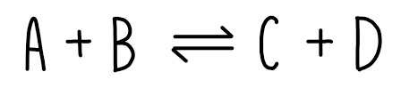
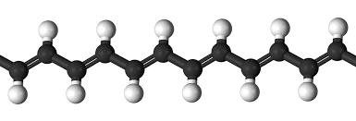
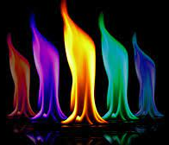
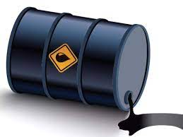
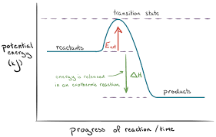

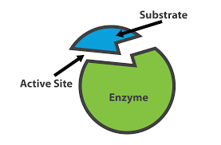
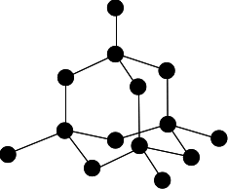






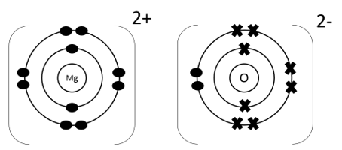
GCSE Chemistry Learning Journey
St Michael’s Catholic School
PIN BANK
Simply drag a pin to add it to your journey
Making fertilizers & the Haber process
Properties of polymers, glass, ceramics & composites
Life cycle assessments & using resources sustainably
HT: Extracting metals from ores
A level Sciences – Biology, Chemistry and Physics​
Apprenticeships​
BTEC Level 3
End of course revision and exams
Making potable water & treating waste water
Greenhouse gasses, global climate change & atmospheric pollutants
RP: Water purification and
analysis
Rusting, metals & alloys
Finite & renewable resources
C13-15: The Earth’s atmosphere, resources & using resources
History of our evolving atmosphere
HT: altering conditions and effect on equilibria
RP: Rate of reaction
Structure & reactions of alkenes
Structure & uses of carboxylic acids & esters
HT: Condensation polymerisation
RP: Calculating Rf values
C11: Polymers
C12: Chemical Analysis
Tests for gases
Reversible reactions & equilibria
RP: Chemical test on ions
HEADING
Changing rates of reaction
HT: finding rate of reaction from a graph
C10: Organic Reactions
Structure & reactions of alcohols
Addition polymerisation
Natural polymers & DNA
Pure substances, mixtures & formulations
Chromatography, analysing chromatograms & instrumental analysis
Tests for positive & negative ions
What am I learning:
Collision theory
Exothermic & endothermic reactions & profiles
RP: Electrolysis
Neutralisation, making salts, the pH scale & strength of acids
C8: Rates of Reaction
Cracking hydrocarbons
C9: Crude Oil & Fuels
C7: Energy Changes
Electrolysis of molten ionic compounds
C6: Electrolysis
Year 11
HT: Ionic equations to explain a reaction
Complete & incomplete combustion of hydrocarbons
Properties of hydrocarbons & fractional distillation
HT: Bond energy
Chemical cells, batteries & fuel cells
Extraction of aluminium using electrolysis
Electrolysis of aqueous solutions
RP: Making Salts
Reactivity series of metals & displacement reactions to extract metals
RP: Investigating temperature changes
Atoms into ions
Covalent bonding and properties of covalent compounds
C4: Chemical Calculations
Expressing concentration
Atom economy & % yield
C5: Chemical changes
C3: Structure & Bonding
Nanoparticles & their applications
Titrations
Group 7 Halogens
HT: Volume of gasses
Group 1 Alkali
Ionic bonding & properties of ionic compounds
Metallic bonding & properties of metallic compounds
Relative masses and moles
HT: Moles from masses, equations & calculations
HT: Titration calculations
RP: Titrations
Structure of the atom
Fractional distillation and paper chromatography
Atoms and Chemical equations
C1: Atomic structure
CAR PARK
Electronic structure
and groups
C2: The Periodic Table
Why not
Chemistry
Development of
periodic table
Electronic structure
Atoms and isotopes
History of the atom
Separating
mixtures
Department Intent: To enable students to make evidence based, ethical and moral decisions so they can develop their scientific knowledge and skills

