Slide 1



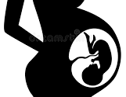
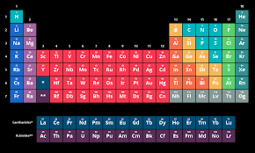



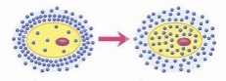
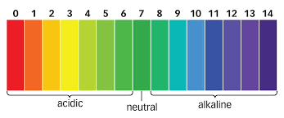
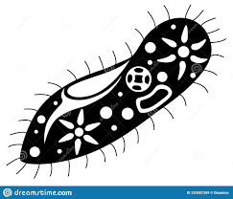
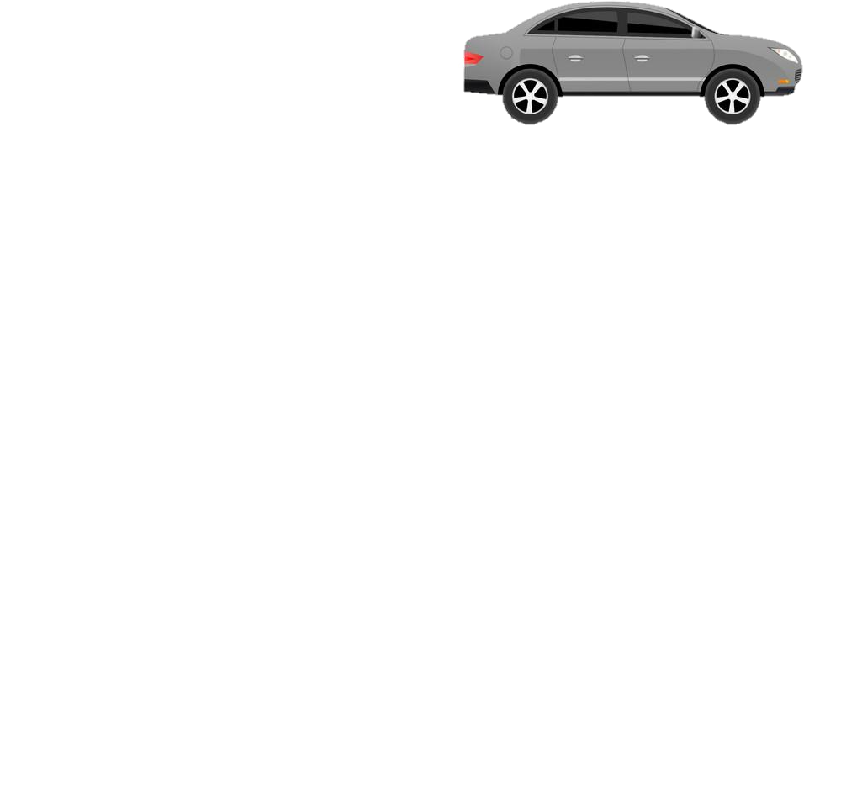

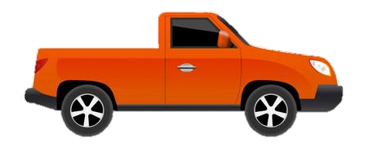

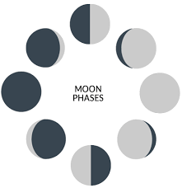
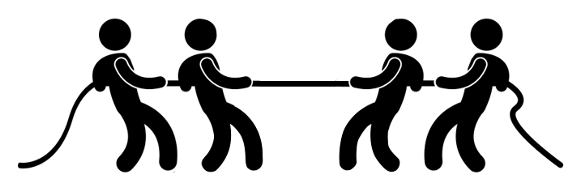
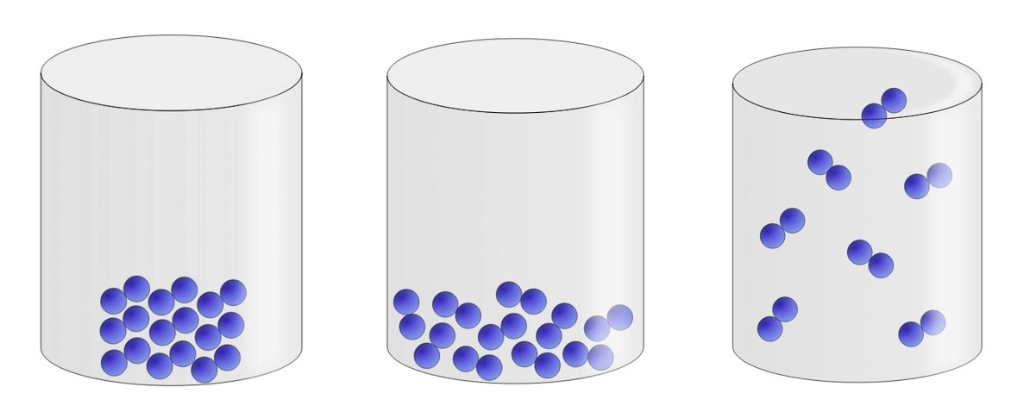


Year 7 LEARNING JOURNEY
St Michael’s Catholic School
PIN BANK
Simply drag a pin to add it to your journey
Plant reproduction project
Earth Structure and rock cycle project
Review
Plant reproduction
Year 8
The red box:
These road work boxes can be used to highlight a particular task, or link parts of the journey to the national curriculum.
Just copy and paste when needed and drag to map position, editing position of pin if necessary. Type over this text.
Earth
Assessment:
Retrieval quiz & 6 mark question
Variation & Adapting to change
Ecosystems & competition
Human reproduction
Neutralisation& Making salts
Variation & interdependence
Human Reproduction
Adolescence & Puberty
HEADING
Strong & weak acids
Food chains & webs
The menstrual cycle
What am I learning:
Chemical reactions
Properties of Metals & non-metals
Movement & The Skeleton
Movement of substances
Chemical reactions of metals & non-metals
Metals & Non- metals, acids & alkalis
Plant, animal and specialised cells
Inside particles & the periodic table
Acids & Alkalis & the pH scale
Levels of Organisation
Unicellular organisms
Observing cells
Cells & Movement
Energy transfers and dissipation
Pure substances & mixtures
Separation Techniques (filtration, evaporation, distillation, chromatography).
Diffusion
The Particle Model & Separating Mixtures
Power
States of matter & the particle model changes of state
Changes of state
Solutions & solubility
Energy resources
Solar system and The Night Sky, Phases of the Moon and Seasons project
CAR PARK
Gravity
Working scientifically skills
Why not
Energy costs and energy transfer
Speed and Gravity
Starting Science and Enquiry Process 1
Food and fuels
Assessment:
Retrieval quiz & 6 mark question
Speed, Distance & Time
Balanced & Unbalanced Forces
Lab safety and equipment
Department Intent: To enable students to make evidence based, ethical and moral decisions so they can develop their scientific knowledge and skills

