Slide 1


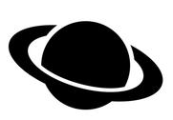

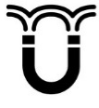

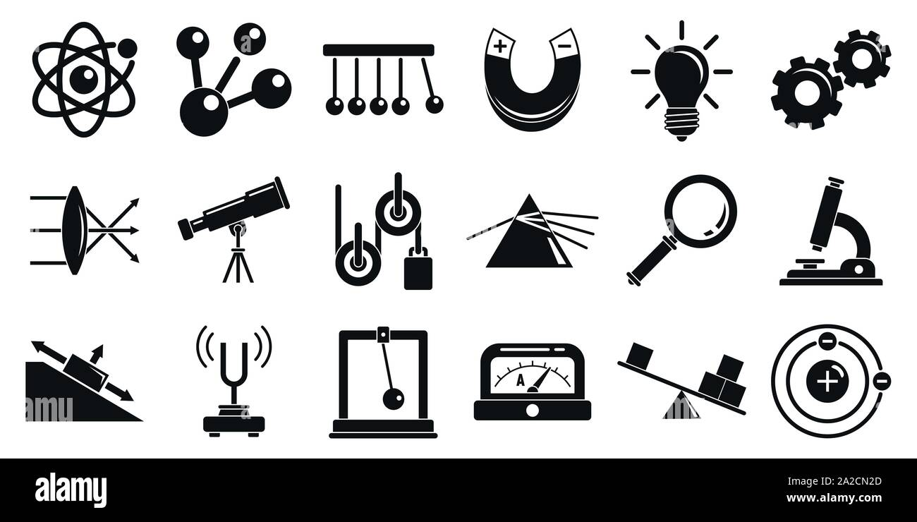


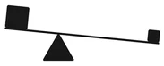
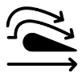


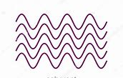




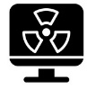
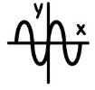

GCSE Physics Learning Journey
St Michael’s Catholic School
Triple only content highlighted in yellow
End of course revision and exams
Planets, satellites and orbits
Star Lifecyle
P16: Space
Motor and generator effect
P15: Electromagnetism
Lenses
Colour
Refraction of light
A level Sciences – Biology, Chemistry and Physics​
Apprenticeships​
BTEC Level 3
P14: Light
Uses for electromagnetic waves
Beginning and future of the universe
Solar system formation
Transformers
Magnetic fields
RP9: Reflection and refraction of light
Infrared
Electromagnets and electromagnetic induction
P13: Electromagnetic waves
RP10: Absorption and emission of IR radiation
Speed and distance -time graphs
RP6: Force and extension
RP7: Force and acceleration
Impact forces and car safety
Electromagnetic spectrum
Velocity and acceleration
Momentum
P11: Force and pressure
P12: Waves properties
Seismic waves
P9: Motion
Sound waves and their use
RP8: measuring waves in a liquid and solid
Centre of mass
Velocity-time graphs
P10: Force and motion
Reflection and refraction
Resolution of forces
Weight and terminal velocity
Forces and breaking
Wave properties
Pressure
and
surfaces
Atmospheric pressure
Up thrust and floatation
Resultant forces
Moments
Gas temperature, pressure
RP5: Density
Nuclear fission
Half lives
Uses for radiation
P7: Radioactivity
Gas pressure and volume
Internal energy and latent heat
Vectors and scalars
Year 11
States of matter
P8: Forces in balance
P6: Molecules and matter
Nuclear fusion
Alpha, Beta and Gamma radiation
Atoms and radiation
The national grid
Alternating current
Appliances, cables and plugs
RP2: Heating and insulation
P3: Energy resources
Energy resources
P4: Electric circuits
Static
Current and charge
Potential difference
P5: Electricity in the home
Energy demands
Energy and the environment
Modelling circuits
RP3: Resistance
RP4: Component characteristics.
Heating and insulating buildings
RP1: Specific heat capacity
P2: Energy transfers by heating
Work and power
Conservation and dissipation
P1: Conservation and dissipation of energy
Physics
Specific heat capacity
Energy and efficiency
Infra Red radiation
Conduction
Energy stores and pathways
Department Intent: To enable students to make evidence based, ethical and moral decisions so they can develop their scientific knowledge and skills

