Slide 1







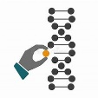

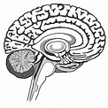



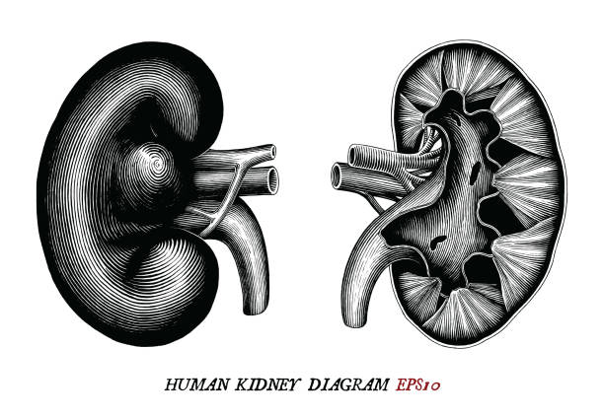

















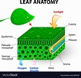



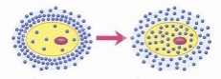

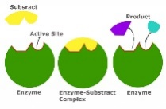

GCSE Biology Learning Journey
St Michael’s Catholic School
PIN BANK
Simply drag a pin to add it to your journey
Triple only content highlighted in yellow
B 15: Genetics and evolution
Cloning and
ethics of it
End of course revision and exams
Genetic engineering
A level Sciences – Biology, Chemistry and Physics​
Apprenticeships​
BTEC Level 3)
Evolution and speciation
Selective breeding
Inheritance
Evolution
Darwin and fossils
The history of genetics
Classification
B14: Variation and evolution
RP: Reaction time
Blood glucose and diabetes
Reproduction, menstrual cycle, controlling fertility and fertility
DNA and
the genome
B10: Nervous system
The brain
B11: Hormonal coordination
B12: Homeostasis
B13: Reproduction
Gene expression
and mutations
Year 11
Homeostasis
The eye and
visual problems
Plant
hormones
Kidneys and
waste products
Types of reproduction
Sustainable food production and Biotechnologies
Reflex arc
Negative
feedback
Thermoregulation
RP: Phototropism
Defence responses and vaccination
Land, air, water pollution
Adaptation
Ecosystems
Diabetes
B7: Non communicable diseases
Monoclonal
antibodies
B6: Preventing, and treating diseases
Heart disease
:
Plant defences
RP: Measuring population sizes
Human defences
B16-18: Ecology
Cancer
and carcinogens
Smoking
Non-communicable disease
Drugs and clinical trials
Antibiotics and painkillers
Viral,
bacterial,
fungal
diseases
Competition
RP: temperature and decay
RP: Microbiology
Plant cells, tissues and organs
Transpiration
Photosynthesis and factors affecting it
RP: Photosynthesis
Preventing
bacterial growth
and infections
The heart
Aerobic
Respiration
Health and disease
Exchange surfaces
Breathing
B5: Communicable diseases
Blood and blood vessels
B8: Photosynthesis
B9: Respiration
Liver
metabolism
B4:Organising animals and plants
How plants use photosynthesis
Anaerobic respiration
RP : Food tests
Structure of the digestive system
B2:Cell division
RP : Looking at cells
Plant and animal cells
RP: Osmosis
RP : Enzyme activity
Biology
Food chemistry: enzymes
B3:Organisation and the digestive system
Stem cells
Growth and differentiation
Movement
in
Cells: Diffusion, osmosis,
active transport.
Microscopes
B1: Cell structure and transport
Department Intent: To enable students to make evidence based, ethical and moral decisions so they can develop their scientific knowledge and skills

