Slide 1




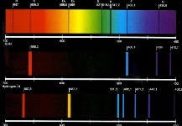


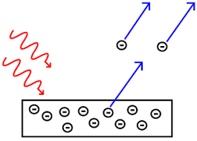
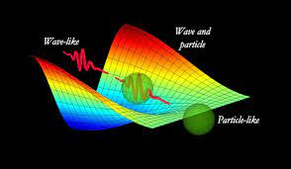
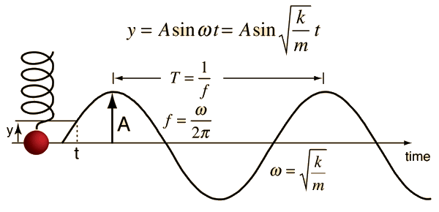
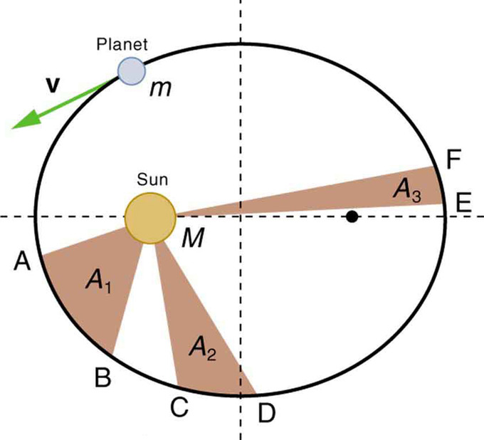

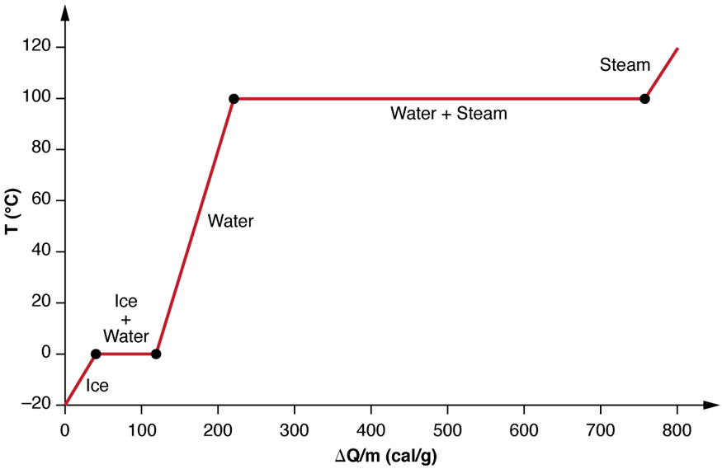
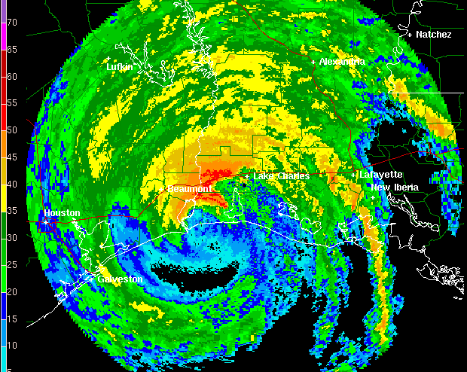
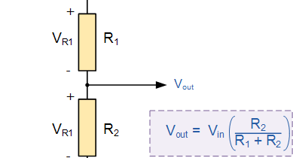
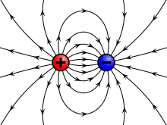
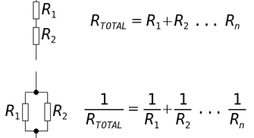

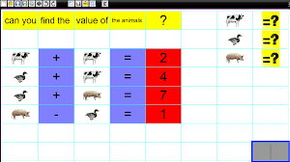
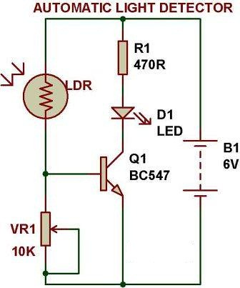
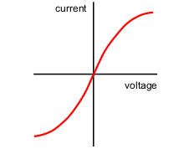
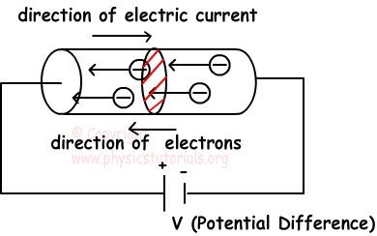
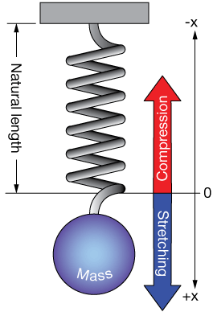
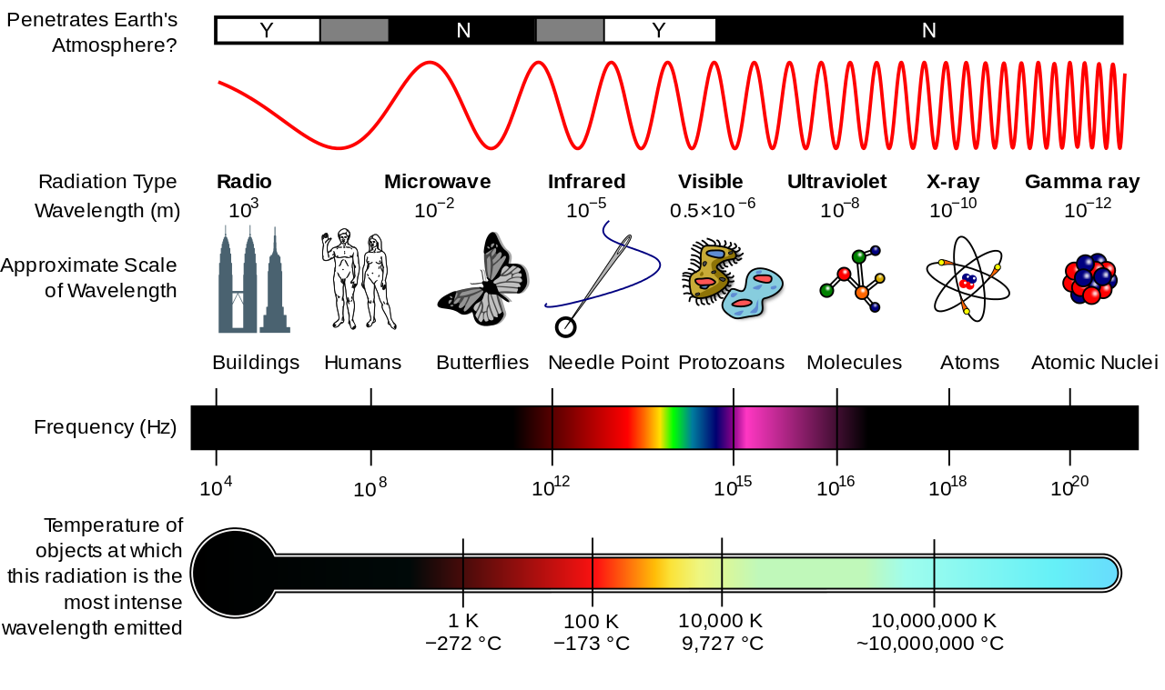
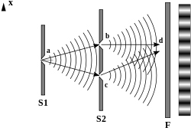
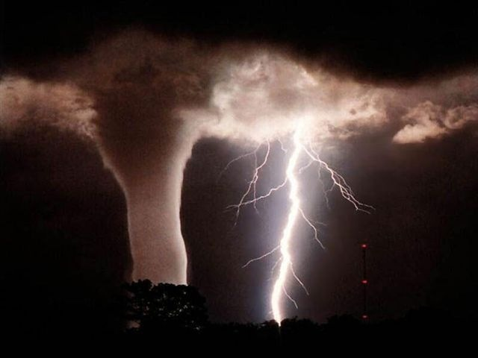
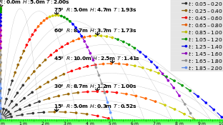
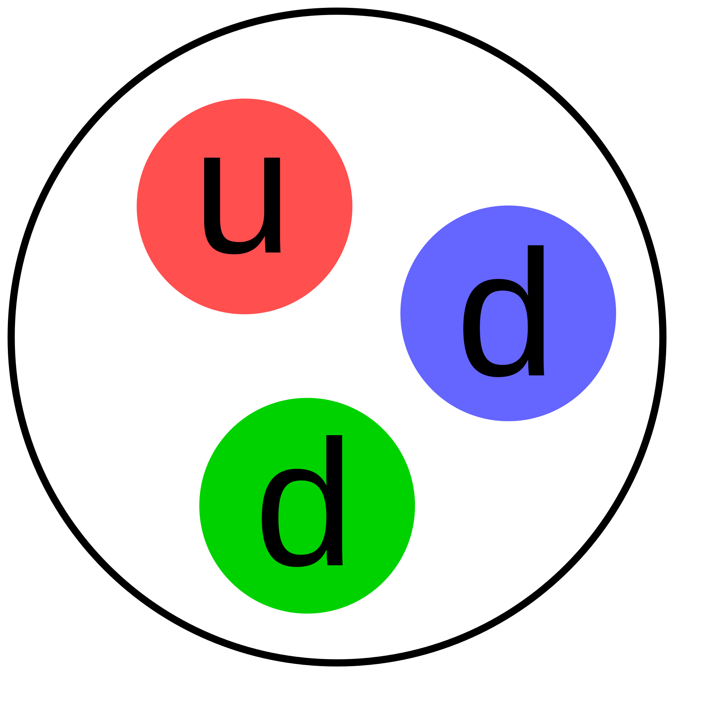
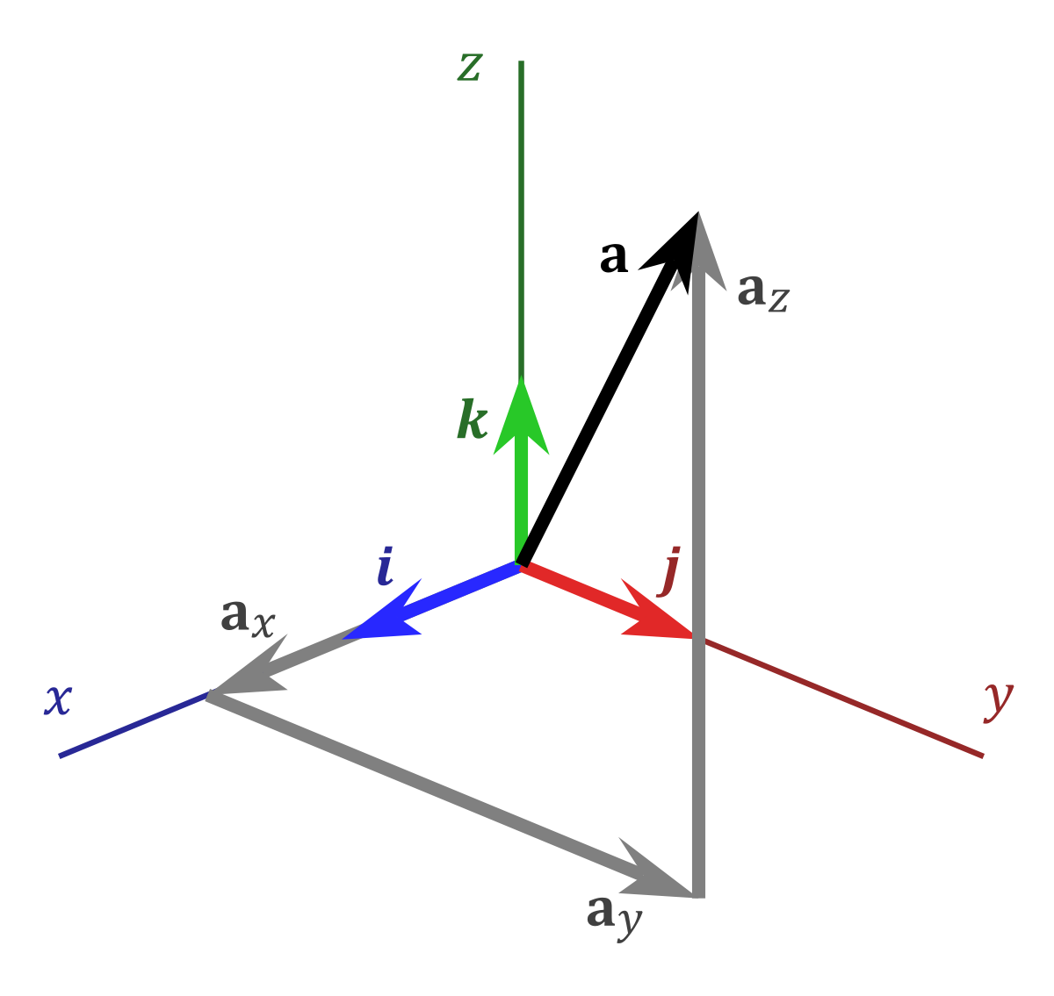
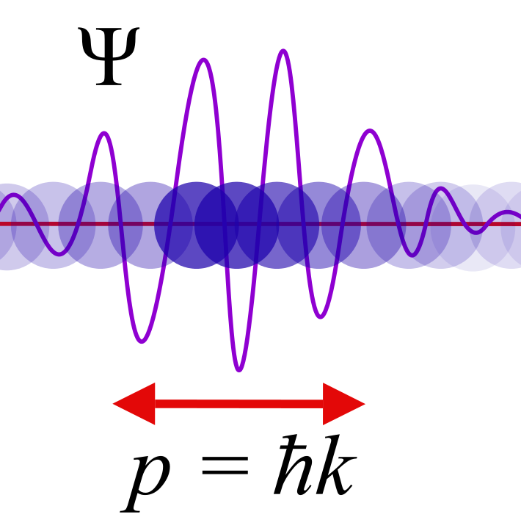
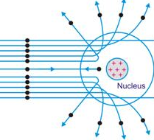
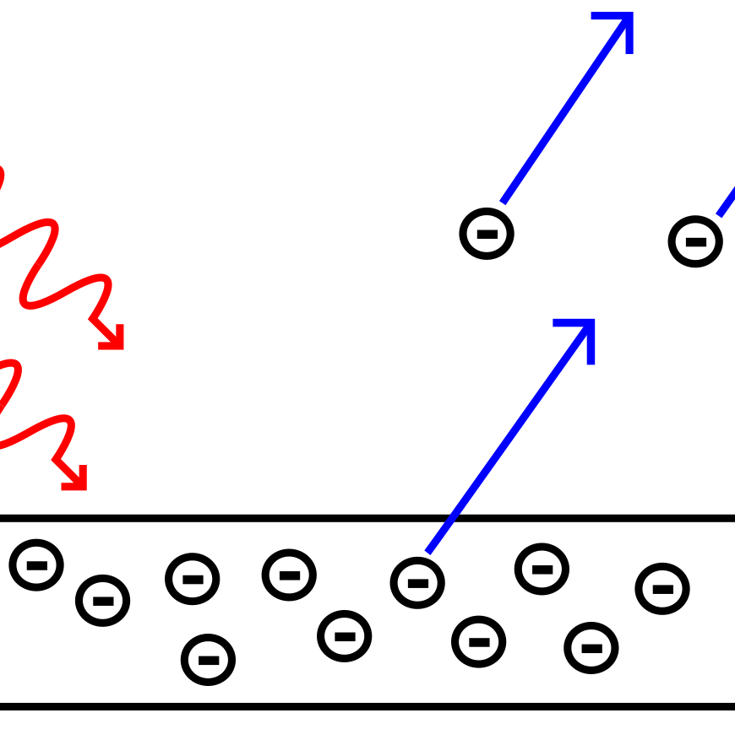

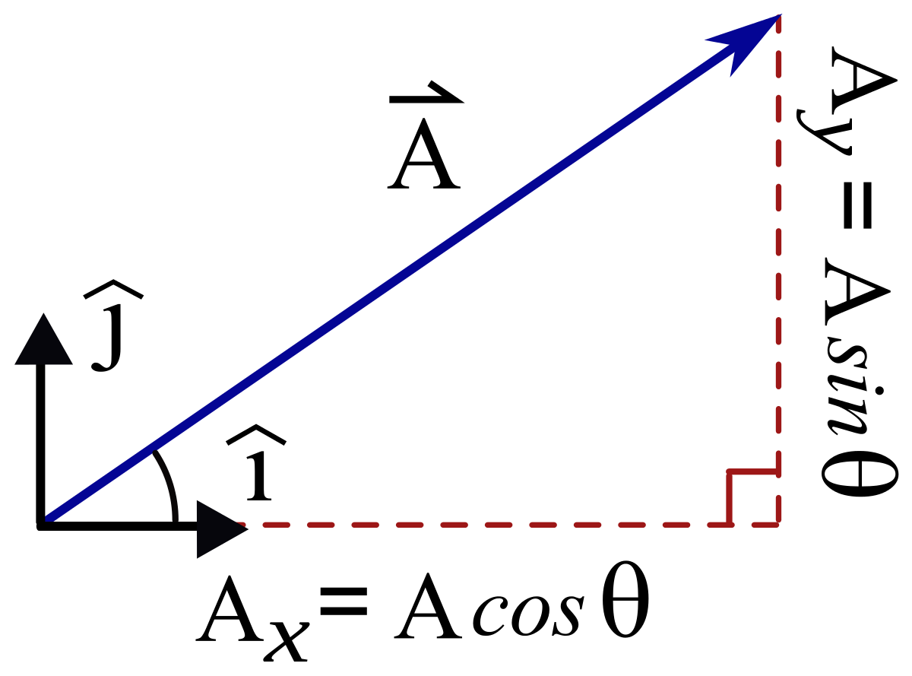
A-LEVEL PHYSICS LEARNING JOURNEY
EXAMS
Doppler Effect
Energy Levels and Spectra
RP 12: Inverse square law
Carbon Dating
Exponential Decay
The Big Bang
Analysing Stars
Nuclear fusion
Astronomical Distances
Einstein’s mass-energy equation
Astrophysics
NUCLEAR PHYSICS
Evolution of the Universe
Life Cycle of Stars
Telescopes
Discovery of electrons
Half-life
Nuclear fission
Binding Energy
Nuclear decay
Damping
Resonance
Gravitational Fields
Kepler’s Laws
Coulomb’s Law
Electric Potential
Charged Particles in a Magnetic Field
Radio- activity
Nuclear Physics
Kinetic Theory of Gases
RP 9: charge and discharge
Transformers
RP 7: SHM
RP 10: Force on wire
THERMAL PHYSICS
FIELDS
RP 11: Flux linkage
Specific Latent Heat
RP 8: Boyle’s and Charles’ laws
Circular and SHM
Electric Fields
Gravitational Potential
Newton’s Law of Gravitation
Charged Particles in an E-Field
Magnetic Fields
EM Induction
Specific Heat Capacity
Thermal Physics
Kirchhoff’s First Law
Combining Resistors
Resistivity
RP 6: EMF and internal resistance
Analysing Circuits
RP 5: Resistivity of a wire
Resistance
Year 13
Momentum
ELECTRICITY
Electrical Energy
Potential Divider
IV Characteristics
Pd and EMF
Electrical Current
Using excel and spreadsheets to analyse data
Stationary waves
Conservation of Energy
Power
Hooke’s Law and Young’s Modulus
Superposition of waves
RP 2: Diffraction
Density and Pressure
WAVES
FORCES & MATERIALS
RP 4: Deforming materials
RP 1: Waves on a string
Kinematics and the motion of bodies
Diffraction and polarisation
Total Internal Reflection
Young’s Double Slit Experiment
RP 3: Freefall
Newton’s Laws of Motion
Archimedes’ Principle
Deforming Materials
Waves
Scalars & Vectors
Induction tasks
Reflection and refraction
Quantum Physics
Quarks
The nucleus
Wave-Particle Duality
PARTICLES & RADIATION
Year 12
The Photon Model
The Photoelectric Effect
Anti-particles, hadrons and leptons
Alpha Particle Scattering
Particle Physics
Foundations of Physics

