Slide 1

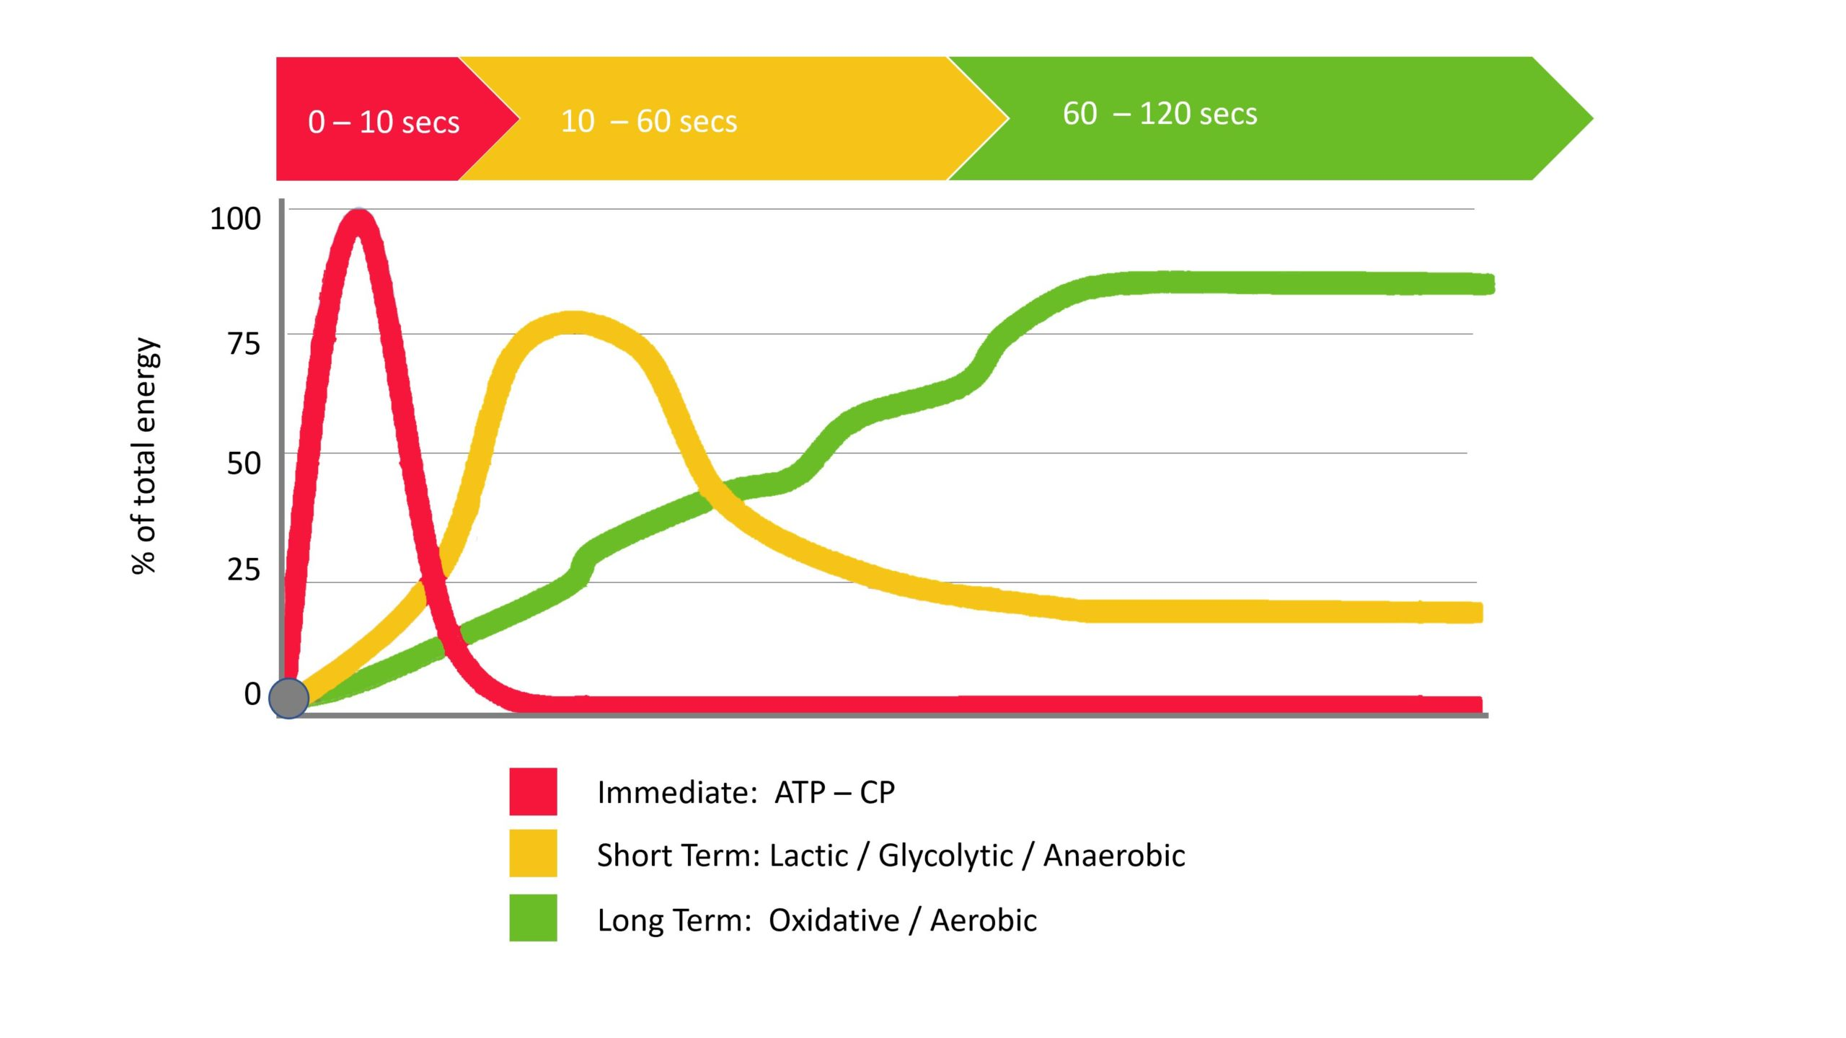
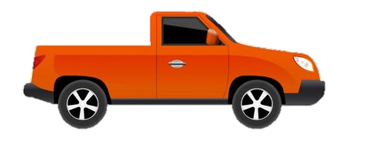
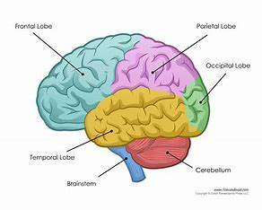
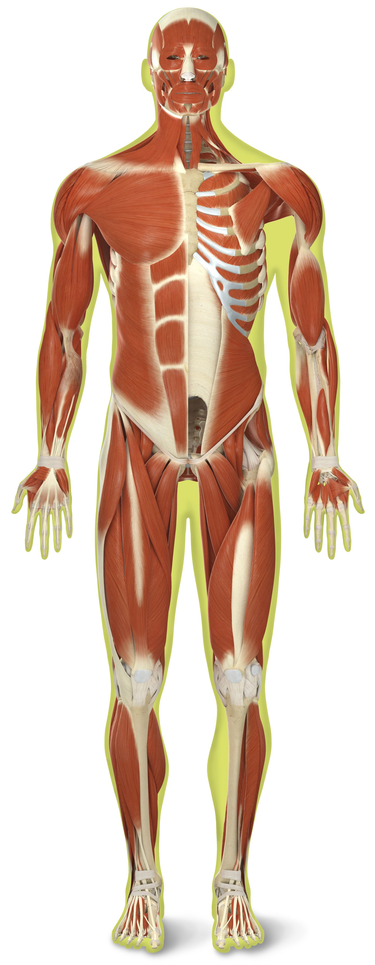

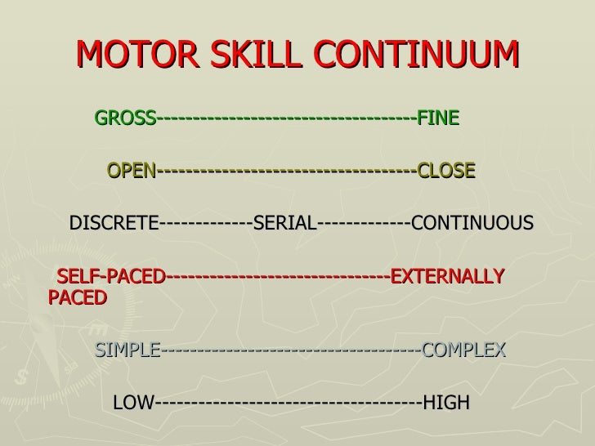
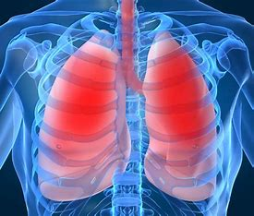

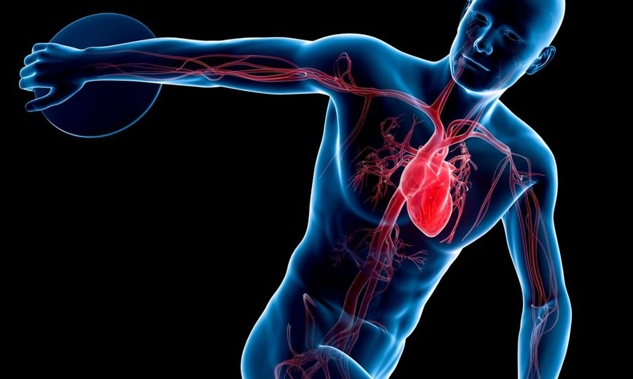

Year 12 AQA A Level PE
Learning Journey
3.1.3 Sport and Society | 3.1.1 Applied Anatomy and Physiology | 3.1.2 Skill Acquisition | NEA
Evaluation – theoretical cause and correction
3.1.2.5.2 Efficiency of information processing
Analysis – 2 weaknesses
Year 13 A Level PE
Year 12 PPE
3.1.2.5.1 General information processing model
3.1.2.4 Use of guidance and feedback
Performance Analysis Assessment
3.1.1.6 Energy systems
Summer term
3.1.2.5 Memory models
3.1.1.5 The musculo-skeletal system and analysis of movement in physical activities
3.1.2.2 Impact of skill classification on structure of practice for learning
3.1.1.4 Neuromuscular system
3.1.2.3 Principles and theories of learning and performance
Spring
term
3.1.3.2 The impact of sport on society and of society on sport
3.1.1.3 Respiratory system
3.1.3.2.1 Sociological theory applied to equal opportunities
3.1.2.1 Skill, skill continuums and transfer of skills
3.1.1.1 Cardio-respiratory system
3.1.3.1.2 Industrial and post-industrial (1780-1900)
Autumn term
3.1.3.1.3 Post World War II (1950 – present)
3.1.1.2 Cardiovascular system
3.1.3.1.1 Pre-industrial (pre-1780)
3.1.3.1 Emergence of globalisation of sport in the 21st century
‘The PE curriculum aims to support students in developing GOOD HABITS for LIFELONG PARTICIPATION, encouraging ASPIRATION, LEADERSHIP and CHARACTER DEVELOPMENT through a wide variety of educational experiences and enrichment activities.’

