Slide 1

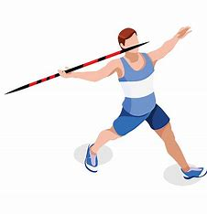
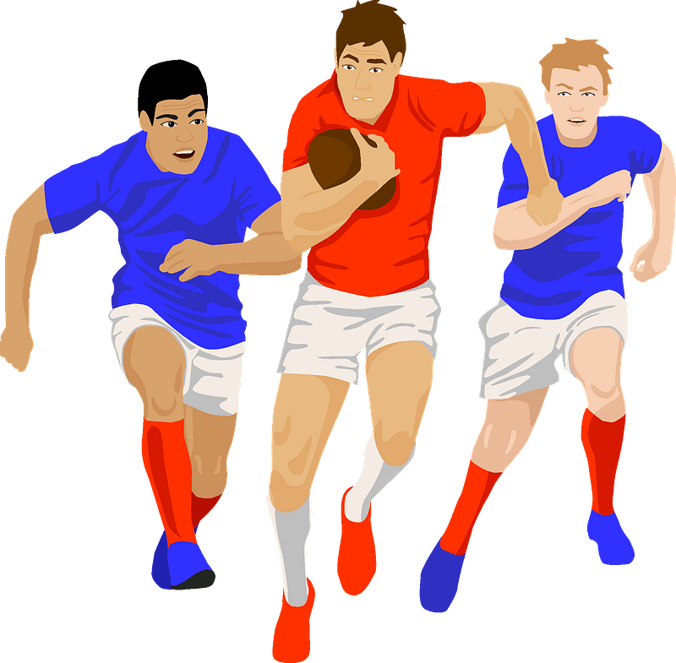
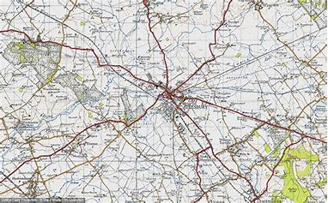
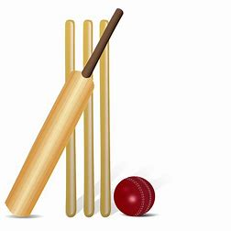
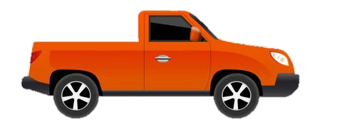
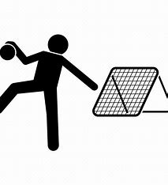


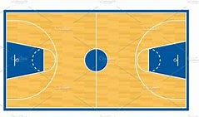

Year 10 Recreational Core PE
Learning Journey
Assessment 5
To be independently active – embedding active, healthy living routines and exploring leadership skills
Map reading
Teamwork
Throwing Events
Athletics
Sprints
Year 11 PE
Rules
Assessment 6
Coordinates
OAA
Jumping Events
Game Play
Middle distance
Tactics
Components of fitness
Passing
Fielding
Circuit Training
Tactics
Assessment 4
Summer term
Batting
Boxercise
Tag Rugby
Game Play
Striking and Fielding
Attacking
Forehand Shots
Strength training
Game Play
Tactics and Strategies
Scoring
Defending
Assessment 3
Passing
HIIT
Fitness
Backhand Shots
Badminton
Attacking
Rules
Game Play
Basketball
Passing & Receiving
Tchoukball
Passing
Positioning
Spring
term
Netball
Assessment 2
Footwork
Tactics and Strategies
Shooting
Tactics in game play
Attacking strategies
Dribbling
Assessment 1
Football
Dribbling and Ball Control
Passing and catching
Competition
Autumn term
Defensive strategies
Tactics
Game Play
Handball
Passing
Shooting and Scoring
‘The PE curriculum aims to support students in developing GOOD HABITS for LIFELONG PARTICIPATION, encouraging ASPIRATION, LEADERSHIP and CHARACTER DEVELOPMENT through a wide variety of educational experiences and enrichment activities.’

