Slide 1





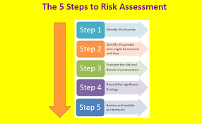

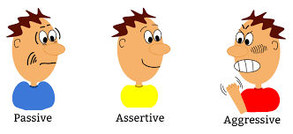




Level 2 Sports Leadership
Learning Journey
Level 2 Qualification
Summer term
Implementation of leadership skills.
Task 3.2 Plan, lead and evaluate a sports/ physical activity event.
Leadership opportunities linked with your centre and in your community
Plan a sports/physical event
Evaluate sports/physical event
Lead a sports/physical event
Task 3.1 Types of sports/ physical activity events
To learn what a risk assessment is.
Evaluate session 2
Lead session 2
Spring
term
Conduct a risk assessment.
Task2.2 Risk assessment
Task 2.1.2 Plan, lead and evaluate sport/physical activity session 2
Task1.3 Reflecting on the leadership skills you have used.
Evaluate session 1
How would you improve a skill?
Behaviour
Task 2.1.1 Plan, lead and evaluate sport/physical activity session 1
Plan Session Plan 1
Lead session 1
Plan Session Plan 2
Skill
Teamwork
Communication
Autumn term
Task1.2 Using Leadership skills and behaviours in other environments.
Problem solving
Self-management
Self-belief
Task1.1 Leadership skills and behaviours

