Slide 1


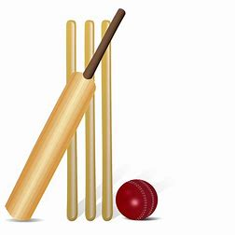





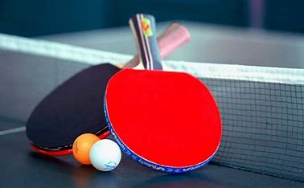

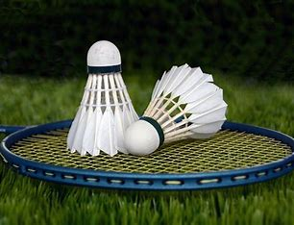
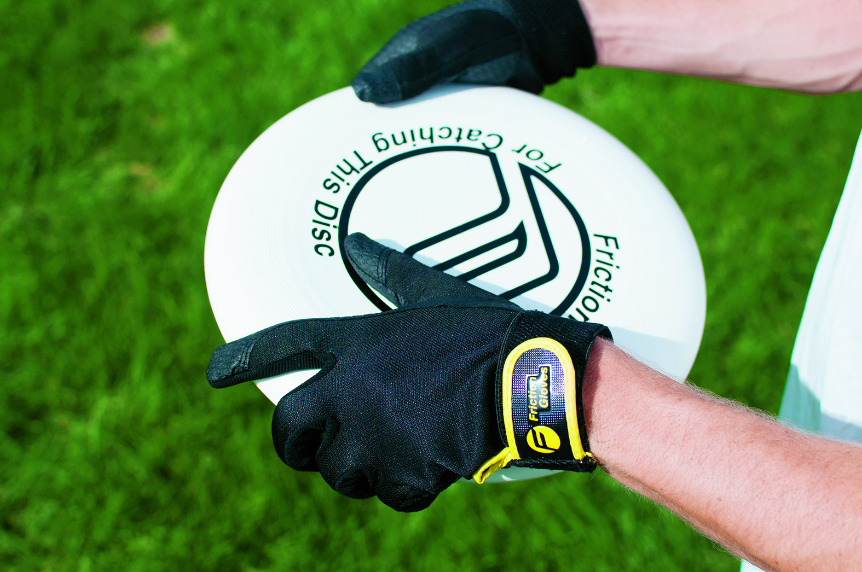



Year 9 Core PE
Learning Journey
Game Play / Tactics
Rules
To create versatile performers, establishing skills and techniques for success in sport and life.
Batting
Forehand Shots
Tennis
Year 10
PE
Middle distance
Bowling
Rounders/ Cricket
Backhand Shots
Fielding
Serving
Sprints
Receiving
Passing
Accurate replication
Sequence
Throwing Events
Dribbling
Flight
Summer term
Jumping Events
Tactics in game play
Aesthetics
Rotation
Athletics
Shooting
Gym/Dance
Lacrosse
Fitness
Game play
Circuit Training
Rules
Forehand Shots
Boxercise
Components of fitness
Cardiovascular endurance
Backhand Shots
Spring
term
Table Tennis
Backhand shots
Game play / Tactics
Leadership
Rugby
Rules
Forehand shots
OAA
Tactics and Strategies
Badminton
Problem Solving
Passing
Defending
Tactics and Strategies
Dribbling
Attacking
Defending
Teamwork
Netball
Handball
Autumn term
Passing
Basketball / Football
Rules
Communication skills
Team Building
Passing
‘The PE curriculum aims to support students in developing GOOD HABITS for LIFELONG PARTICIPATION, encouraging ASPIRATION, LEADERSHIP and CHARACTER DEVELOPMENT through a wide variety of educational experiences and enrichment activities.’

