Slide 1


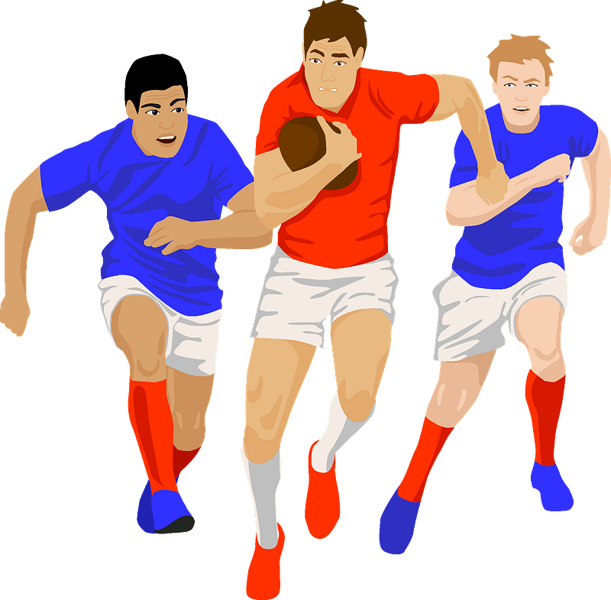
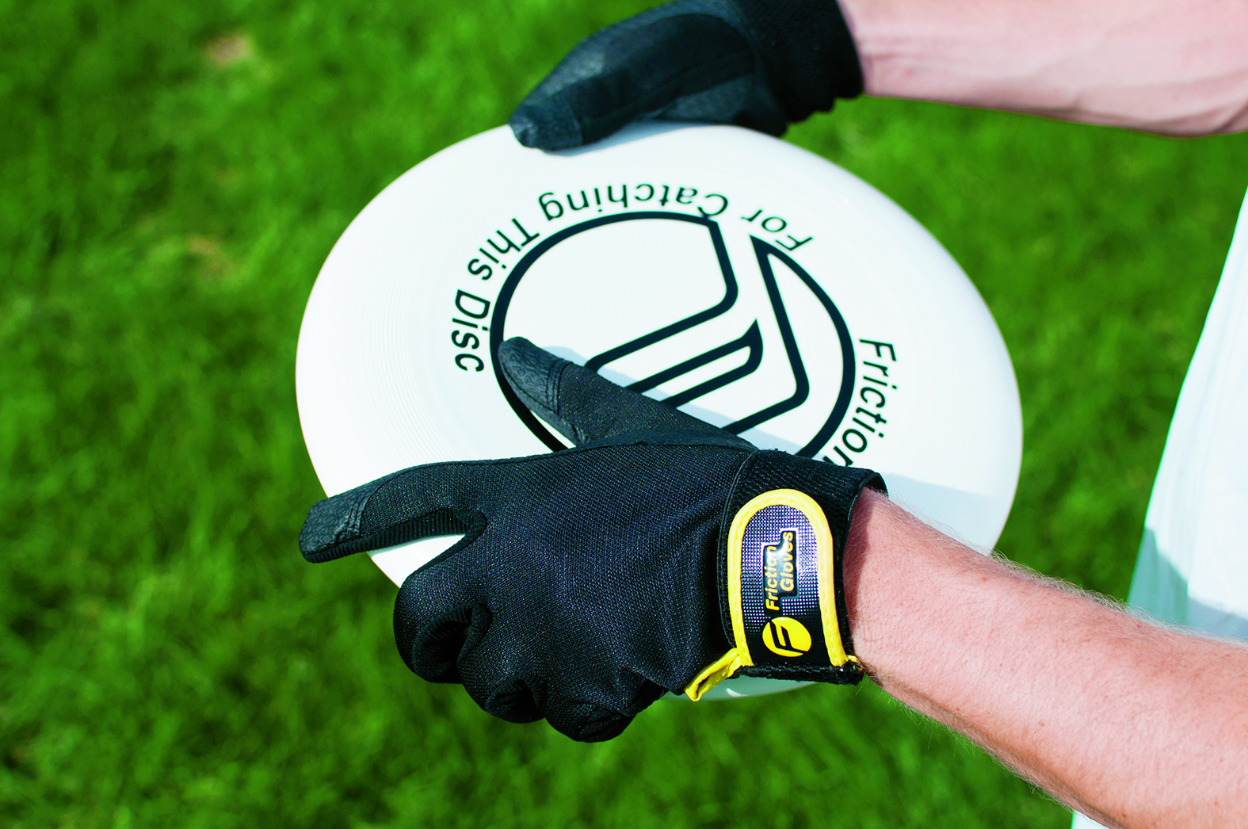

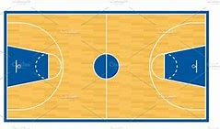
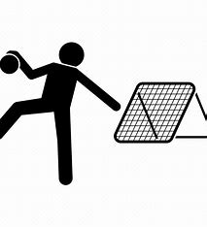


Year 11 Boys Competitive Core PE
Learning Journey
To be independently active – embedding active, healthy living routines and exploring leadership skills
Year 12 PE
Choice of Activities for Summer Term
Forehand Shots
Tactics and Strategies
Badminton
Assessment 4
Game Play
Summer term
Tactics and Strategies
Game Play
Rules
Backhand Shots
Passing
Rules
Tactics
Game Play
Game Play
Attacking
Assessment 3
Passing
Footwork
Netball
Tactics and Strategies
Ultimate Frisbee
Tackling
Circuit Training
Defending
Tactics
Components of fitness
Rugby
Attacking strategies
Competition
Boxercise
Spring
term
Passing
Assessment 2
Defensive strategies
Fitness
HIIT
Strength training
Football
Scoring
Shooting
Passing
Assessment 1
Passing
Positioning
Receiving
Autumn term
Defending
Tchoukball
Tactics in game play
Dribbling
Attacking
Basketball
‘The PE curriculum aims to support students in developing GOOD HABITS for LIFELONG PARTICIPATION, encouraging ASPIRATION, LEADERSHIP and CHARACTER DEVELOPMENT through a wide variety of educational experiences and enrichment activities.’

