Slide 1

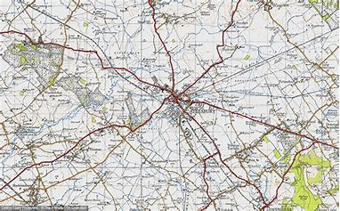
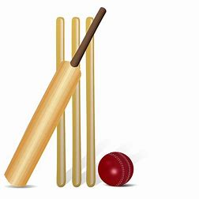

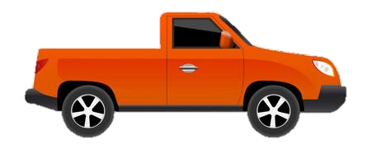

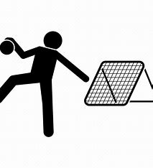
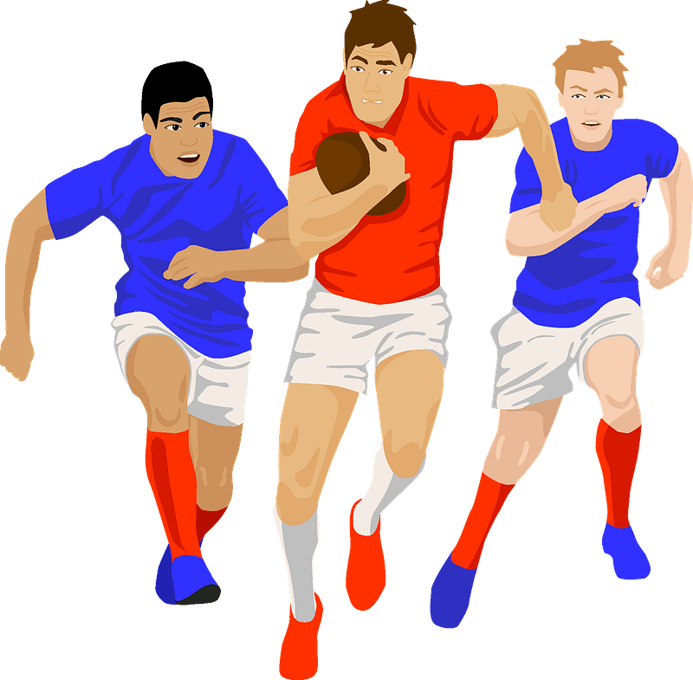

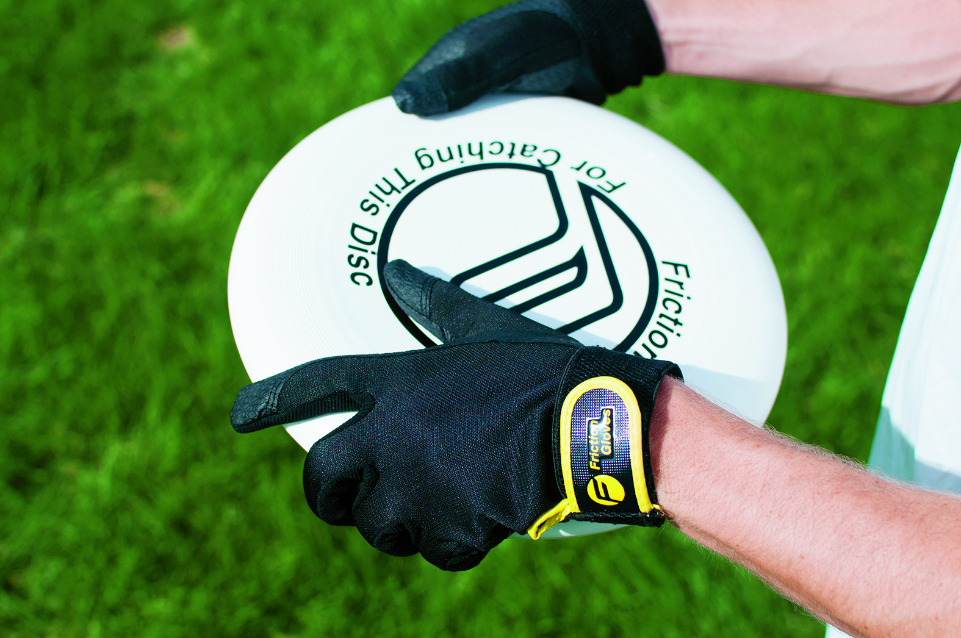


Year 10 Girls Competitive Core PE
Learning Journey
To be independently active – embedding active, healthy living routines and exploring leadership skills
Game Play
Rules
OAA
Batting
Map reading
Year 11 PE
Middle distance
Tactics
Striking and Fielding
Coordinates
Assessment 5
Assessment 6
Fielding
Sprints
Teamwork
Throwing Events
Defensive strategies
Tactics
Returning
Spikeball
Assessment 4
Summer term
Jumping Events
Competition
Serving
Game play
Athletics
Attacking strategies
Positioning
Shooting
Passing
Receiving
Passing
Defending
Assessment 3
Passing
Football
Tactics in game play
Dribbling
Basketball
Scoring
Attacking
Attacking
Defending
Badminton
Backhand Shots
Tactics and Strategies
Tag Rugby
Spring
term
Assessment 2
Passing
Tactics
Game Play
Forehand Shots
Game Play
Tchoukball
Game Play
Game Play
Passing
Assessment 1
Rules
Rules
Autumn term
Tactics and Strategies
Ultimate Frisbee
Passing/Moving
Tactics and Strategies
Netball
‘The PE curriculum aims to support students in developing GOOD HABITS for LIFELONG PARTICIPATION, encouraging ASPIRATION, LEADERSHIP and CHARACTER DEVELOPMENT through a wide variety of educational experiences and enrichment activities.’

