Slide 1

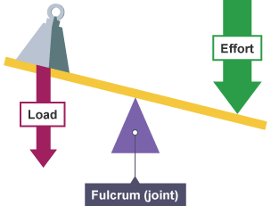
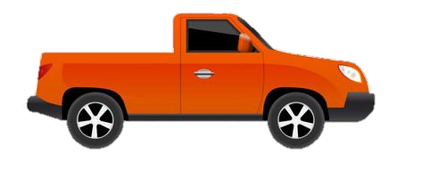


Year 10 AQA GCSE PE
Learning Journey
NEA coursework completion
Evaluation – Identification of training method
NEA
Year 11 GCSE PE
Year 10 PPE
Analysis of weaknesses
3.1.2 Movement Analysis
1st, 2nd, 3rd class levers
Movement analysis
Performance Analysis Assessment
3.1.2.1 Lever Systems
Mechanical advantage
Summer term
Analysis of strengths
3.1.1.4 Short and long term effects of exercise
Planes and axes
3.1.1 Anatomy and Physiology
Structure of the heart
Gaseous exchange
Recovery
Sporting examples
Mechanics of breathing
Blood Vessels
The pathway of air
EPOC
3.1.1.3 Anaerobic and aerobic exercise
Cardiac cycle
3.1.1.2 The structure and functions of the cardio-respiratory system
3.1.3.5 Effective use of warm up and cool down
Spring
term
3.1.3.4 How to optimise training and prevent injury
Injury prevention
3.1.3 Physical Training
Bones
Structure of the skeleton
Types of training
Joints
Muscles
Calculate intensities
Seasonal aspects
3.1.1.1 Structure and functions of the musculoskeletal system
Functions of skeleton
Measuring Components of fitness
3.1.3.2 The components of fitness, benefits for sport and how fitness is measured and improved
Apply principles of training
Health & fitness
SPORT & FITT
Autumn term
3.1.3.3 The principles of training and their application to personal exercise/training programmes
Limitations of fitness testing
Relationship between health and fitness
3.1.3.1 The relationship between health and fitness and the role that exercise plays in both
Data collection
Components of fitness
‘The PE curriculum aims to support students in developing GOOD HABITS for LIFELONG PARTICIPATION, encouraging ASPIRATION, LEADERSHIP and CHARACTER DEVELOPMENT through a wide variety of educational experiences and enrichment activities.’

