Slide 1



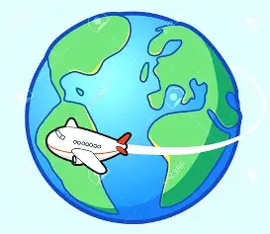

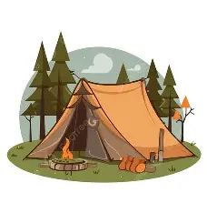
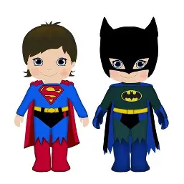

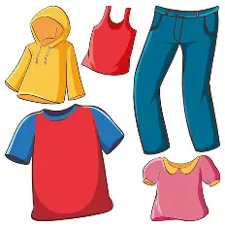
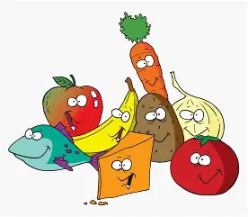
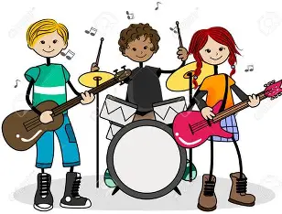


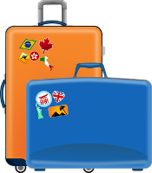
LEARNING JOURNEY
St Michael’s Catholic School
PIN BANK
Simply drag a pin to add it to your journey
Spanish
Tip 5 | Allow yourself to make mistakes, even silly ones. They help you learn!
Consolidation of the year’s learning (project) and revisions for end of year tests (AP3)
Grammar:
Discovering more about the comparative
Using the superlative + mejor + peor
Using the imperative
Tackling challenging listening
Destination
Year 9
Discussing holiday destinations
Cultural project: creating a Spanish speaking country holiday brochure
Listening and speaking tests
Describing a world trip (listening skills)
Grammar:
Using me gustaría + infinitive
Using querer + poder
Using reflexive verbs
Saying this/these
Tip 4 | Set achievable and specific learning goals with a time limit
Asking for directions
Revisions for reading and writing tests (AP2)
Describing a holiday home
Talking about summer camps
Operación verano
Describing holiday activities
Talking about sporting events
Cultural: Easter in Spain
Tip 3 | Download relevant apps to revise: DuoLingo, WordReference, etc.
Talking about clothes + describing a fancy dress (writing skills)
Grammar:
Using a wider range of opinions, negatives, usted/ustedes, the near future, direct object pronouns
Discussing getting ready to go out
Making excuses
Arranging to go out
Cultural: Valentine’s day
¿Qué hacemos?
Listening and speaking tests
SKILLS TAUGHT IN MFL
Speaking
Reading aloud
Listening
Writing
Grammar
Dictation
Learning about food in other countries
Tip 2 | Learn how to ask “how do you say X?” in the language and use it often
Giving an account of a party (speaking skills)
Grammar:
Using a range of opinions
Using the comparative
Saying what you did yesterday
Revisions for reading and writing tests (AP1)
Describing mealtimes
Discussing what to buy for a party
Discussing your favourite type of music
¡A comer!
Ordering a meal
Talking about TV
Understanding a TV guide (reading skills)
Cultural: Christmas in Spain
Saying what food you like
Tip 1 | Learn and revise vocabulary regularly, approx. 20 words a week
Todo sobre mi vida
Saying what you use your phone for
Saying what your holiday was like
Talking about a past holiday
Baseline test
Mis vacaciones
listening and Speaking tests
Grammar:
Using the preterit of –ar, -er, ir verbs
Using the preterit of ir, ser
Presentation of a past holiday + consolidate learning (revision skills)
Giving a presentation about your holiday (speaking skills)
Describing the last day on holiday
Saying what you did on holiday
Phonics: consolidation of Spanish sounds and pronunciation patterns
Year 8
To develop faith filled global citizens who understand the importance of interpersonal communication in a multicultural world.​

