Slide 1





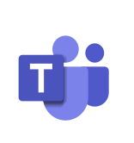
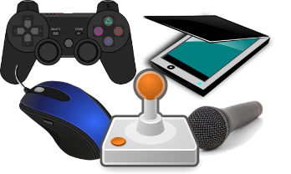
YEAR 7 COMPUTING LEARNING JOURNEY (KS3)
END OF YEAR TEST
St Michael’s Catholic School
What am I learning:
Developing computational thinking and problem solving skills; creative learning and self-expression.
Variables. creating scores
Motion. controlling how sprites move
Year 8
Block Based
Coding
What do we share
Control. controlling how sprites react
Sprites, design and creation of
If Statements
Adding new slides, duplicating and deleting slides
Adding animations to elements
Inserting elements, such as shapes, images, videos
Sharing personal information
Protecting Your Privacy
Saving and opening work
Internet Safety
 | Phishing
What am I learning:
Developing skills and knowledge to create, and present information using Microsoft PowerPoint software
Using transitions
Fake news
Presentation Software
Distinguish between DTP and Word Processing
Defining DTP Terms
Desktop Publishing Software
What am I learning:
Developing an understanding of types of software and their uses
Cuss the importance of DTP
Using the software, understanding the basic tools of the software package
Discovering what an output device is
Opening and Saving work
Hardware Devices
(IPOS)
Types of Software
Compare the different Units of Storage
Introduction
To
Software
Word Processing
Software
Formatting elements
Different storage devices, through the years
Discuss the role of the Central Processing Unit and its uses
Passwords
Hardware Devices
(IPOS)
Rules and expectations of the Computer Lab
Logging on to the school system
Hardware Devices
(IPOS)
Hardware Devices
(IPOS)
Introduction
to
Computing
Discovering input devices and their uses
Definition of Key terms in computing
Using teams
Signing into teams
Department of Business and Computing

