Slide 1
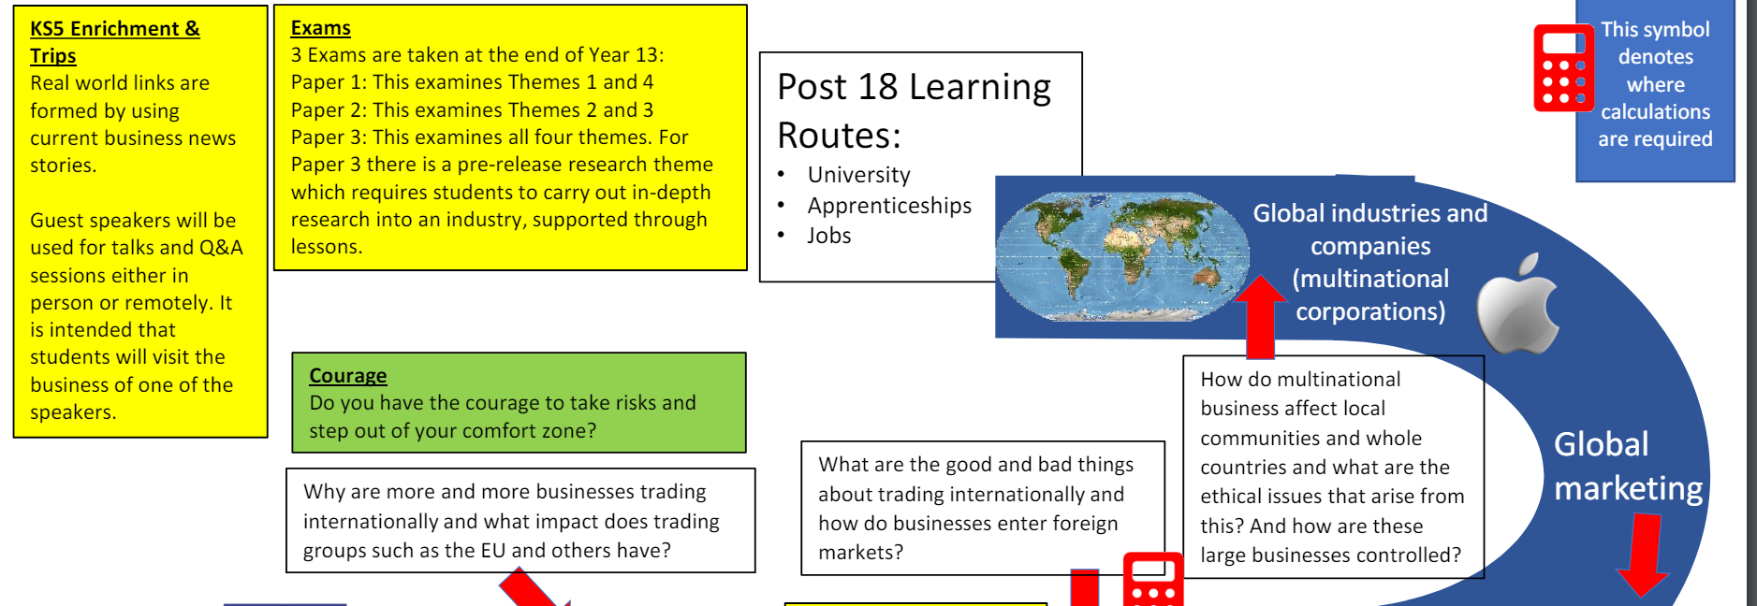


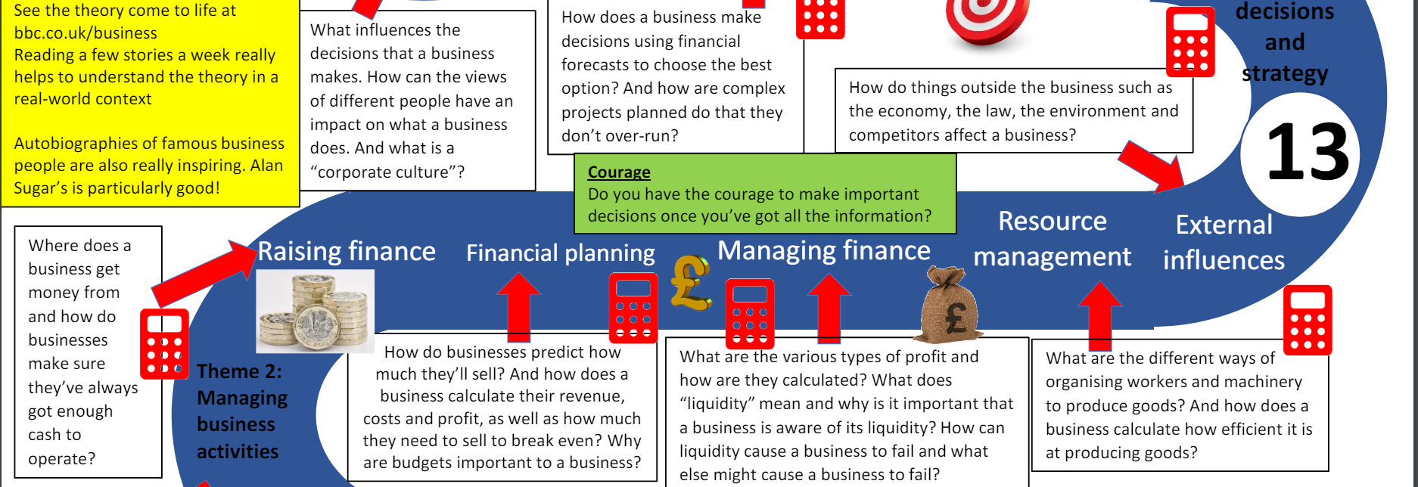

Learning Journey
Yr.12 & Yr.13
START
HERE

