Slide 1

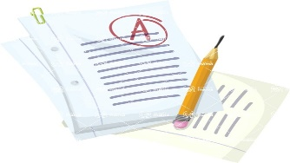




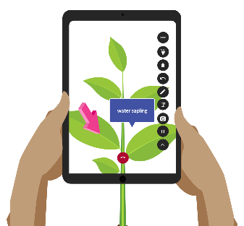
YEAR 10 IT LEARNING JOURNEY (KS4)
CAMBRIDGE NATIONALS LEVEL 1/2 IT
St Michael’s Catholic School
R050 – IT in the digital world – 40% Exam
R060 - Data manipulation using spreadsheets - 30% NEA
R070 - Using augmented reality to present information 30% NEA (25/26)
MOCK Exam
Year 11
MOCK Exam preparation
4. Cyber Security
& Legislation
5. Digital
communications
6. Internet of Everything
JUNE
Unit Revision Exam
Unit Revision Exam
Unit Revision Exam
APRIL
NEA 1 –January Year 10 - Cont'd
Data manipulation using spreadsheets
Internally assessed work – Approximately 15 hours – 30% of final grade
NEA 1 –December Year 10 - Part 1
JAN
Data manipulation using spreadsheets
Internally assessed work – Approximately 15 hours – 30% of final grade
3. Data &
testing
2. Human Computer Interface
1. Design tools
Unit Revision Exam
Unit Revision Exam
Unit Revision Exam
SEP
R050 - IT in the digital World
Department of Business and Computing

