Slide 1



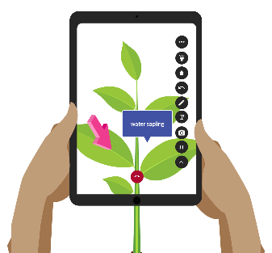


YEAR 9 COMPUTING LEARNING JOURNEY (KS3)
END OF YEAR TEST
St Michael’s Catholic School
Publishing AR App
Introduction in to AR
Year 10
Building an AR app
What am I learning: Python is a general-purpose, versatile and popular programming language. You will learn the syntax, strings, outputs and functions.
Iterative Testing
Adding interactive elements
The uses and functions
What am I learning:
Technology that superimposes a computer-generated image on a user's view of the real world, thus providing a composite view.
Augmented
Reality
Python, text based coding language
Conditional statements (IF statements)
Print function
Python
Variables
While Loops
Time module
If, Elif, Else
Random module
What am I learning:
How to create a database to store and process large amounts of data.
Functions
Reports
Data Types
Tables
Fields, records, files
Forms
Queries
Microsoft
Access
validation
Saving work and opening in different formats
Complex validation
Look up lists
Designing a database
What am I learning:
The hardware/software and network systems that allow the computers we use daily to function.
Operating systems and their purposes
LAN,WLAN, WAN
Disk de-fragger
Networks Introduction
If Statements
Hardware
Software
Clients & Servers
Systems software
Utility software
Network Types
Linking worksheets
What am I learning:
Mastering skills and knowledge to develop spreadsheet complex models that can calculate and present data efficiently
Advanced functions and formula
Understanding elements of the digital divide
Research
Complex models
vlookups
Spreadsheet Software
Digital Divide
Careers in
ICT
What-If scenarios
Presenting information to the group
Discussing ethical issues
Using formula in a model
Presentation
Department of Business and Computing

