Slide 1


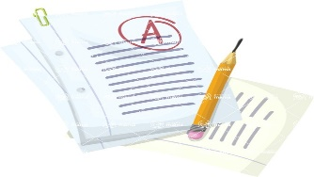

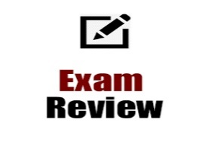

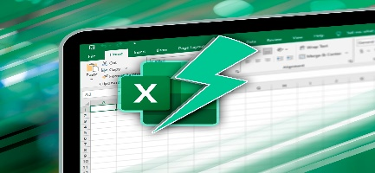

YEAR 11 IT LEARNING JOURNEY (KS4)
St Michael’s Catholic School
CAMBRIDGE NATIONALSLEVEL 1/2 IT
R050 – IT in the digital world – 40% Exam
R060 - Data manipulation using spreadsheets - 30% NEA (2025/2026)
R070 - Using augmented reality to present information 30% NEA
Exam – IT in the digital World R050
Externally assessed work – 1 Hour 30 minutes– 40% of final grade
R05 Exam
Preparation
Year 12
PPE Mock Exam
PPE Mock Exam Review
APRIL
COURSEWORK -January Year 11 (Completion)
Data manipulation using spreadsheets
Internally assessed work – Approximately 15 hours – 30% of final grade
JAN
COURSEWORK -December Year 11
Data manipulation using spreadsheets
Internally assessed work – Approximately 15 hours – 30% of final grade
PPE Mock Exam
Spreadsheet
Concept Review
Mock Exam Review
SEP
Department of Business and Computing

