Slide 1

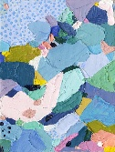
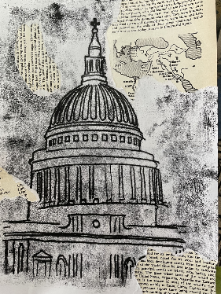

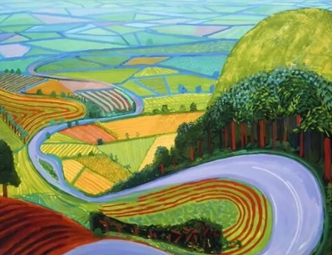
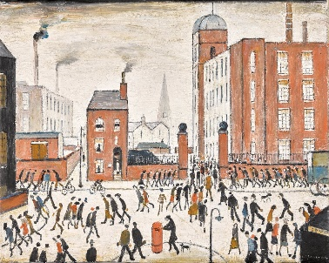
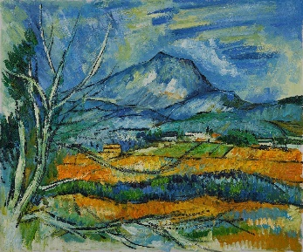
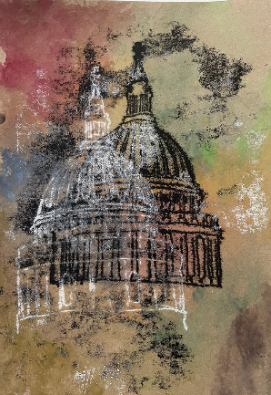
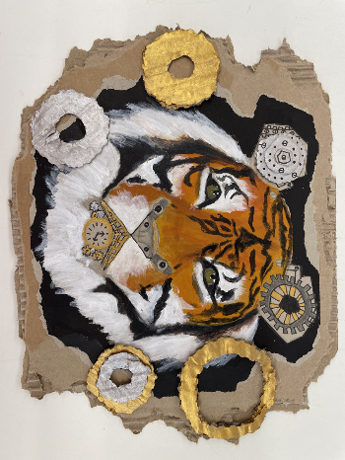
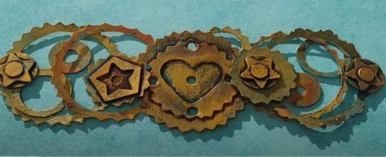
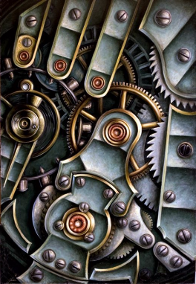
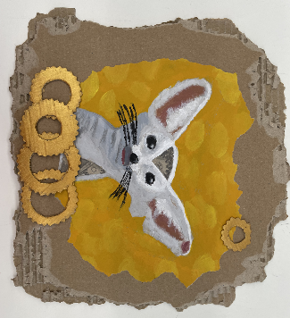

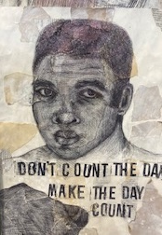
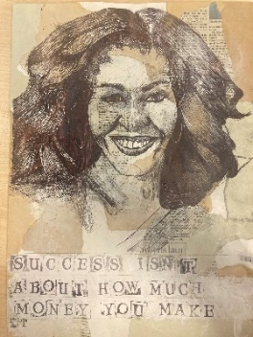
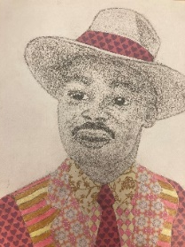
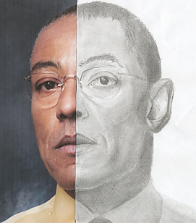
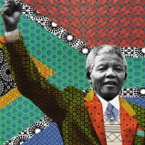
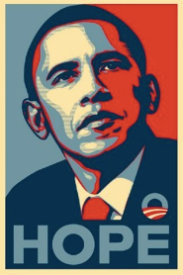
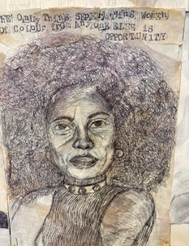
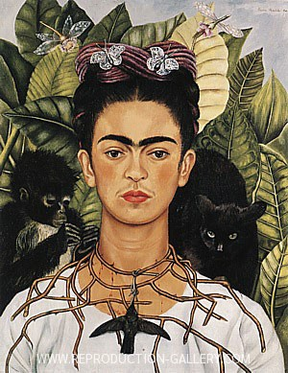
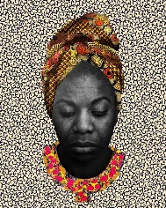
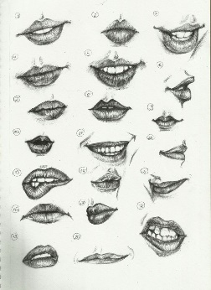
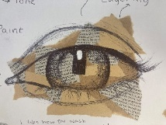
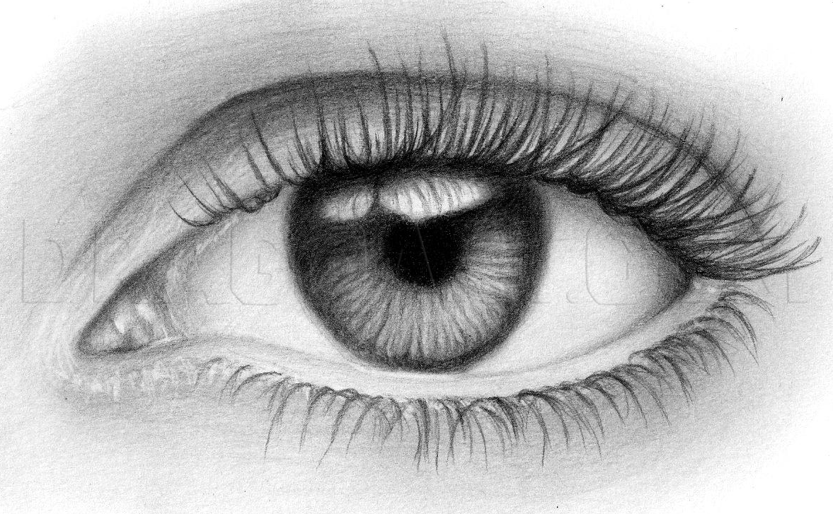
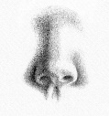
Year 9 Art LEARNING JOURNEY
St Michael’s Catholic School
HOW AM I ASSESSED IN YEAR 9 ?
THE ‘BIG 5’
DEVELOPING IDEAS INSPIRED BY ARTISTS
EXPERIMENTING WITH MEDIA AND MATERIALS
OBSERVATIONAL DRAWING
ANALYSIS AND ANNOTATION
PRESENTING FINAL RESPONSES
What am I learning: : Landscape
How to apply The Formal Elements of Art
Line, form, shape, colour, texture and pattern
Observational drawing skills
Photography skills and drawing from a primary source
Making connections from research to your own work
To create an artist research page
KEY VISUAL LANGUAGE
EXPLORATION
EXPERIMENTATION
MIXED MEDIA TECHNIQUES
PERSPECTIVE
ABSTRACT ART
‘BIG 5’ DEVELOPING IDEAS
INSPIRED BY ARTISTS
YEAR
10
Landscape
What am I learning?
SKILLS IN…
Perspective
Painting
Mixed Media
Photography
‘BIG 5’ ANALYSIS AND ANNOTATION
Describe what you can see?
Describe what materials you think were used?
Is there a meaning/mood?
David Hockney
Paul Cezanne
LS Lowry
‘BIG 5’ OBSERVATIONAL DRAWING
KEY VISUAL LANGUAGE
OBSERVATION
SHAPE
LINE
FORM
DETAIL
TONE
What am I learning;
Steam Punk – analysis Vladimir Gvozdev
Developing and improving confidence
Mixed media
Painting skills using acrylics
‘BIG 5’ DEVELOPING IDEAS
INSPIRED BY ARTISTS
‘BIG 5’ EXPERIMENTING
WITH MEDIA AND MATERIALS
Steam
Punk
What am I learning?
SKILLS IN…
Features
Proportion
Drawing
Oil pastels
Mono printing
Any deeper meaning
KEY VISUAL LANGUAGE
IDENTITY
INSPIRATION
ROLE MODELS/ ICONS
CONTEMPORARY/ HISTORIC
MIXED MEDIA
EXPRESSIONS
‘BIG 5’ PRESENTING FINAL RESPONSES
Portraits
and
Identity
Who is your inspiration?
What am I learning?
Artist Research of various Portrait Artists throughout time including…
Frida Kahlo
Makeba Rainy
Shepard Fairey
Tim Okamura
Ed Fairburn
Kehinde Wiley
What am I learning:
ISSUES BASED ART such as…
Black liberation
Feminism
Social injustice
Gender discrimination
Sporting hero
What am I learning?
SKILLS IN…
Mixed Media
Drawing
Biro pen
Fine liner
Pencil
Collage
YEAR
9
What am I learning:
How to effectively draw features of the face, with accuracy
Improve and develop observational drawing skills
Presentation of pages in the sketchbooks.
Confidence in sketching with pencil, biro pen and fine liner
To create independent pupils whose God given talents are nurtured and shared.
Learning develops a knowledge of culture, their environment and an understanding of the relevance of design and creativity in the wider world.
Department Intent

