Slide 1





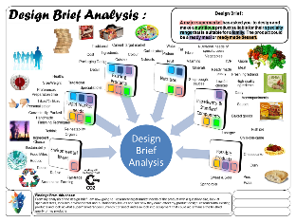



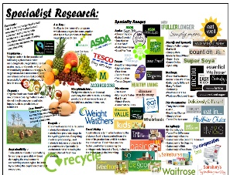

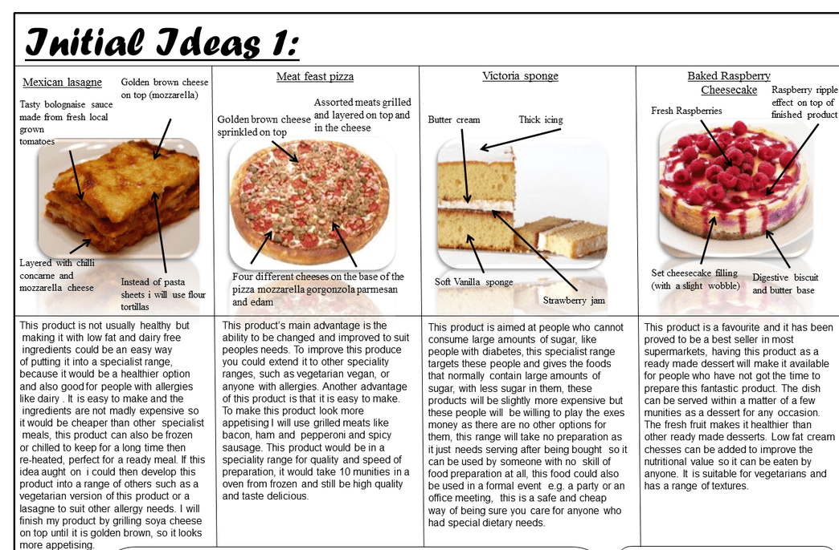

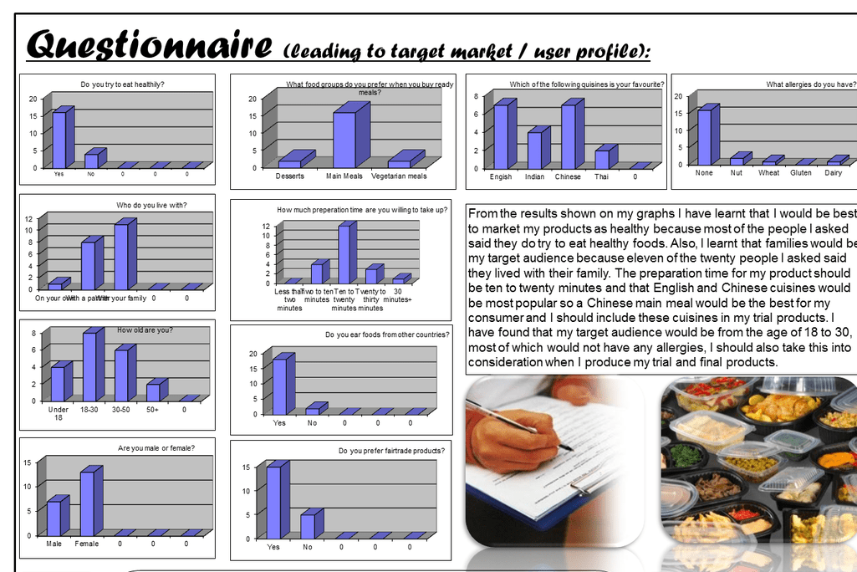


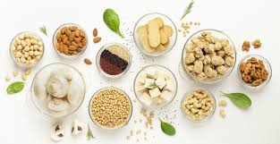
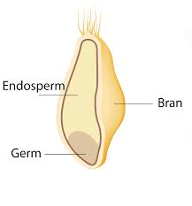
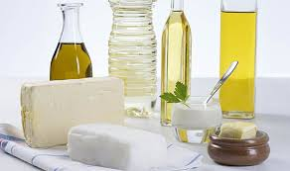
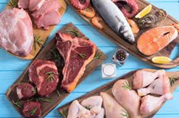
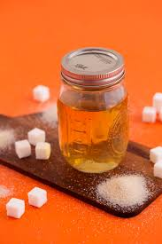
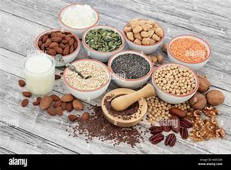
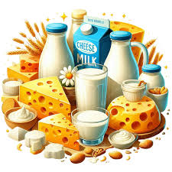
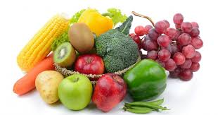
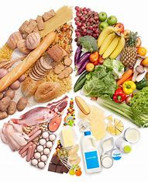

GCSE FOOD PREPARATION AND NUTRITION LEARNING JOURNEY
St Michael’s Catholic School
Chef/Catering
Food Technologist
Marketing /Retailing
Nutritionist/Dietician
Teacher
Food manufacturer
Product development
Food Stylish
Food microbiologist
Careers
Apprenticeship
Professional H&C routes A-level University
Graduation
EXAM
Revision
Principles of Nutrition
Diet and good health
Food provenance and food waste
NEA 2
Food Preparation Assessment
A- Researching
B- Planning for the final Menu
C- Demonstrate technical skills
D- making the final dish
E- Analysis and Evaluation
Basic mixtures and recipes : skills practice
Cake making
Pastry making
Sauces , batters and roux and gelatinisation
Food Investigation
A- Research- sensory analysis
B- Conduct an experiment
C- Analyse and Evaluate
NEA 1
Recap Prior
Learning
Culture and cuisines, The science of cooking food, Food Spoilage, Factors affecting food choice
YEAR 11
Beans , nuts seeds , soya , tofu and mycoprotein.
Types available
Allergens
Uses
Nutritional value
Processing
Cereal
GM crops, staple crops, harvesting, grain, structure, and nutritive value, Food science and bread
Meat, poultry, fish, and eggs
Provenance and classification, nutritional value of cuts of meat, fish, and eggs
Fats- Butter, oil, sugar, and syrup
Classification, nutritional value, and health problems to
include sugar, food safety, and storage
Alternative proteins
Technological developments, microorganisms in food production
Dairy Product Animal rearing and farming, secondary processing, nutritional value, pasteurization and bacteria
Fruits and Vegetables
Classification, food miles, seasonality, primary and secondary processing, and oxidation
Diet and Good Health
What is healthy diet
Special dietary needs
Vegetarianism
Individual nutritional needs
Principles of nutrition
What is nutrition
Micro and macronutrients
Deficiencies
YEAR
10
Departmental Vision:
To provide a rich learning environment in which each pupil's, God given, creative and practical talents are nurtured and grown. Outcomes are celebrated in the wider community and inspire others.
Learning continually develops knowledge and love of God's creations in the wider world. Pupils respond to this through visual stimuli, experimentation, and effective realising of intentions.

