Slide 1

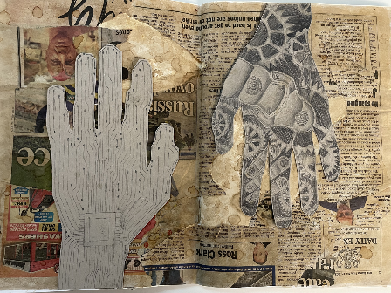
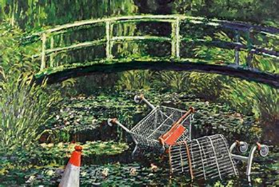

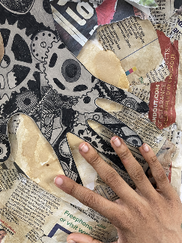
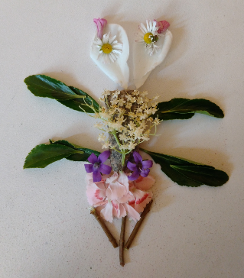

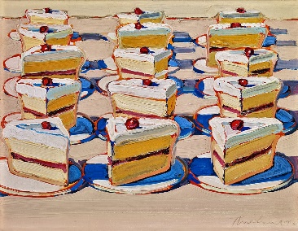
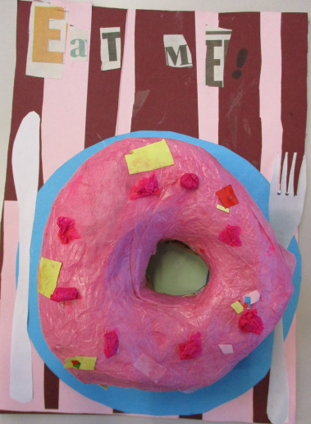
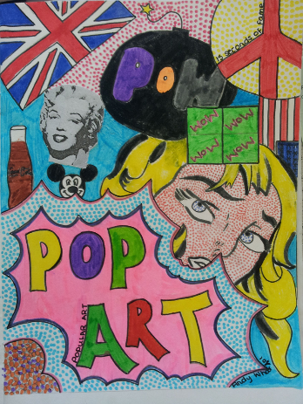
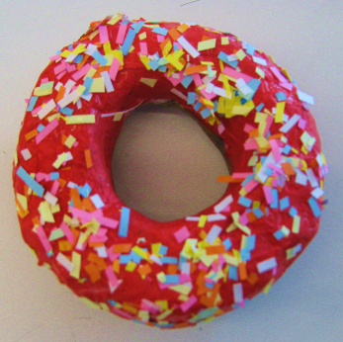
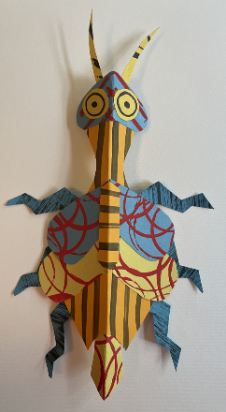
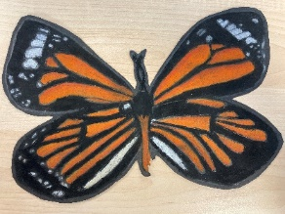
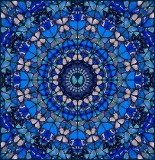
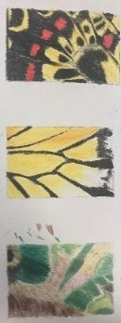
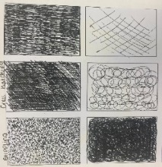
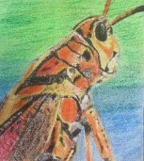
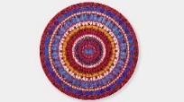
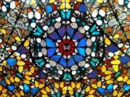
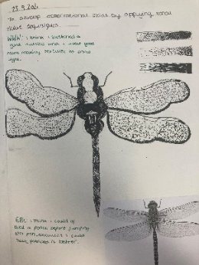
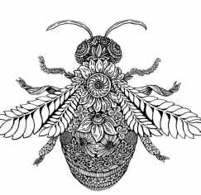
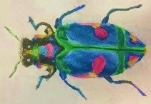
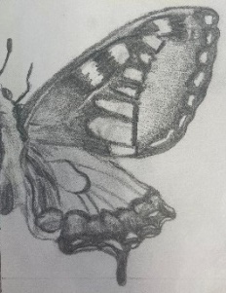
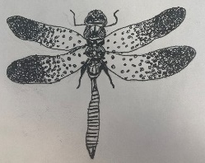
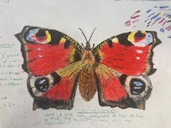
Year 8 Art LEARNING JOURNEY
St Michael’s Catholic School
HOW AM I ASSESSED IN YEAR 8 ?
THE ‘BIG 5’
DEVELOPING IDEAS INSPIRED BY ARTISTS
EXPERIMENTING WITH MEDIA AND MATERIALS
OBSERVATIONAL DRAWING
ANALYSIS AND ANNOTATION
PRESENTING FINAL RESPONSES
What am I learning?
How to create a piece with deeper meaning – Contrast of man and nature.
Assembling different parts to form a final piece
The work of Banksy – Vandalized Painting
‘BIG 5’ PRESENTING FINAL RESPONSES
YEAR
9
What am I learning?
SKILLS
Pencil
Pen
Coffee
Watercolour
Mixed media
Man Vs Nature
Inspired piece
What am I learning?
Skills
New techniques
Symbolism - recap on bugs and butterflies
Mixed media techniques
Layers in a final piece
Mono chrome/contrast
‘BIG 5’ ANALYSIS AND ANNOTATION
Describe what you can see?
Describe what materials were used?
Is there a meaning/mood?
KEY VISUAL LANGUAGE
MIXED MEDIA
Man = Cogs and circuits
Nature = Insects and nature
Man
Vs
Nature
What am I learning:
Artist Research ;
Wayne Thiebaud
The Pop Art movement
Pattern
Flat colour
3d food made out of papier mâché
What am I learning?
SKILLS
3d sculpture
Papier mâché
Still life
Food inspiration
‘BIG 5’ EXPERIMENTING WITH MEDIA AND MATERIALS
‘BIG 5’ DEVELOPING IDEAS
INSPIRED BY ARTISTS
Pop Art/
Still life
s
KEY VISUAL LANGUAGE
Relief
SHAPE
LINE
TONE
DETAIL
MARK MAKING
TEXTURE
PATTERN
SYMBOLISM
CONCEPTUAL
CONTROVERSY
Who is
Claire Youngs?
A contemporary
Graphic
Illustrator.
What am I learning?
Damien Hirst Artist Research
Spiritual symbolic art
Life vs death
Pattern, symmetry and application of colour
Experimentation
Looking at detail
Bugs
&
Butterflies
What am I learning?
Experimenting;
Pencil
Colour pencil
Fine liner
Oil pastel
Watercolour
Paint
3d sculpture
What am I learning:
MEDIA AND MATERIALS
Fine liner
Paint
Pencil
Colour pencil
Watercolour
Oil pastel
‘BIG 5’
Observational Drawing
YEAR
8
What am I learning:
Recap on observational drawing skills from Year 7
Improving colour pencils skills – blending and achieving tone
Mark making techniques
Understanding of artist’s work
ROSALINDMONKS
DAMIEN HIRST
CLARE YOUNGS
Department Intent
To create independent pupils whose God given talents are nurtured and shared.
Learning develops a knowledge of culture, their environment and an understanding of the relevance of design and creativity in the wider world.

