Slide 1

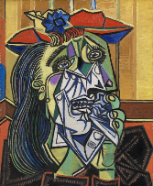
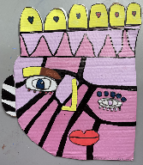
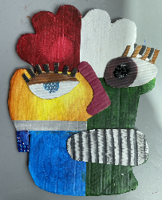
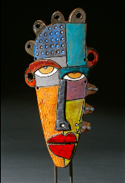

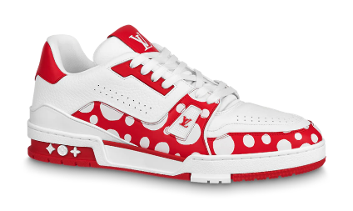
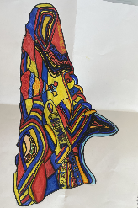
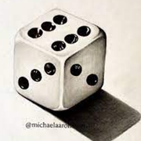
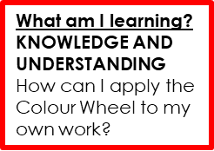
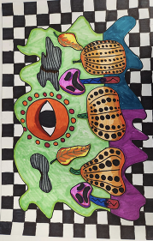
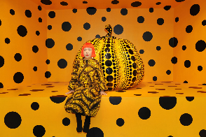
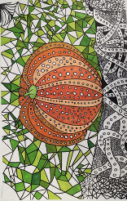


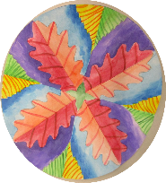

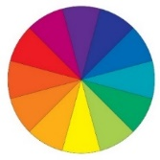
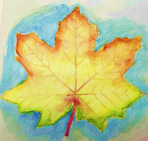
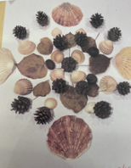
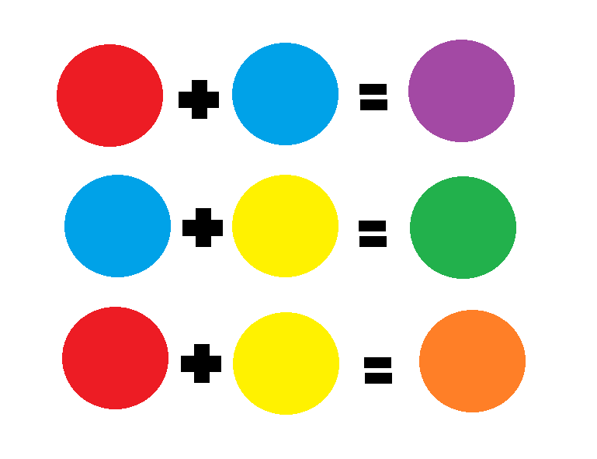
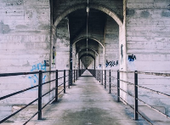
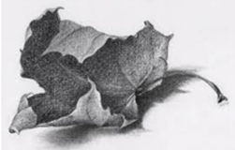
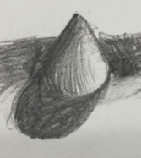
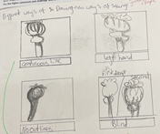
Year 7 Art LEARNING JOURNEY
St Michael’s Catholic School
HOW AM I ASSESSED IN YEAR 7 ?
THE ‘BIG 5’
INTRODUCTION TO FORMAL ELEMENTS
OBSERVATIONAL DRAWING SKILLS
DEVELOPING IDEAS INSPIRED BY ARTISTS
EXPERIMENTING WITH MEDIA AND MATERIALS
PRESENTING FINAL RESPONSES
‘BIG 5’ DEVELOPING IDEAS
INSPIRED BY ARTISTS
What am I learning?
African art and it’s influence on Kimmy Cantrell and Pablo Picasso.
Multiple perspectives
Shape, line and pattern
Relief
Oil Pastels
KEY VISUAL LANGUAGE
Multiple
View points
Depth
Shape
Asymmetric
Abstract
Line
Pattern
Relief
YEAR
8
What am I learning?
Making links with the real world of fashion.
Louis Vuitton and artists collaborations
Short project
What am I learning?
Designing a fashion accessory inspired by culture.
What am I learning?
Drawing assessment recap on tonal skills and perspective-
Dice
African
Masks
Creative
Spaces
What am I learning?
KNOWLEDGE AND UNDERSTANDING
the work of Yayoi Kusama – contemporary artist
‘BIG 5’ ANALYSIS AND ANNOTATION
Describe what you can see?
Describe what materials were used?
Is there a meaning/mood?
‘BIG 5’ PRESENTING FINAL RESPONSES
Artist study
What am I learning?
Sketching with confidence and fluidity
Links to Mathematics – shape/ symmetry
Repetition and pattern
‘BIG 5’ EXPERIMENTING WITH MEDIA AND MATERIALS
‘BIG 5’PRESENTING FINAL RESPONSES
What am I learning?
KNOWLEDGE AND UNDERSTANDING
How am I inspired by leaves and nature
How do they inform my ideas to therefore create my own ideas?
What am I learning?
Radial Design
Links to maths
Template/symmetry
What am I learning?
Experimentation
Pencil
Colour pencil
Mixed media
Watercolour
Radial Designs
Green
&
Spikey
KEY VISUAL LANGUAGE
PRIMARY COLOURS
SECONDARY COLOURS
TERTIARY COLOURS
COMPLEMENTARY COLOURS
KEY VISUAL LANGUAGE
SHAPE
LINE
TONE
DETAIL
PROPORTION
SYMMETRY
‘BIG 5’ DEVELOPING IDEAS
INSPIRED BY ARTISTS
What am I learning?
The meaning of COLOUR
How does colour affect the mood of a painting?
What am I learning?
Andy Goldsworthy Artist Research
Links to colour and nature
Colour and symbolism
What am I learning?
PERSPECTIVE
One point
Two point
Birds eye view
What am I learning:
Different ways of seeing
Formal
Elements
YEAR
7
What am I learning?
Formal Elements
Line, tone, pattern, texture , colour, form, shape
‘BIG 5’ OBSERVATIONAL DRAWING
Department Intent
To create independent pupils whose God given talents are nurtured and shared.
Learning develops a knowledge of culture, their environment and an understanding of the relevance of design and creativity in the wider world.

