Slide 1


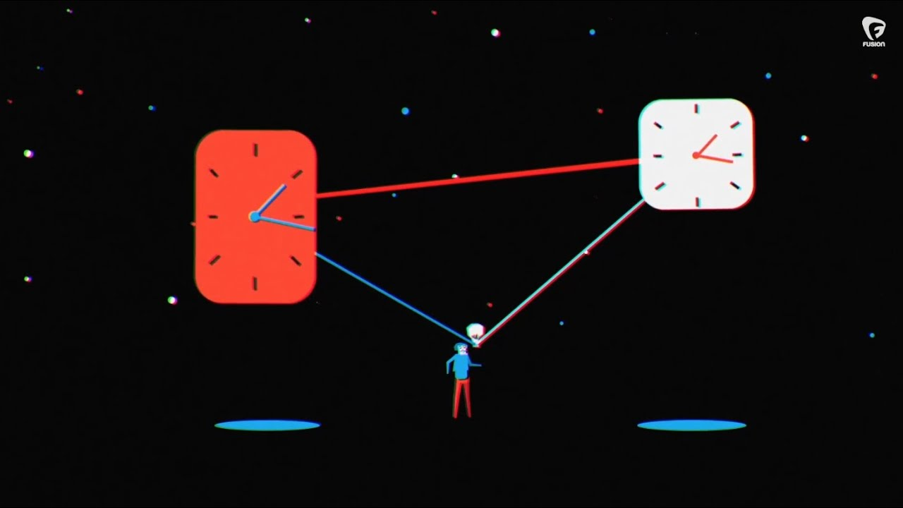
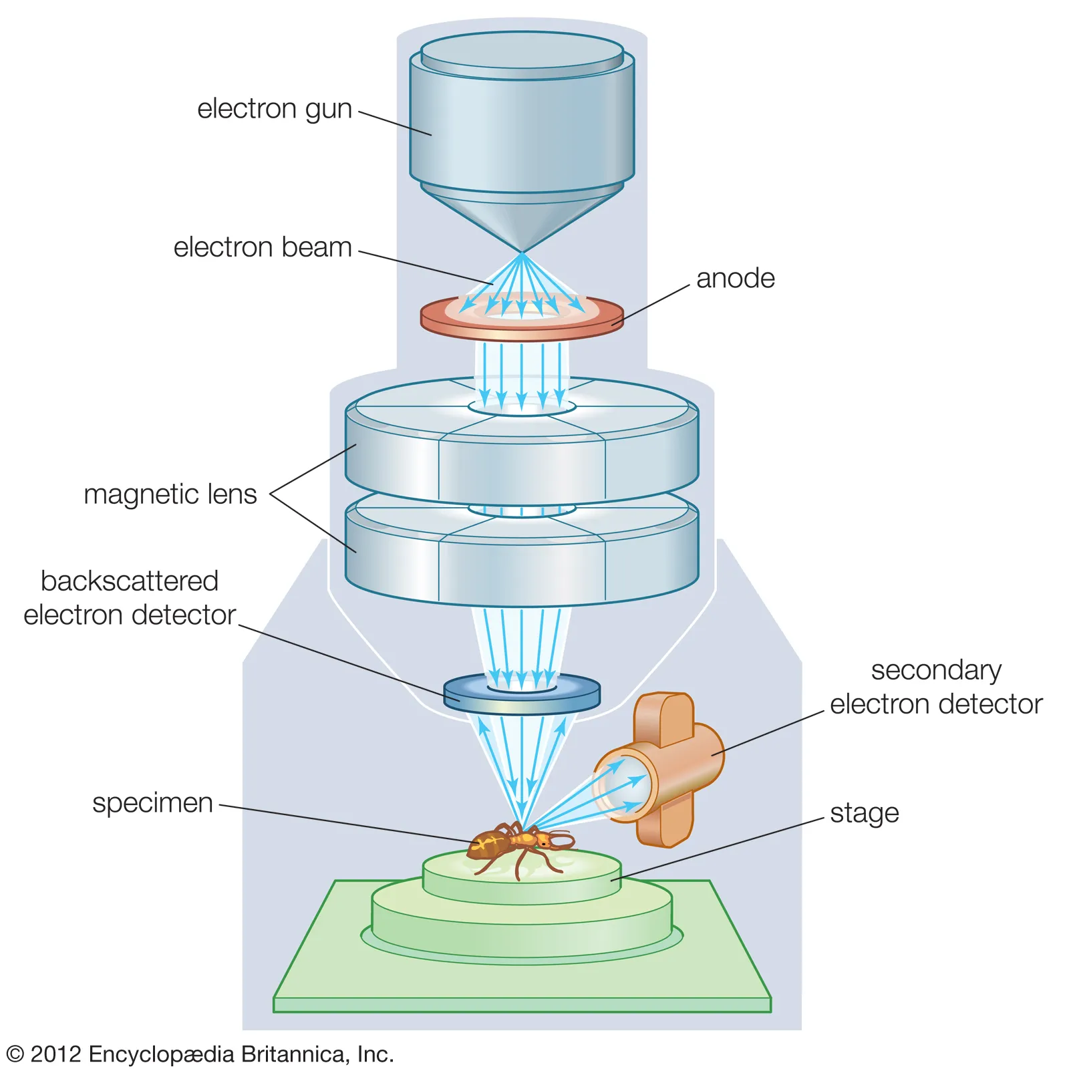

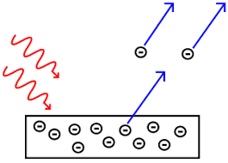
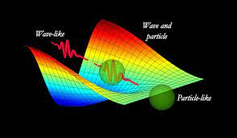
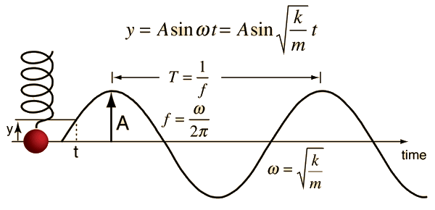
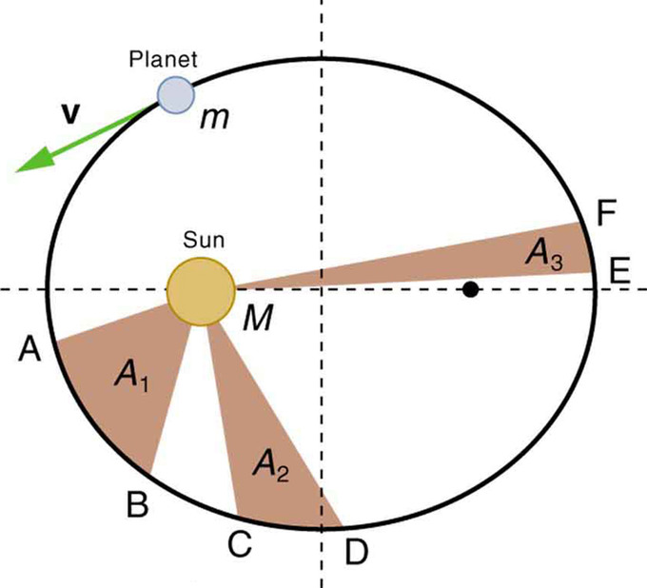

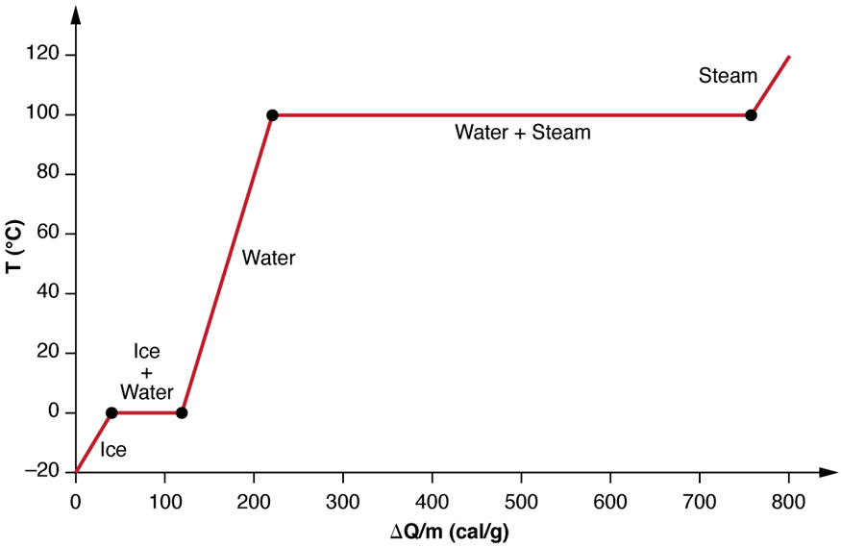
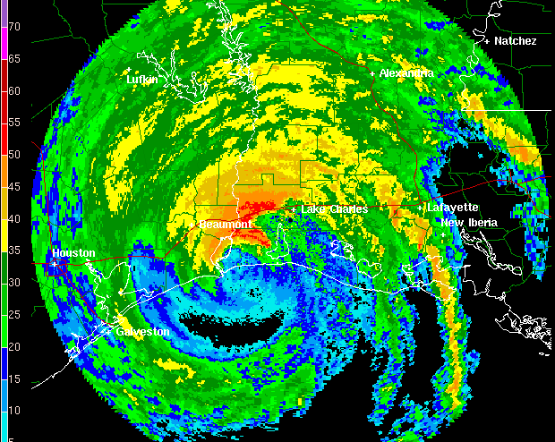
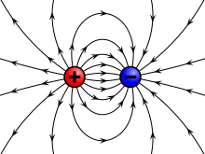
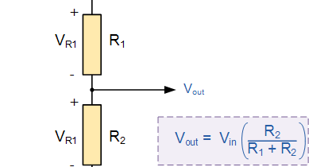
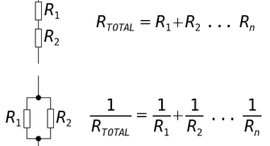

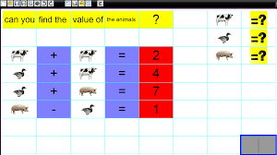
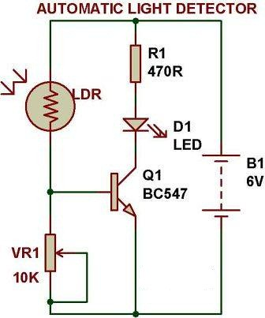
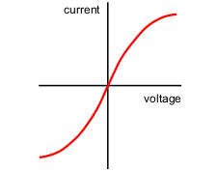
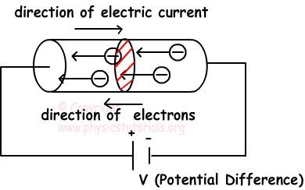
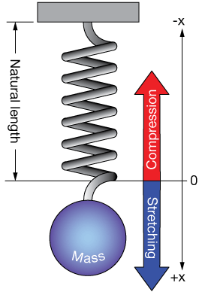
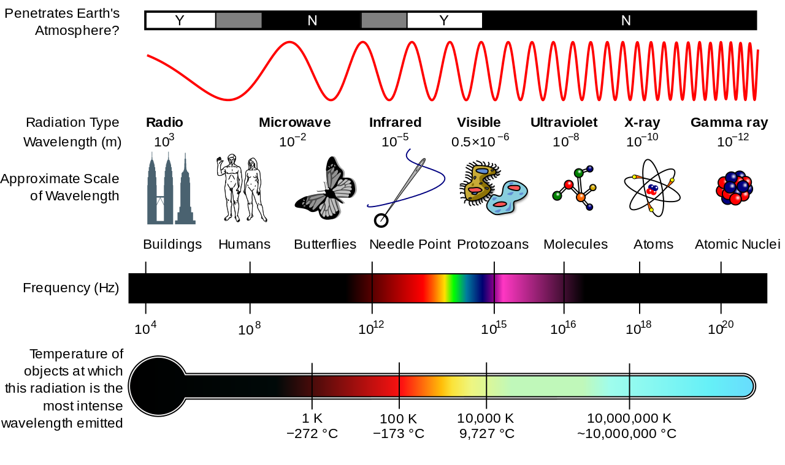
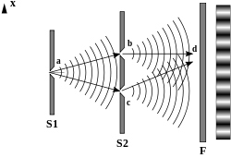
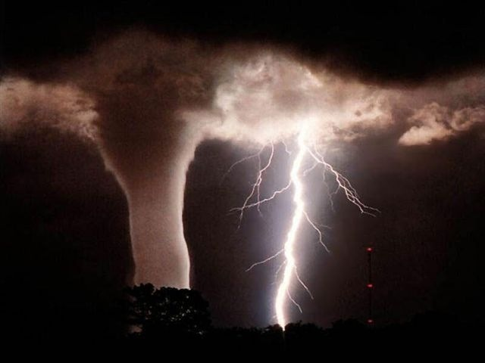
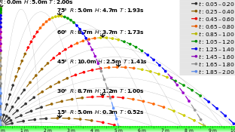
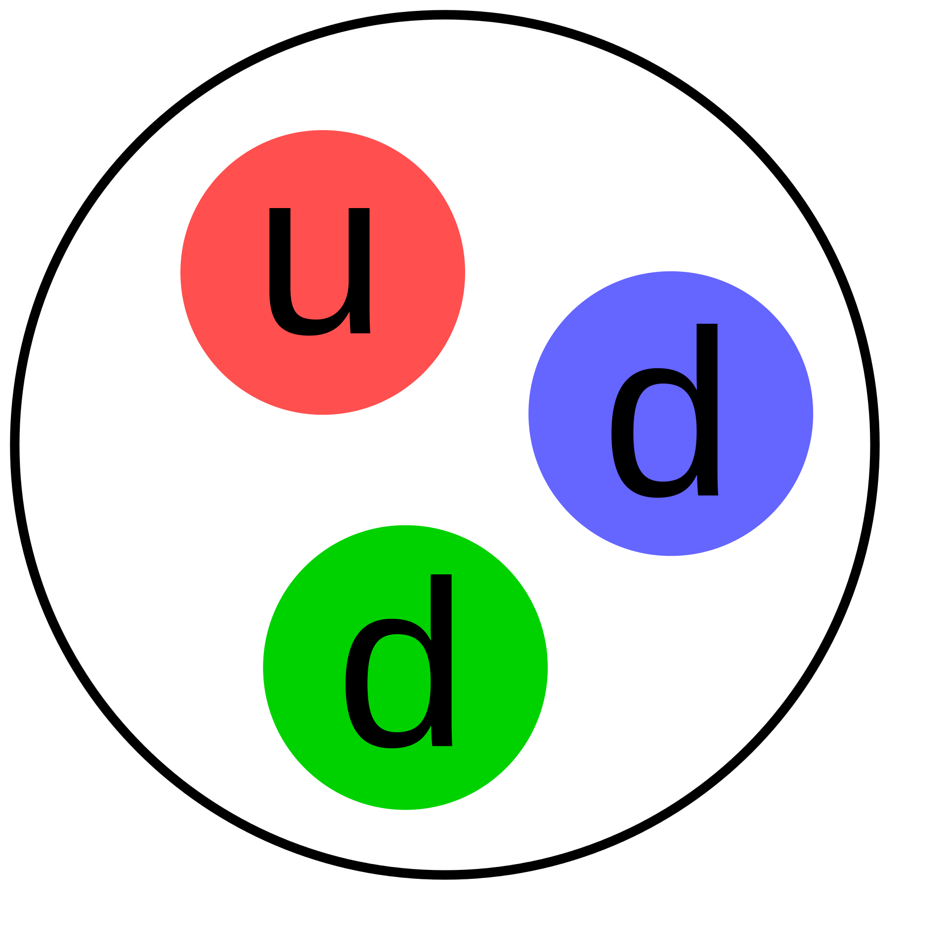
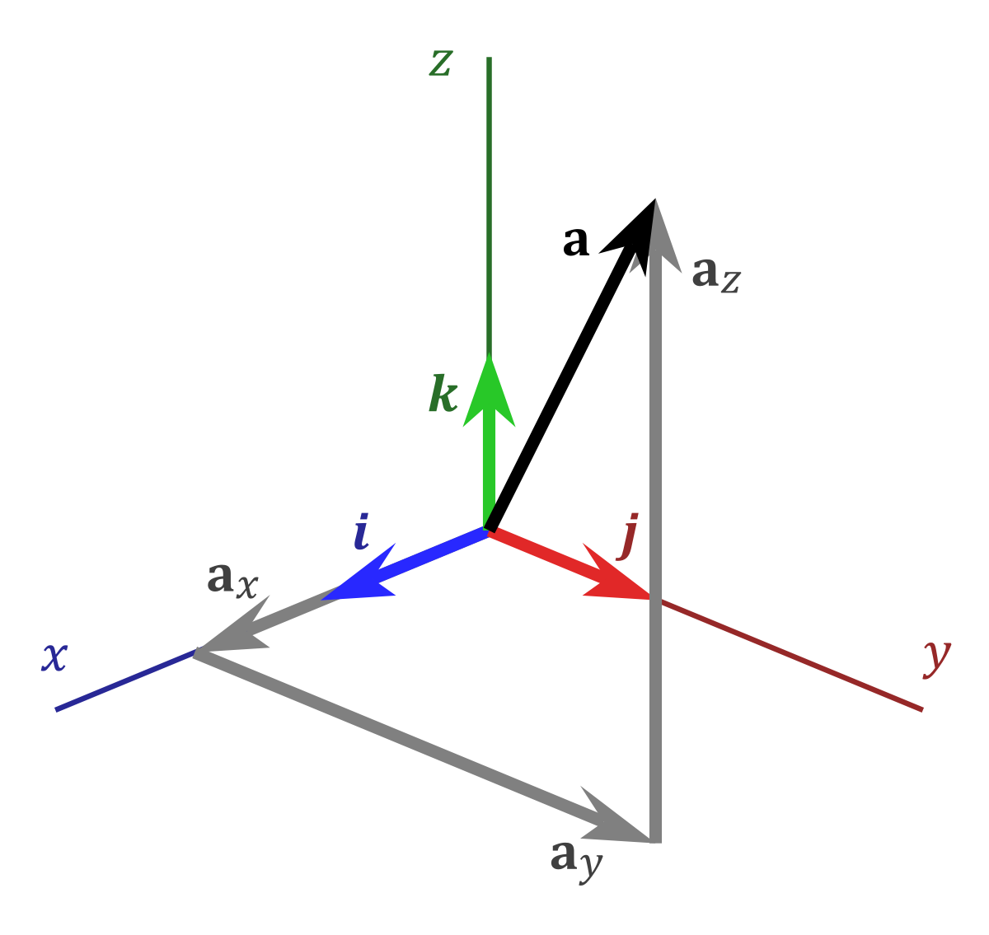
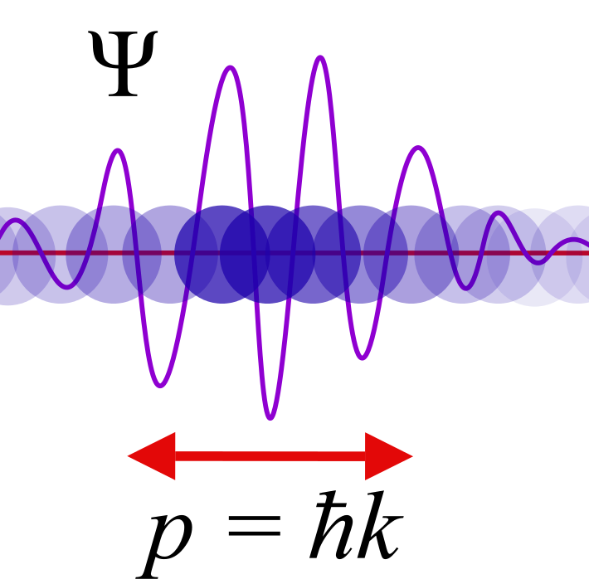
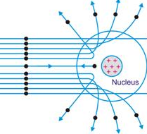
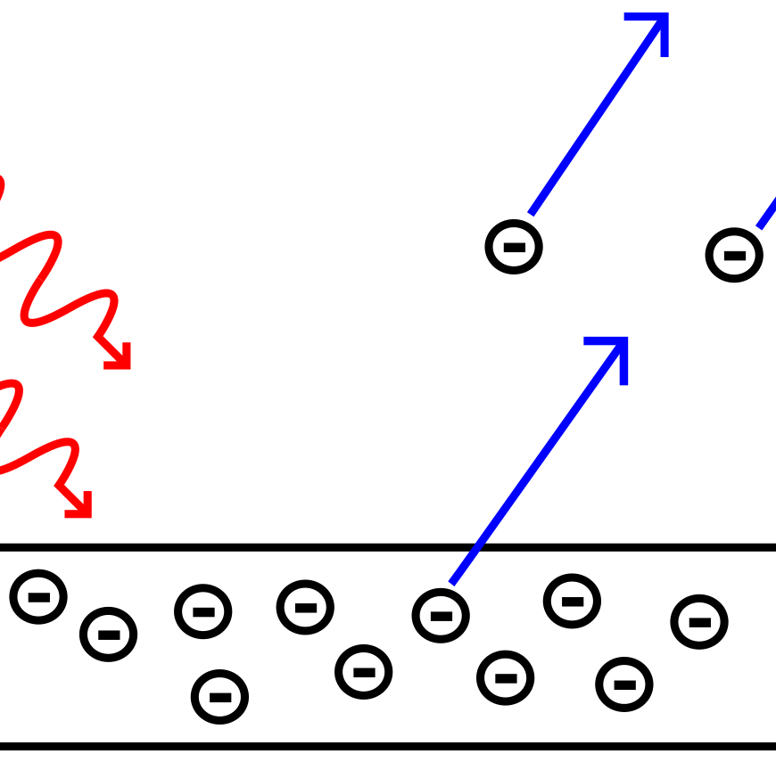
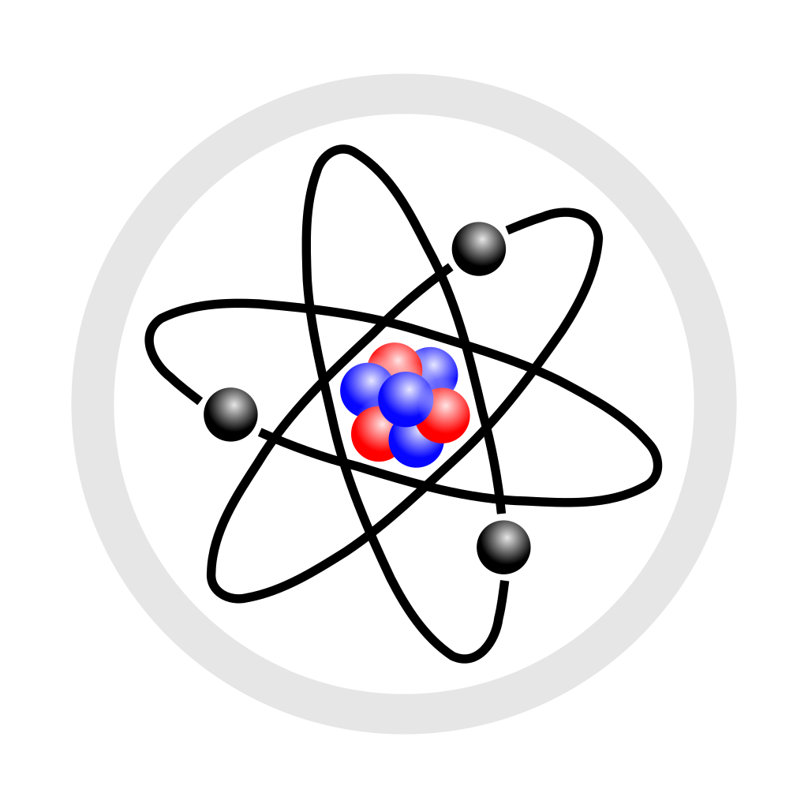
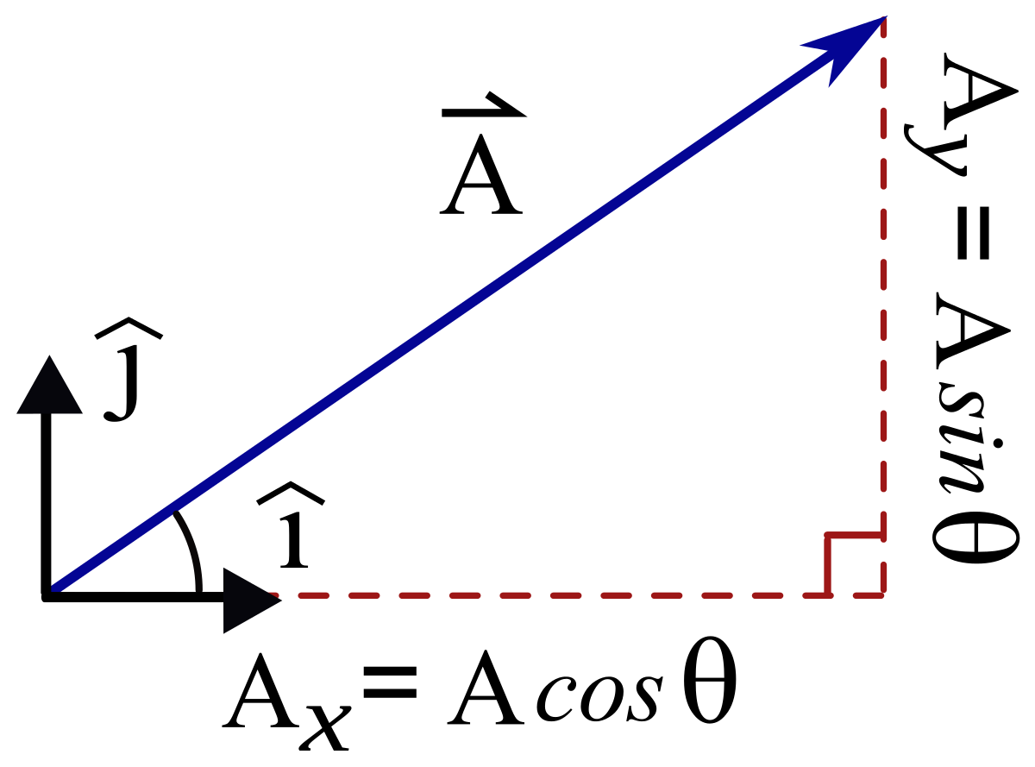
A-LEVEL PHYSICS LEARNING JOURNEY
EXAMS
Special relativity
Electron microscopes
EM waves
Milikan’s oil drop experiment
Carbon Dating
Exponential Decay
Nuclear fusion
Einstein’s mass-energy equation
Michelson-Morley experiment
Turning points
NUCLEAR PHYSICS
Wave- particle duality
Photoelectric effect
Half-life
Nuclear fission
Binding Energy
Nuclear decay
Newton & Huygen
Discovery of electrons
Charged Particles in a Magnetic Field
Damping
Resonance
Gravitational Fields
Kepler’s Laws
Coulomb’s Law
Electric Potential
Radio- activity
Nuclear Physics
Kinetic Theory of Gases
Transformers
THERMAL PHYSICS
FIELDS
Specific Latent Heat
Circular and SHM
Electric Fields
Gravitational Potential
Newton’s Law of Gravitation
Charged Particles in an E-Field
Magnetic Fields
EM Induction
Specific Heat Capacity
Thermal Physics
Analysing Circuits
Kirchhoff’s First Law
Combining Resistors
Resistivity
Resistance
Year 13
Momentum
ELECTRICITY
Electrical Energy
Potential Divider
IV Characteristics
Pd and EMF
Electrical Current
Using excel and spreadsheets to analyse data
Stationary waves
Conservation of Energy
Power
Hooke’s Law and Young’s Modulus
Superposition of waves
Density and Pressure
WAVES
FORCES & MATERIALS
Diffraction and polarisation
Total Internal Reflection
Young’s Double Slit Experimentt experiment
Kinematics and the motion of bodies
Newton’s Laws of Motion
Archimedes’ Principle
Deforming Materials
Waves
Scalars & Vectors
Induction tasks
Reflection and refraction
Quantum Physics
Quarks
The nucleus
Wave-Particle Duality
PARTICLES & RADIATION
Year 12
The Photon Model
The Photoelectric Effect
Anti-particles, hadrons and leptons
Alpha Particle Scattering
Particle Physics
Foundations of Physics

