Slide 1




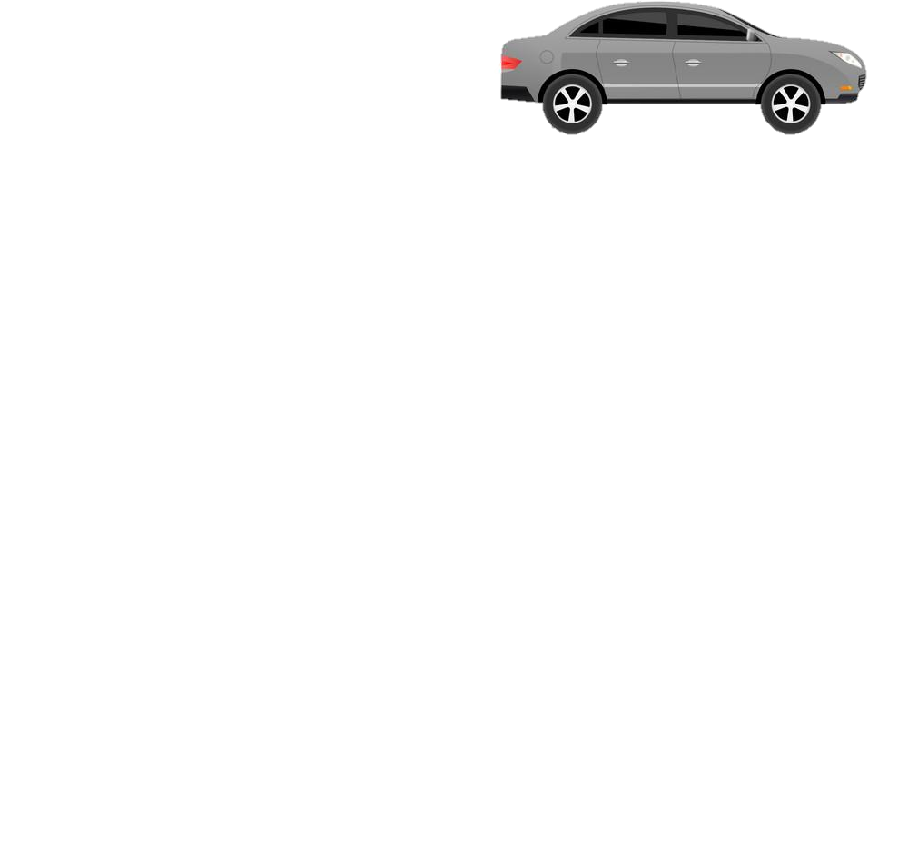
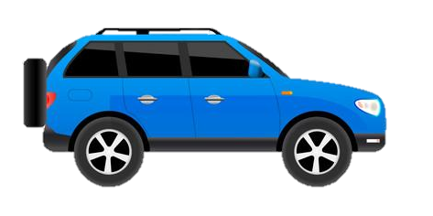
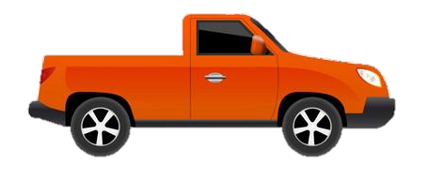

Curriculum Map
St Michael’s Catholic School – GCSE – Computer Science
PIN BANK
The red box:
These road work boxes can be used to highlight a particular task, or link parts of the journey to the national curriculum.
Just copy and paste when needed and drag to map position, editing position of pin if necessary. Type over this text.
Simply drag a pin to add it to your journey
Destination One: A level Computer Science/IT
Destination Two – Btec level 3 or any course related to Computer Science or ICT
End of topic test
Knowledge – Logic and languages
Logic diagrams and truth tables
Defensive Design
Errors and testing
Translators and facilities of languages
The Integrated Development Environment
The red box:
These road work boxes can be used to highlight a particular task, or link parts of the journey to the national curriculum.
Just copy and paste when needed and drag to map position, editing position of pin if necessary. Type over this text.
Term 4 and 5 - Revision for exams
Term 3 - Logic and languages
End of topic test
Knowledge – Programming
Programming fundamentals
Sequence and selection
Iteration
Arrays
Procedures and functions
Records and files
End of topic test
Knowledge-Computational thinking, algorithms and programming
Computational thinking
Searching and sorting algorithms
Developing algorithms using flowcharts
Developing algorithms using pseudocode
Interpret, correct or complete algorithms
Term 3 Continue with Programming
Computer Science
Term 1, and 2 –Continue with Algorithms and programming
Year 11
End of topic test
Term 5 and 6 – Paper I – Computer Systems – Network security and
systems software
Start Paper 2 –Algorithms and programming
Knowledge – Network security and systems software
Network threats
Identifying and preventing vulnerabilities
Operating systems
Utility software
End of topic test
Term 3 and 4 – Paper I – Computer Systems – Computer Networks, connections and protocols
Knowledge – Computer Networks, connections and protocols
The internet and wide area networks
Local area networks
Wireless networking
Client-server and peer-peer networks
Standards, protocols and layers
End of topic test
Term 1 &2– Paper I – Computer Systems – Systems Architecture, memory and storage
Knowledge – Systems architecture , memory and storage
Architecture of the CPU
CPU Performance
Memory
Secondary storage
Term 1 – Paper I – Computer Systems – Ethical,legal cultural,environmental impacts of digital technology
Knowledge – Ethical, legal, cultural and environmental impacts of digital technology
Computer systems in the modern world
Ethical, cultural and environmental issues
Legislation and privacy
End of topic test
CAR PARK
Why not
Year 10
Curriculum Intent - To develop computational, ethical and moral thinking and empower students to understand the ever-changing world. Provide them with the skills to create, develop, present and publish ideas and information, and make informed decisions about the impact of technology on everyday life, as active stewards of faith.

